Slide 1
reSolve Garden
(Y1)

Slide 2
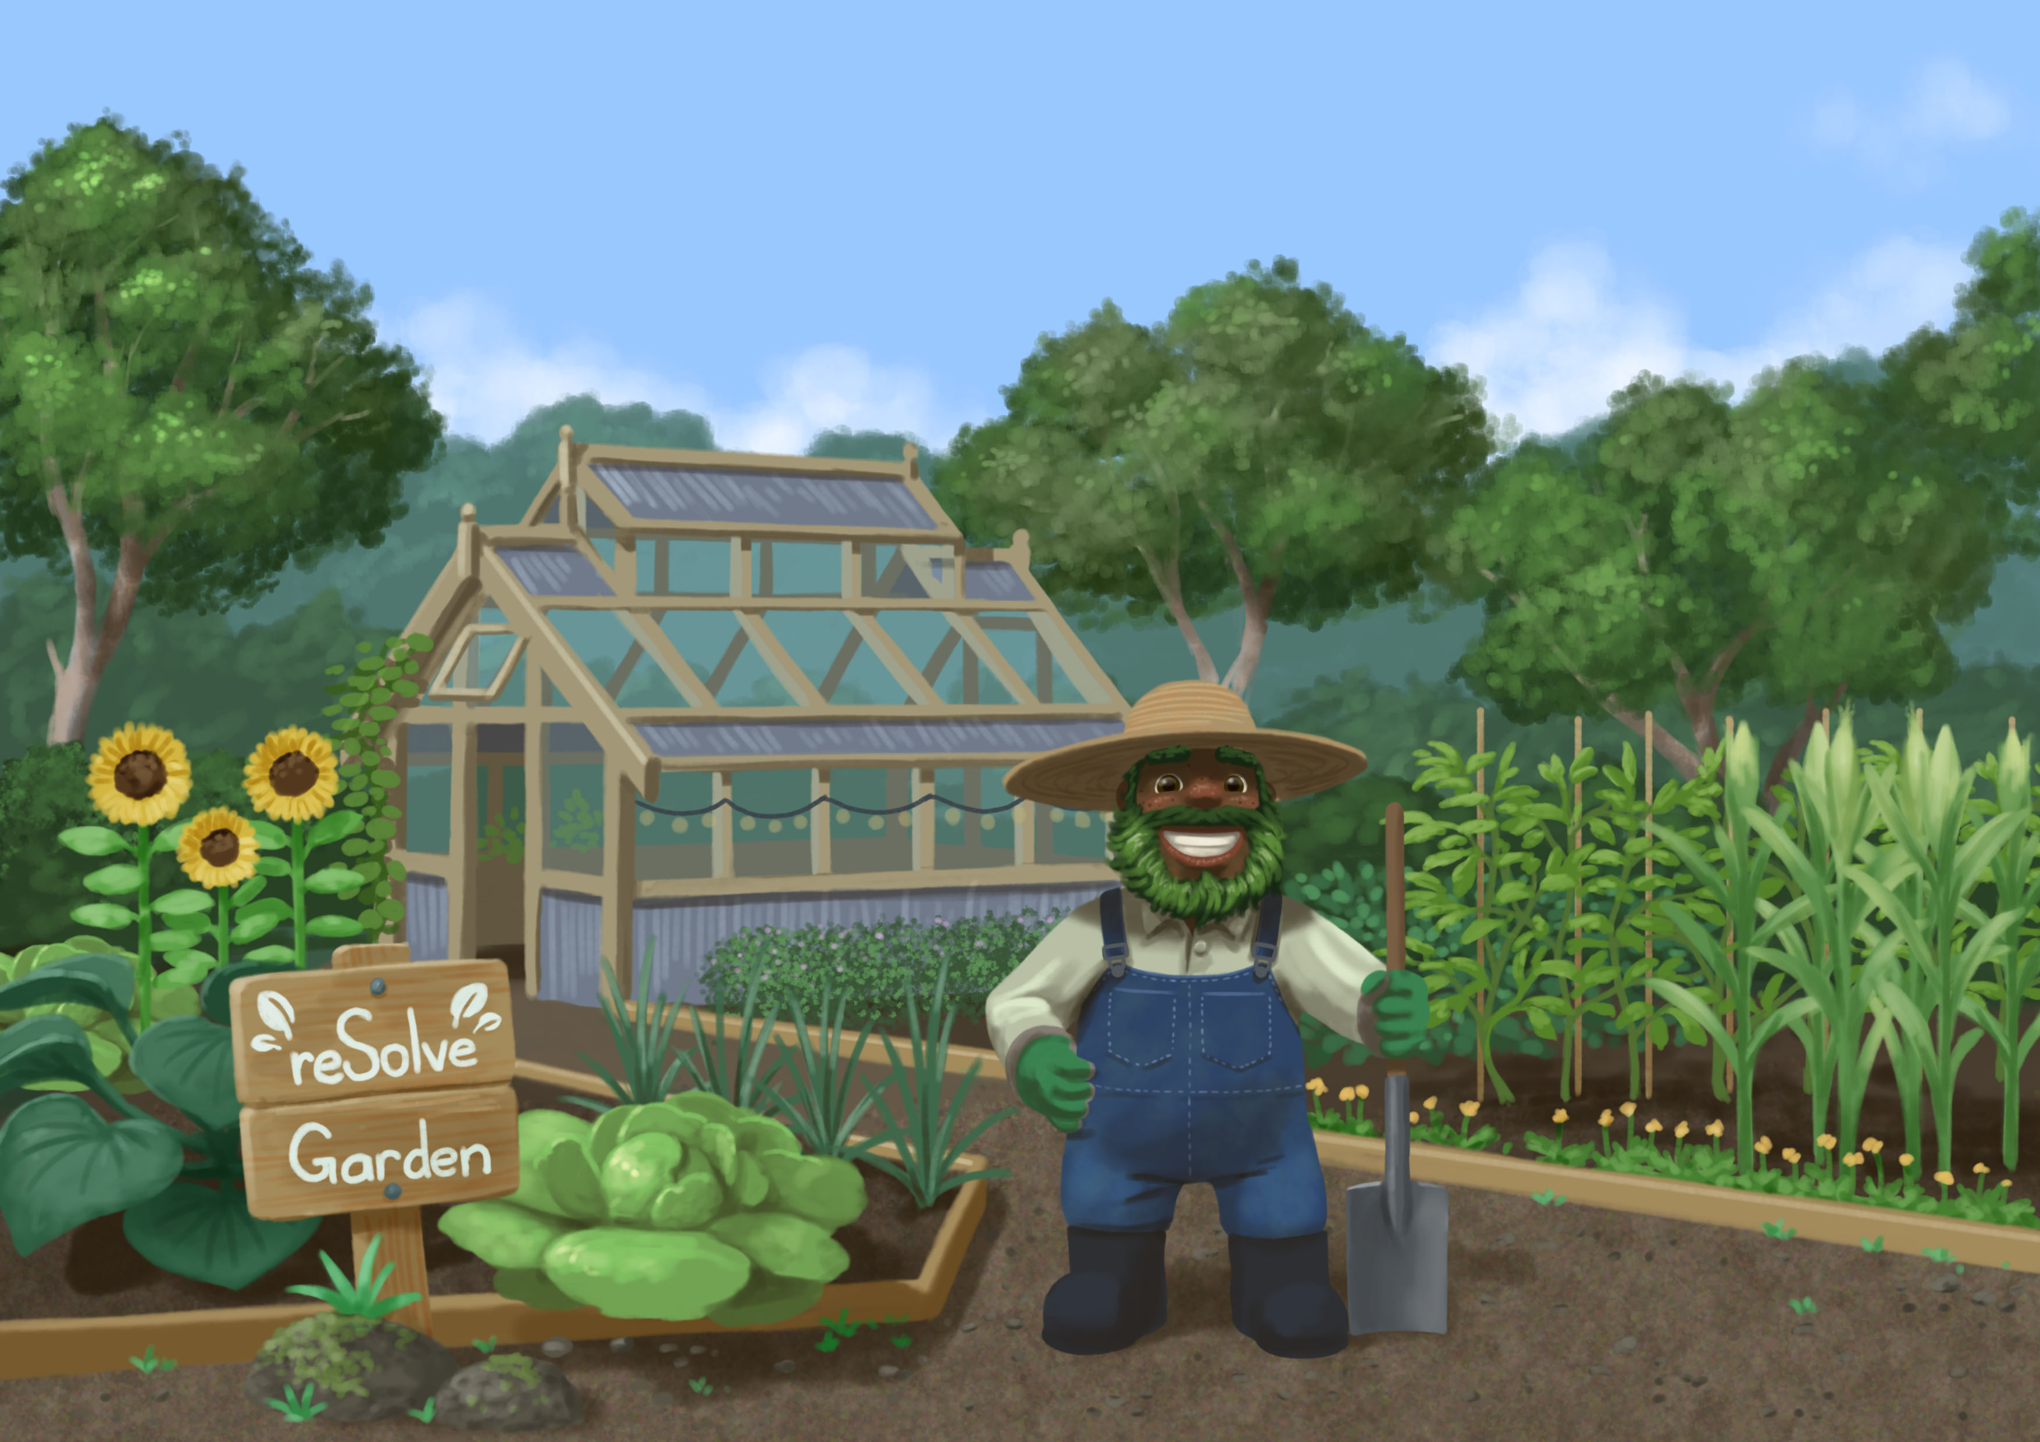

Slide 3
Task 1 • How many seeds?

Slide 5
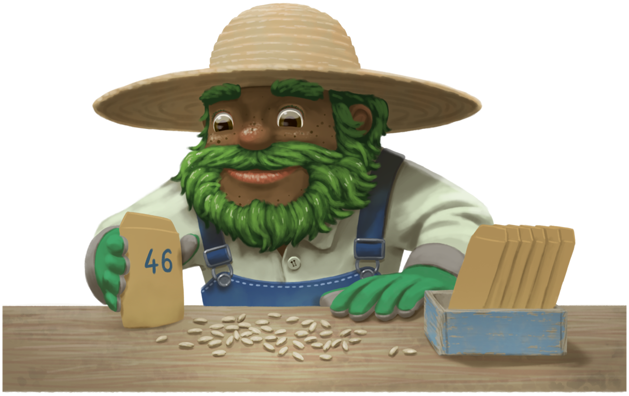

Slide 6
Task 2 • Making tens

Slide 8
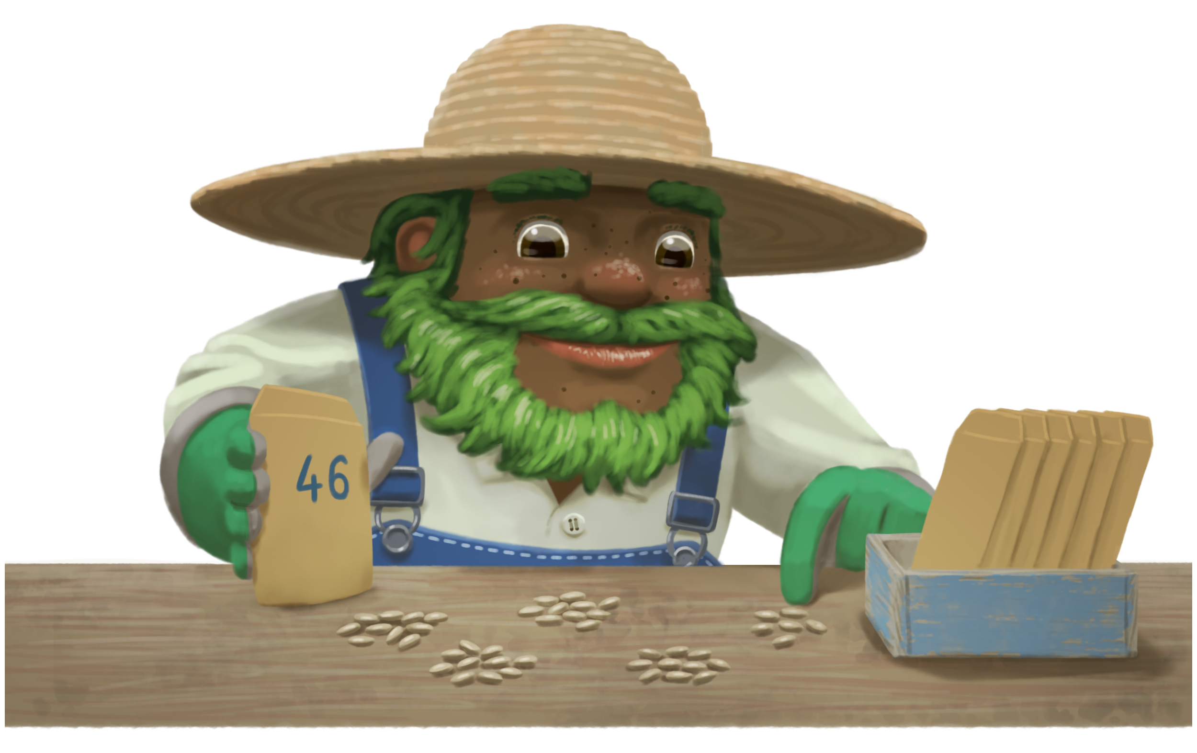

Slide 9
Task 3 • Planting seeds

Slide 11
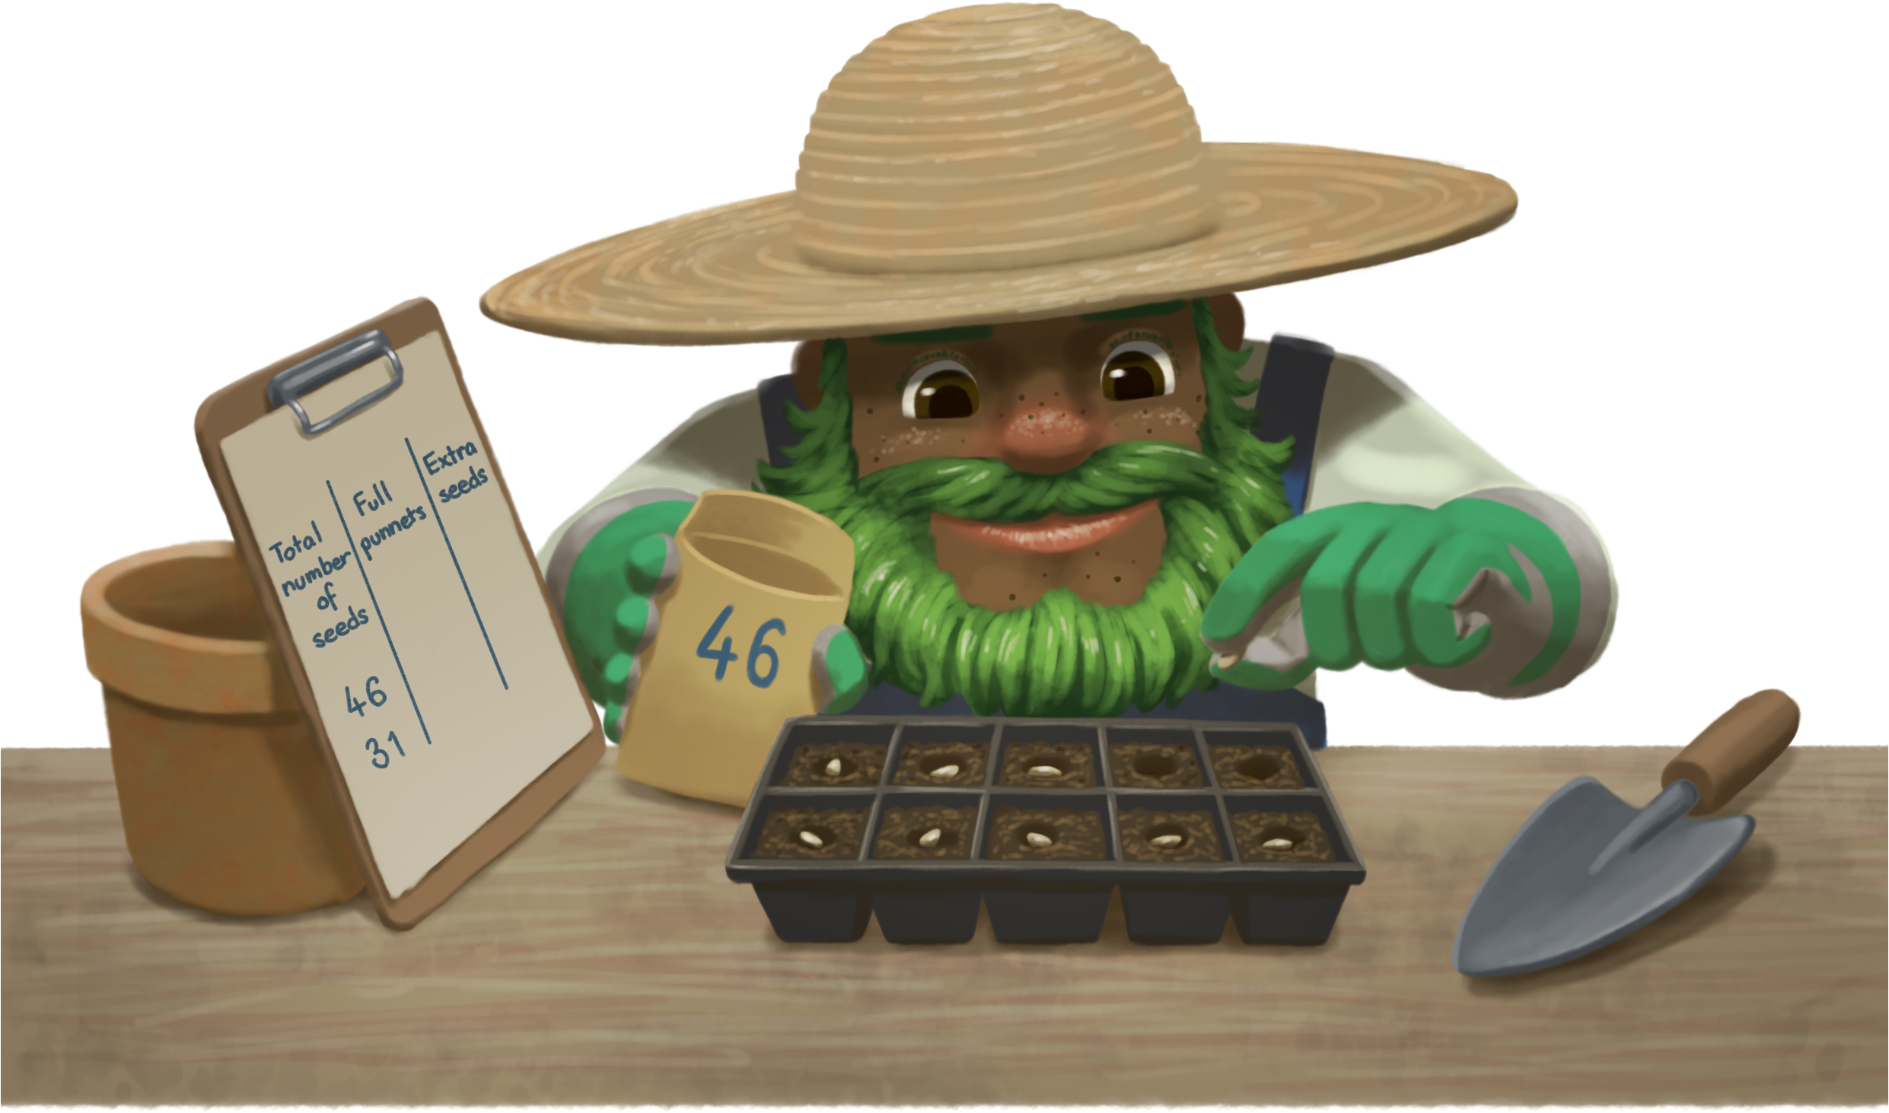

Slide 12
Mr Sprout’s Recording Chart
Total number of seeds | Full punnets | Extra seeds

Slide 13
Task 4 • Planting 50

Slide 14
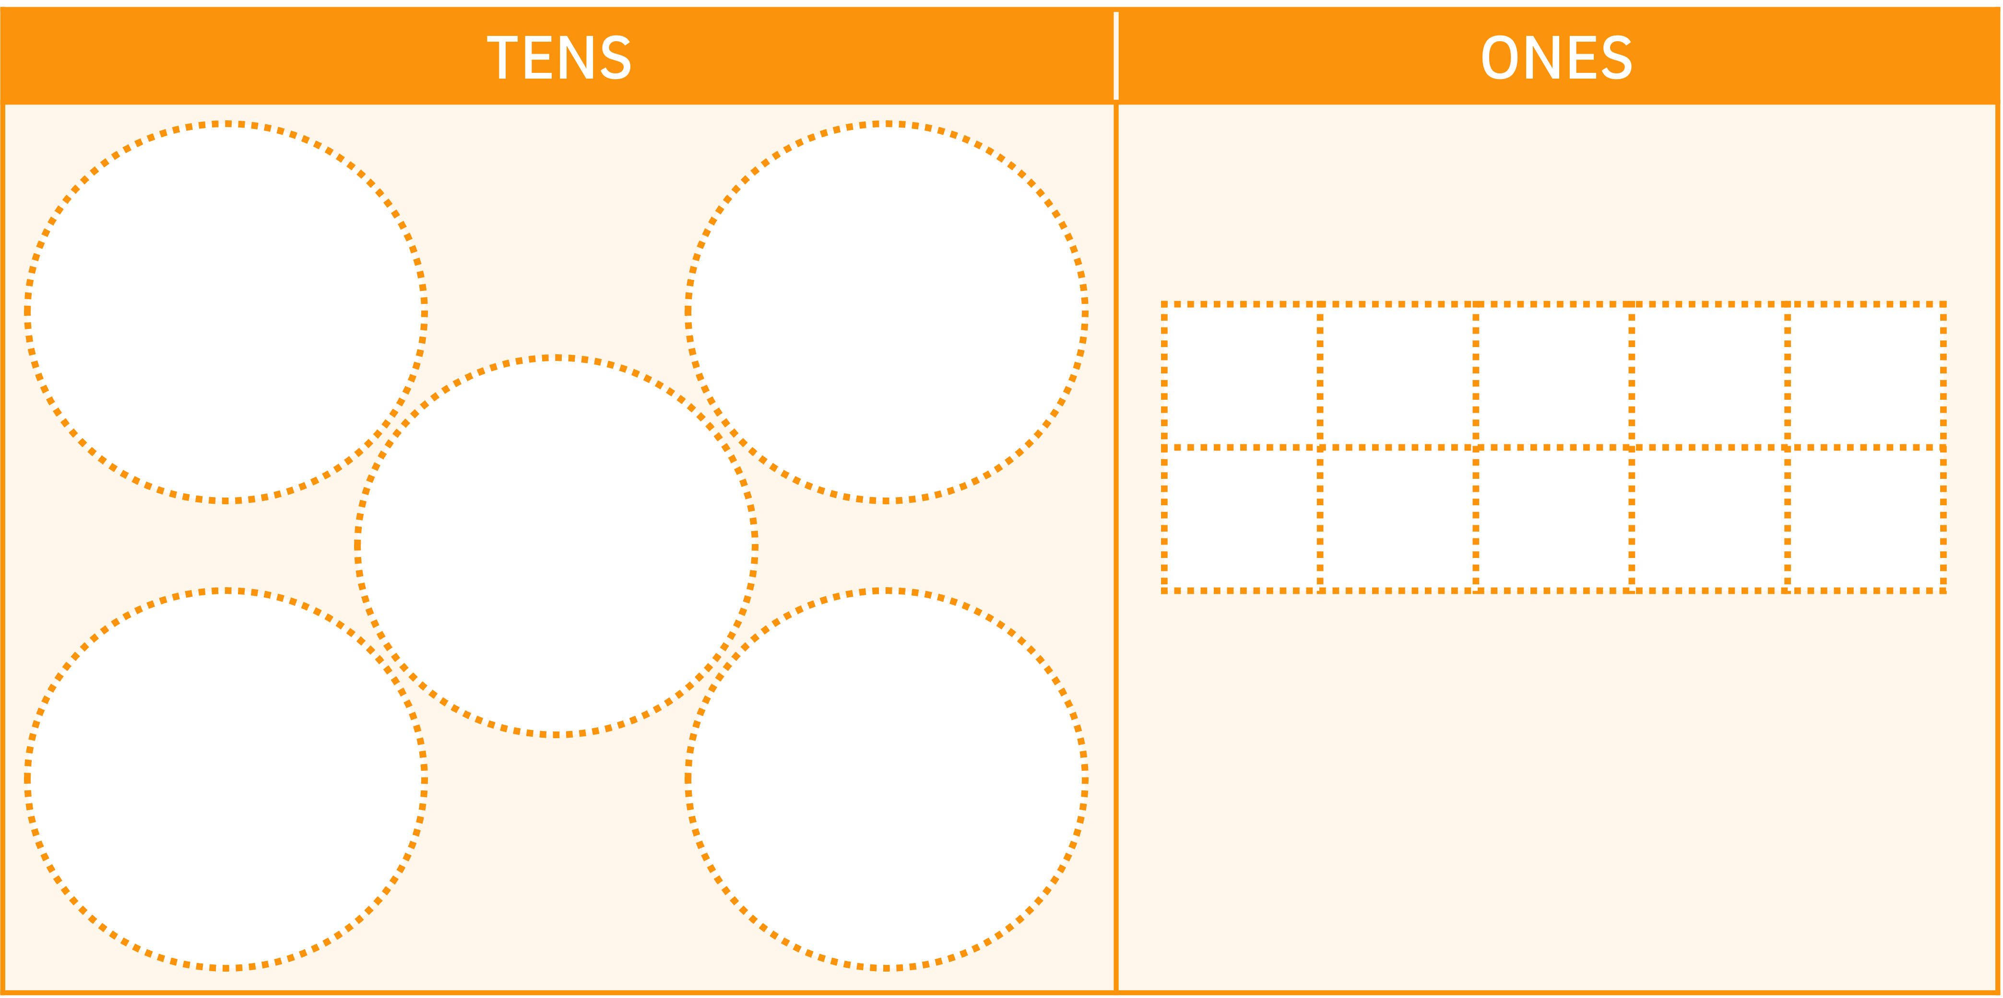
PLANTING 50
Play this game in pairs.
Take turns to roll the dice. Collect the number of seeds (counters) shown on the dice and place in the punnet (ten-frame) under the heading "Ones" on your gameboard.
When a punnet is filled, group the 10 seeds together and put them in a circle under the heading "Tens" on your gameboard.
The first player to collect 50 seeds is the winner.

Slide 15
Task 5 • Planting more seeds

Slide 18
Mei’s strategy
26
Mei drew all her seeds. She crossed out each seed after she had put it in a punnet.

Slide 19
Nasim’s strategy
2 6
Nasim wrote that he would have two full punnets and six left over seeds.
resolve.edu.au
(19)

Slide 20
Lola’s strategy
26
Lola knew she would have 2 full punnets and 6 extra seeds. She drew a picture showing the all the seeds in the punnets.

