Slide 1
Algebra: Balancing act
(Y2)

Slide 2
Task 1 • Balancing numbers
resolve.edu.au
(2)

Slide 3
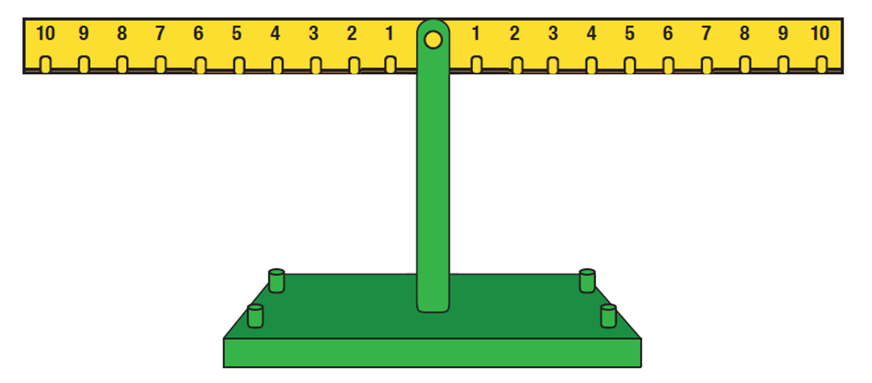
Virtual maths balance
Notes:
Click on heading or image to access website link to the maths balance

Slide 4


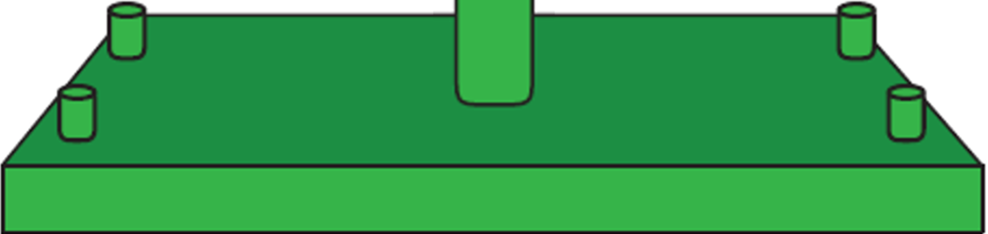
Balancing numbers
5 + 4
=
3 + 6
?
5 + 4
3 + 6
(5 + 1) + (4 - 1)
6 + 3
3 + 6
Notes:
Discuss- If the 5 is moved to the 6, where should the 4 move to keep it balanced?
Click 1- reveals 5+4
Click 2 – reveals 3+6
Click 3 & 4- reveals 5+4 and 3+6 under balance scales
Click 5- reveals arrow from 5 to 6
Click 6- reveals ? on weight on 4
Click 7-reveals arrow from 4 to 3
Click 8 & 9- reveals equation on left Teacher note: the teacher can model the brackets by cupping their hands as if holding the 5+1 as they refer to it, and the same for 4-1. This echoes the brackets in the written equation.
Click 10- reveals 3+6

Slide 5
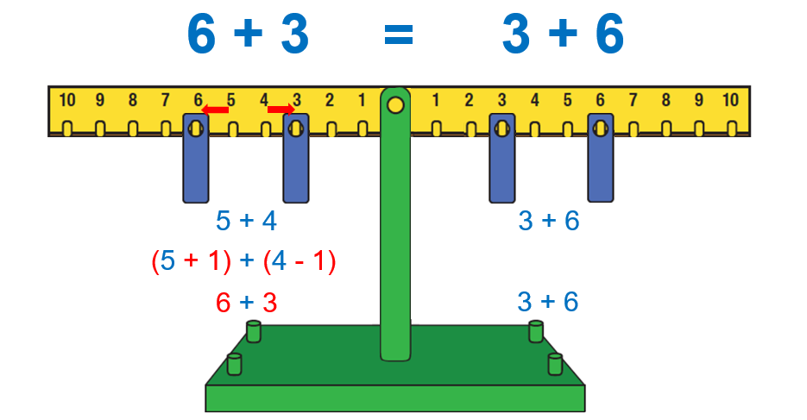
Balancing numbers
Notes:
Discuss- If the 5 is moved to the 6, where should the 4 move to keep it balanced?
Click 1- reveals 5+4
Click 2 – reveals 3+6
Click 3 & 4- reveals 5+4 and 3+6 under balance scales
Click 5- reveals arrow from 5 to 6
Click 6- reveals ? on weight on 4
Click 7-reveals arrow from 4 to 3
Click 8 & 9- reveals equation on left Teacher note: the teacher can model the brackets by cupping their hands as if holding the 5+1 as they refer to it, and the same for 4-1. This echoes the brackets in the written equation.
Click 10- reveals 3+6

Slide 6
Keeping it balanced
6 + 3
=
3 + 6
?
6 + 3
3 + 6
(3 - 2) + (6 + 2)
6 + 3
1 + 8
Notes:
Discuss- If the 3 is moved to the 1, where should the 6 move to keep it balanced?
Click 1 & 2- reveals 6+3 and 3+6 under balance scales
Click 3- reveals arrow from 3 to 1
Click 4 -reveals ? on weight on 6
Click 5- reveals arrow from 6 to 8
Click 6 & 7- reveals equation on right Teacher note: the teacher can model the brackets by cupping their hands as if holding the 3-2 as they refer to it, and the same for 6+2. This echoes the brackets in the written equation.
Click 8- reveals 6+3

Slide 7
Equivalence
6 + 3
=
1 + 8
6 + 3
3 + 6
(3 - 2) + (6 + 2)
6 + 3
1 + 8
Notes:
Shows arrows moved by decreasing and increasing numbers by same amount on one side to maintain equivalence.

Slide 8
Task 2 • Card balance
resolve.edu.au
(8)

Slide 9
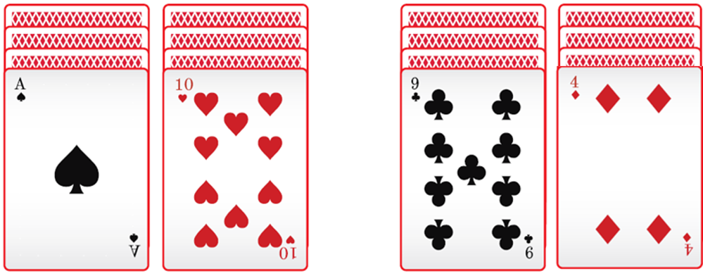
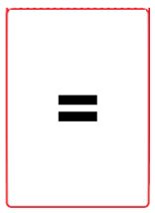
What you need for Card Balance
Each group needs:
2-3 players
1 deck of cards
Each player is given:
four piles of four cards, placed face down, in two sets of two.
an equals sign card to place in the middle of the cards when the two sets balance
resolve.edu.au
(9)

Slide 10


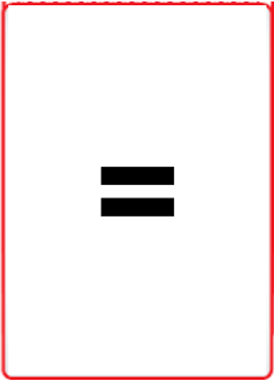
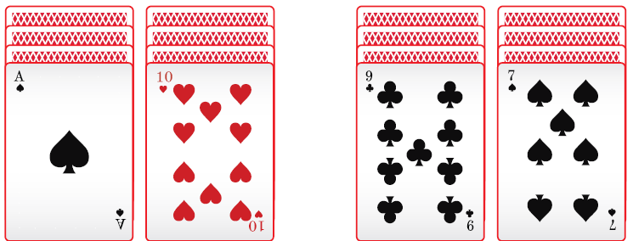
The aim of the game
Al
May
resolve.edu.au
(10)
Notes:
The aim of the game is to balance the sets of numbers.
If using picture cards, a King, Queen or Jack = 0
10

Slide 11
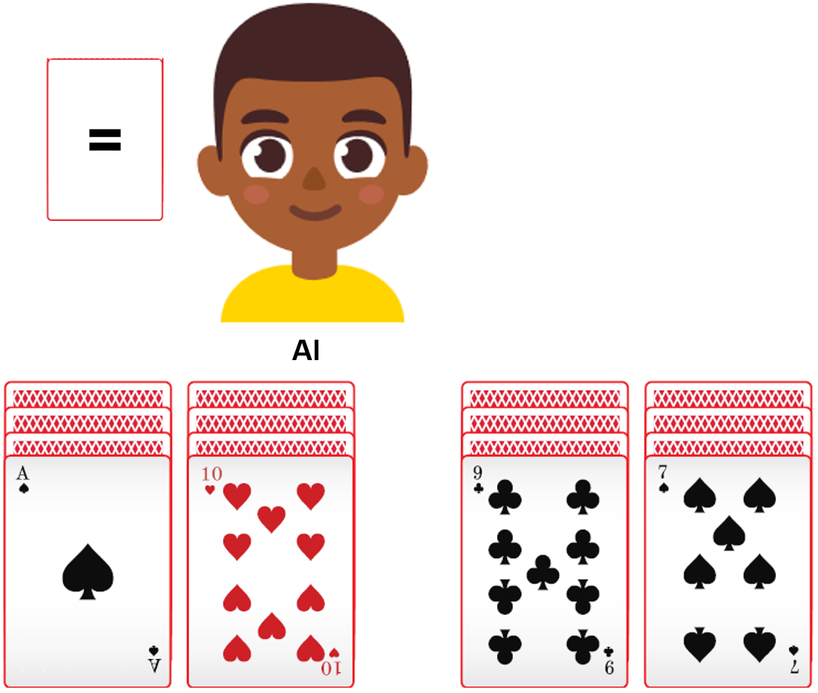
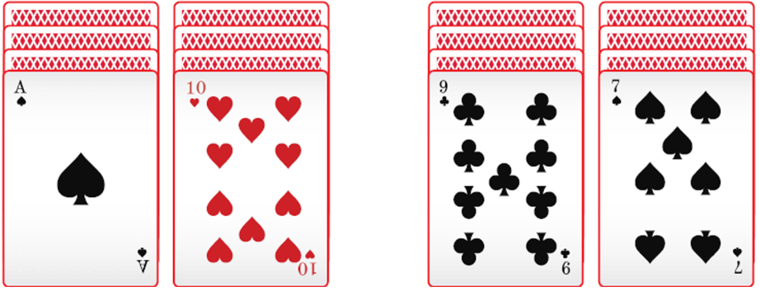
Let’s watch Al play
Notes:
It is Al’s turn to make a move.
Which card do you think he might choose to discard to try to balance his cards?

Slide 12
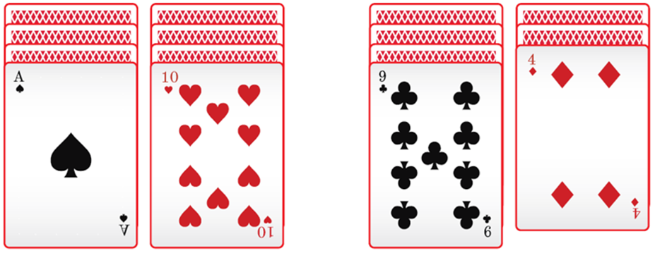
Discard and flip, or balanced?
Notes:
Al discards the 7 and flips over a 4 underneath.
He puts the 7 card to one side, and it is out of play.
His cards do not balance as 1 + 10 do not equal 9 + 4
On his next go he will try to balance the value of the cards on both sides.
He could stop now with a score of 2 points, which is the difference between 11 and 13, the total of each pair of cards.

Slide 13
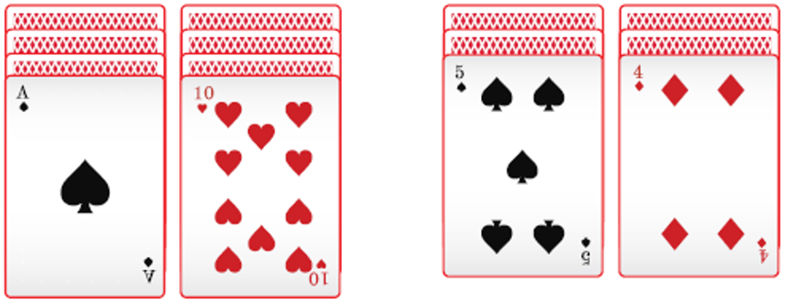
Discard and flip, or balanced?
Notes:
Which card do you think he might choose to discard to try to balance his cards?
On his next go, Al decides to carry on playing and he discards the 9 card and flips over a 5.
He puts the 9 card to one side, and it is out of play.
His cards do not balance as 1 + 10 do not equal 5 + 4
Al could try to balance the value of the cards on both sides or stop with a score of 2 points, which is the difference between 11 and 9, the total of each pair of cards.

Slide 14
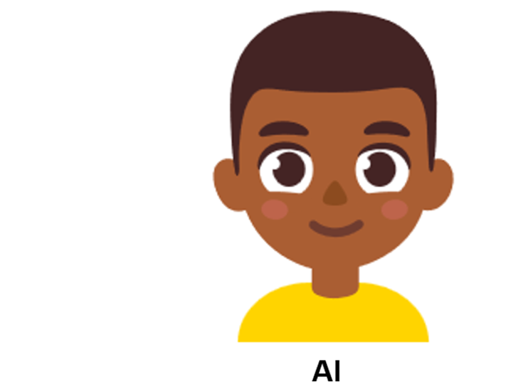

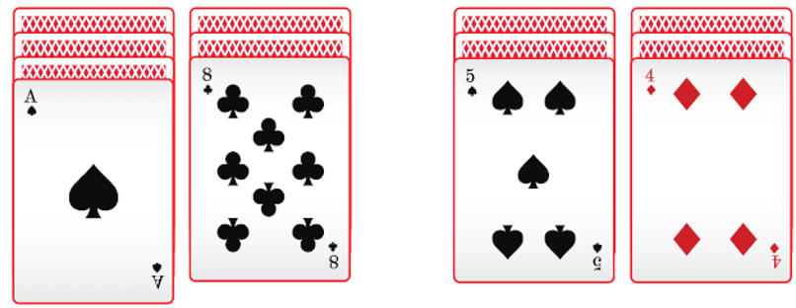
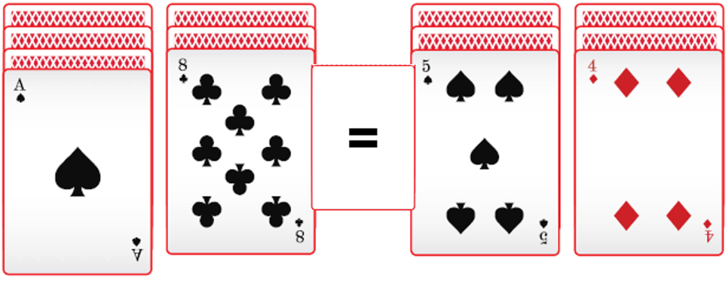
Discard and flip, or balanced?
Notes:
Al chooses to continue and discards the 10 and flips over an 8.
This time his cards balance with- 1 + 8 = 5 + 4

Slide 15
Balanced cards
Notes:
Al shows that his cards balance by putting down his equals sign card.
He wins this game because his cards balance.
His score is 0, because the difference between 9 and 9 is 0.
The players can deal out new cards to play again.
The player with the lowest score over three games is the winner.

Slide 16
How to play Card Balance
All players flip over the top card on their four card piles.
Players take turns to discard one of their top cards and flip over the card underneath. Each discarded card is out of play.
If their number cards balance, they put the equals sign in between their cards and their score is zero.
  The number cards = the number value
  An ace = 1
  A picture card (King, Queen or Jack) = 0
The game ends when all players have balanced their cards or have no more cards left to flip over.
At the end of the game, a player’s score is the difference between their two pairs of cards.
The lowest score over three games wins.
As you model the game in the slides, invite students to work out the totals of the cards on each slide, to see if they are equivalent and balance.
resolve.edu.au
(16)

Slide 17
Task 3 • Balancing blocks
resolve.edu.au
(17)

Slide 18

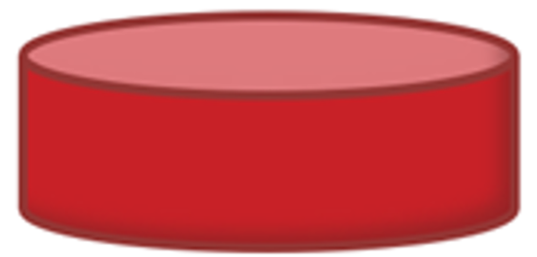


Some blocks
resolve.edu.au
(18)

Slide 19

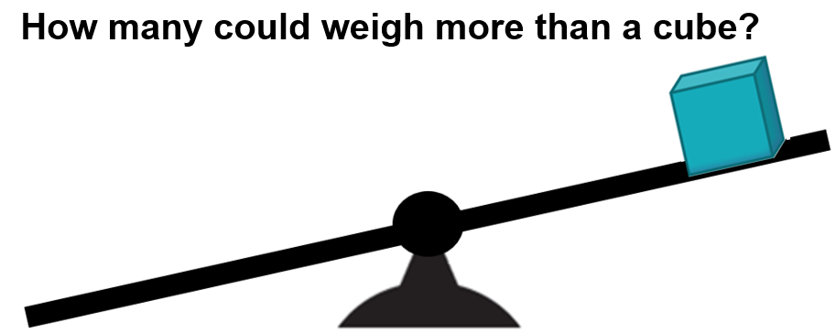
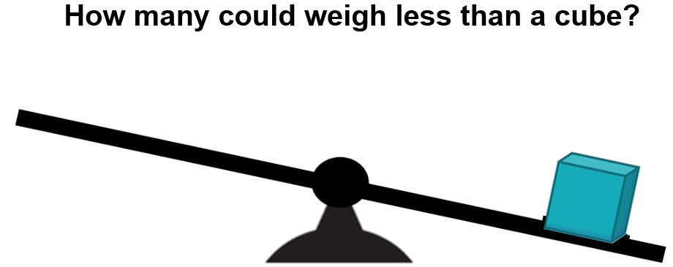
How many green balls won’t balance?
Two green balls weigh the same as a cube.

Slide 20
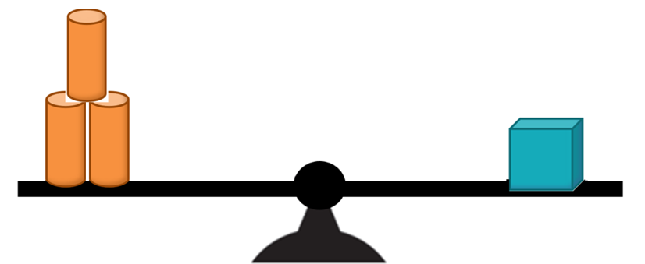

How many orange cylinders won’t balance?
Three orange cylinders weigh the same as a cube.

Slide 21

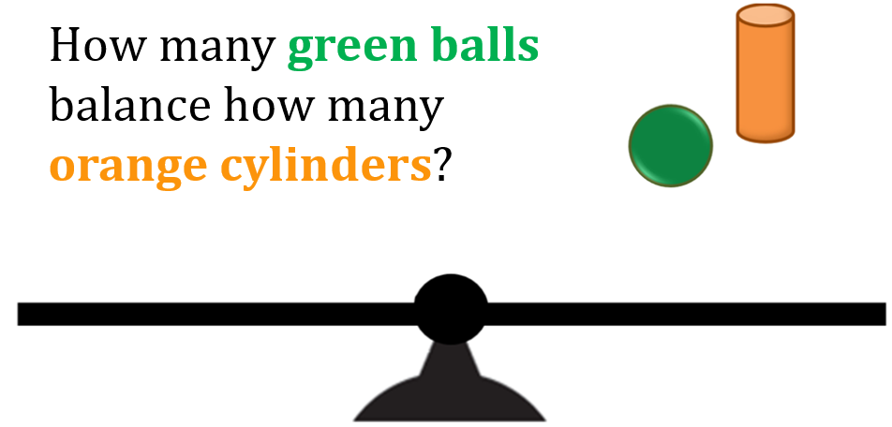
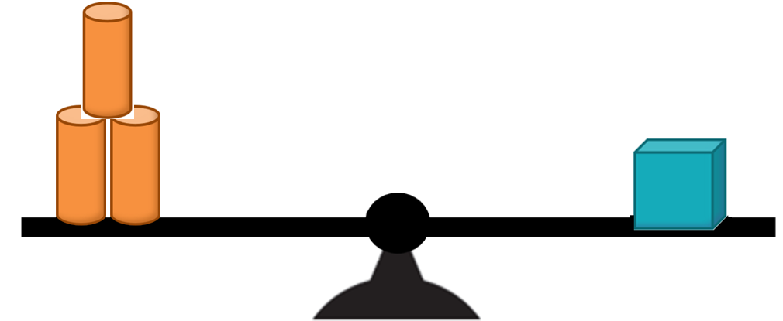
Balance the blocks

Slide 22


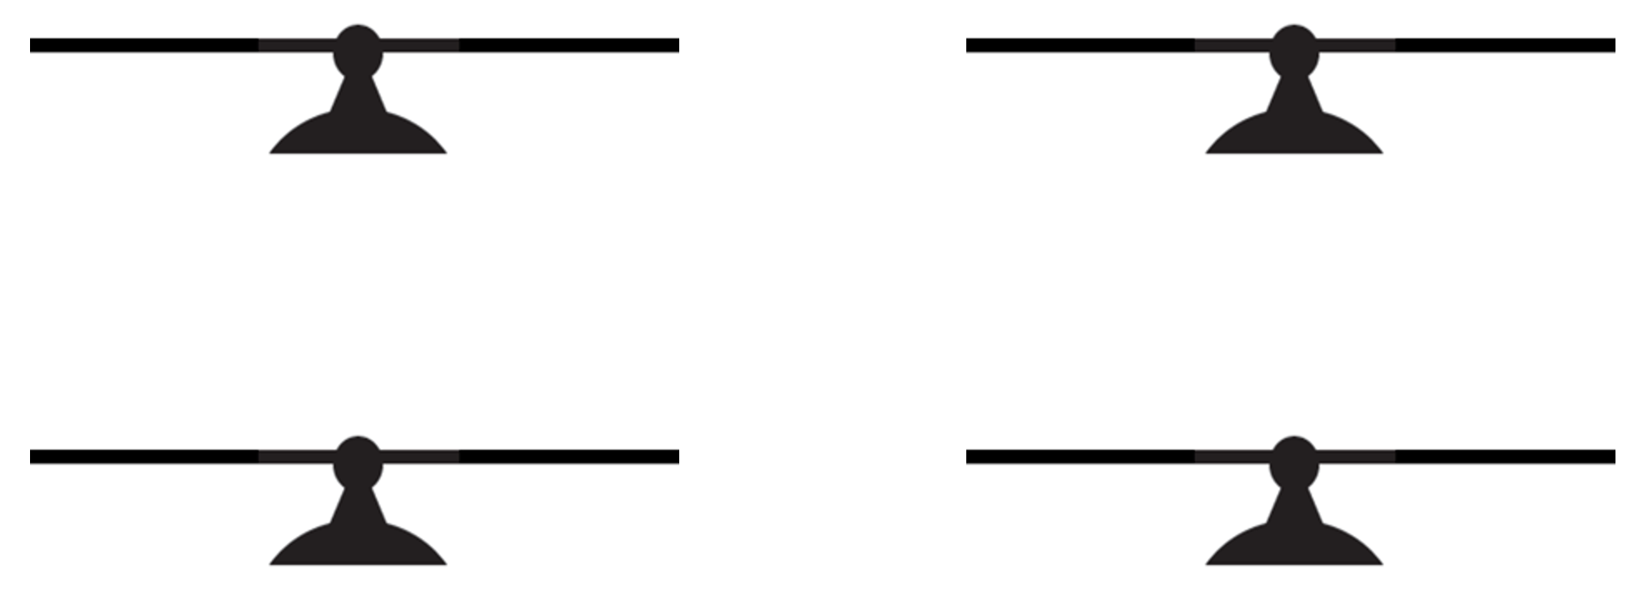


Blocks that balance

Slide 23
Task 4 • Finding equivalence
resolve.edu.au
(23)

Slide 24
Virtual maths balance

