Slide 1
Multiplication: Building bots
(Y3)

Slide 2
Task 1 • Making robots

Slide 3


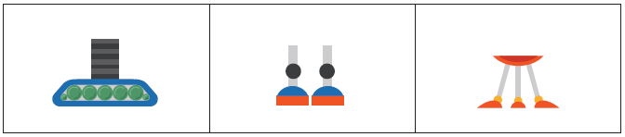
Building robots

Slide 4
Task 2 • Robot combinations

Slide 5
Robot Go Fish!
Shuffle the cards and deal 7 cards to each player. Place remaining cards in a pile in the centre.
Take turns to build a new robot or go fish:
Build a new robot
To build a new robot you must have a head, body and legs. The robot must be different to any others already built. Place the completed robot in front of you, then take 3 new cards from the pile.
Go fish
Pick another player and ask if they have a head, body or legs card. If they do, they must hand it over. If they don’t have the correct parts card, they say “Go fish!” and you take one new card from the pile.
The game ends when there are no more cards left or when no more unique robots can be made.
The winner is the player who makes the most unique robots.
After each game, use the robot part pictures and your templates to create copies of each unique robot you’ve built.

Slide 6


How did Leah’s group sort their robots?
Leah

Slide 7


How did Ray’s group sort their robots?
Ray

Slide 8
Making the problem simpler
Ray
How can focusing on one group make the problem simpler?
Which robots are missing?

Slide 9
Task 3 • Robot production line

Slide 10
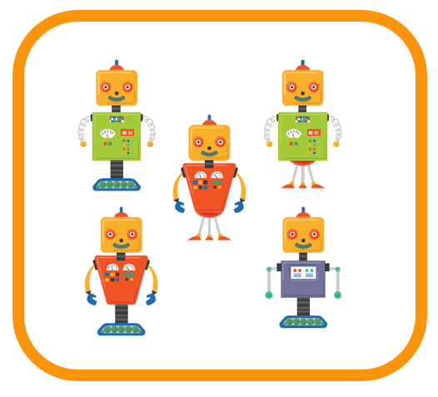
Focusing on one group to simplify the problem
How could these robots be organised to make it easier to see the missing ones?

Slide 11



Using arrays
Focus on one robot body part and use the array to reveal missing combinations.

Slide 12


Slide 13
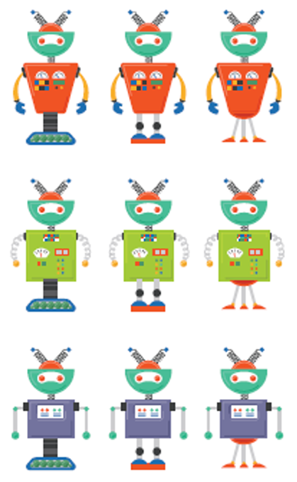

Slide 14
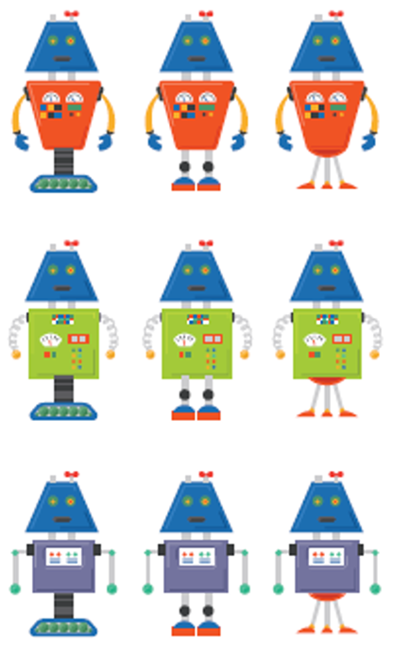

Slide 15
(3 x 3)
+ (3 x 3)
+ (3 x 3)
3 groups of 3 x 3 = 27

Slide 16
Task 4 • More robot combinations

Slide 17
(3 x 3)
+ (3 x 3)
+ (3 x 3)
3 groups of 3 x 3 = 27

Slide 18
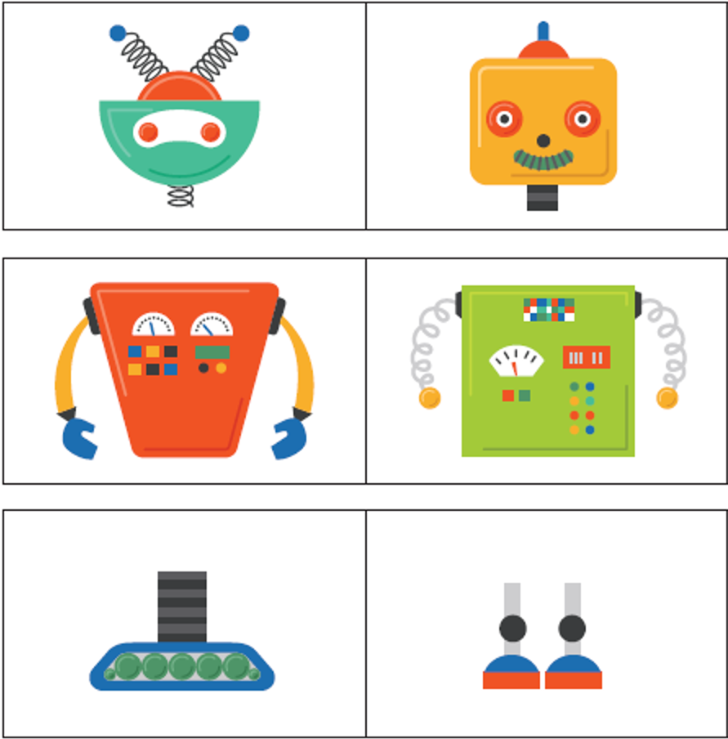
How many combinations?
How many unique robot combinations could you make using 2 heads, 2 bodies and 2 types of legs?
What maths could you use?
How do you know when you have found every unique robot combination?

Slide 19
Building robots
Build robots using one of these combinations:
2 heads, 3 bodies and 2 types of legs
2 heads, 2 bodies and 3 types of legs
3 heads, 1 body and 2 types of legs
1 head, 2 bodies and 3 types of legs
Organise your robots to make it easy to see any missing robot combinations.

