Slide 1
Counting your odds and evens
(Y4)

Slide 2
Lesson 1 • Number maze

Slide 3
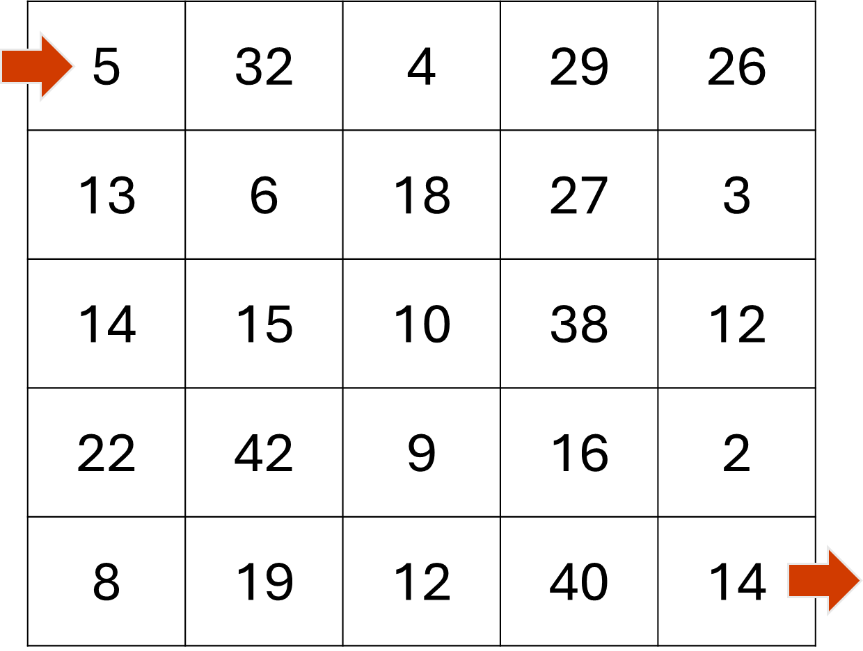
Number maze

Slide 4
Odd and even
What makes a number even?
What makes a number odd?

Slide 5
Number maze
You need to move from 5 at the start through to 14 at the end.
You can only move to the right and down.
Add together the numbers of each square you pass through.
The aim is to finish with an odd total.

Slide 6
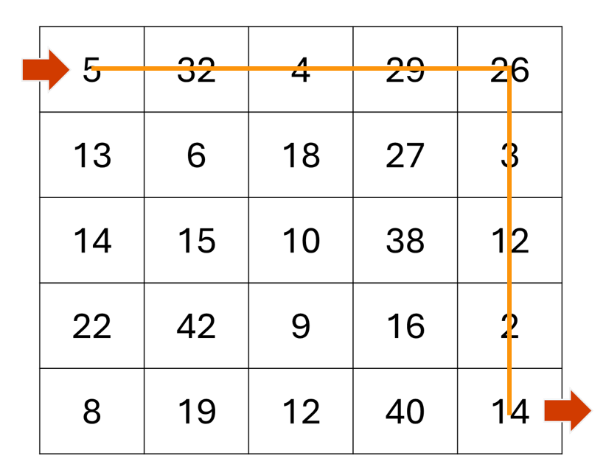
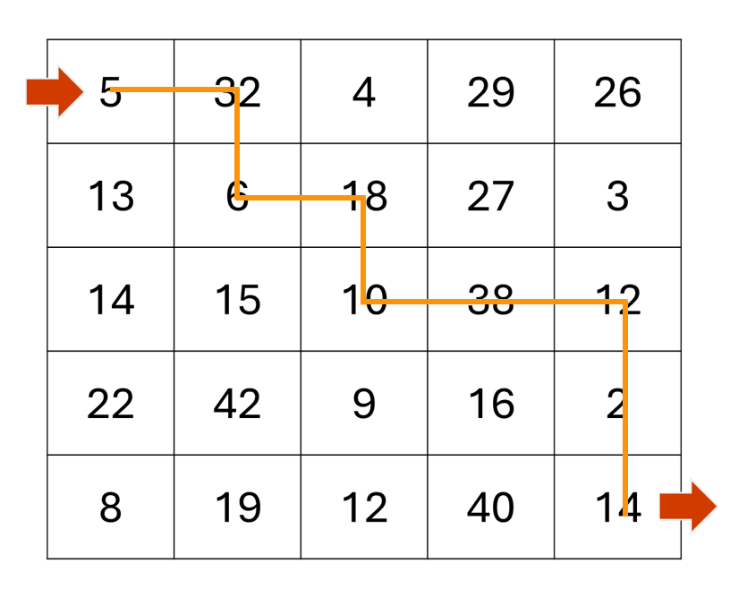
Number maze

Slide 7
Lesson 2 • Designing your own maze

Slide 8
Changing up the maze
3 | 20 | 4
8 | 10 | 12
2 | 6 | 18
2 | 7 | 4
6 | 8 | 10
12 | 5 | 14

Slide 9
Large and small number mazes
5 | 32 | 4
13 | 6 | 18
5 | 32 | 4 | 29
13 | 6 | 18 | 27
14 | 15 | 10 | 38
22 | 42 | 9 | 16

Slide 10
Lesson 3 • Explaining the pattern

Slide 11
Mystery maze
12 | 7 | 6
 |  | 9
?
?

Slide 12
Convince me
We disagree because…
We think you’ve missed…
We’re still not sure because…
That works for this example, but what about…?
How did you work that out?
We think there’s another way to look at this…
We agree with… but not with…
What if we changed … to a different number?
12 | 7 | 6
 |  | 9
?
?

Slide 13
When will a path be odd or even?
A path will always give an even total if …
A path will always give an odd total if …

