Slide 1
Cracking codes
(Y7)

Slide 2
Mathematical modelling

Slide 3
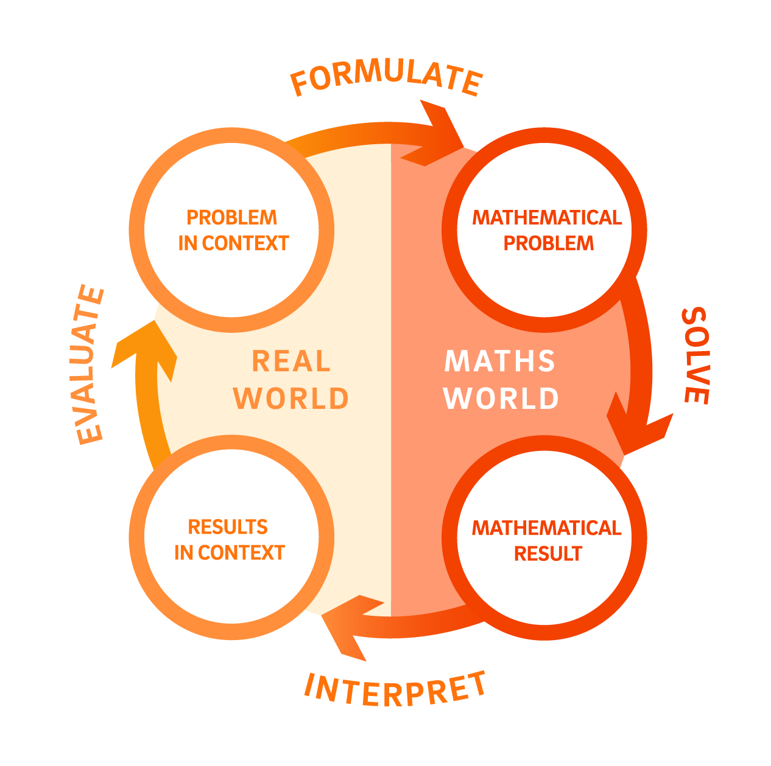

Slide 4
Frequency analysis

Slide 5
Frequency analysis 1
Analysis of newspapers and novels, with a total sample of 100 362 alphabetic characters.
Beker, H. & Piper, F. (1982). Cipher Systems: The protection of communication. Northwood.

Slide 6
Frequency analysis 2
Analysis of Google Books database, with a total sample of 3 563 505 777 820 alphabetic characters.
Letter | Relative Frequency (%)
A | 8.04
B | 1.48
C | 3.34
D | 3.82
E | 12.49
F | 2.4
G | 1.87
H | 5.05
I | 7.57
J | 0.16
K | 0.54
L | 4.07
M | 2.51
N | 7.23
O | 7.64
P | 2.14
Q | 0.12
R | 6.28
S | 6.51
T | 9.28
U | 2.73
V | 1.05
W | 1.68
X | 0.23
Y | 1.66
Z | 0.09
Norvig, P. (2012). English Letter Frequency Counts: Mayzner Revisited or ETAOIN SRHLDCU- https://norvig.com/mayzner.html

Slide 7
Comparing the two frequency analyses

Slide 8
Mathematical modelling

