Slide 1
Euler’s dice
(Y7)

Slide 2
Lesson 1

Slide 3
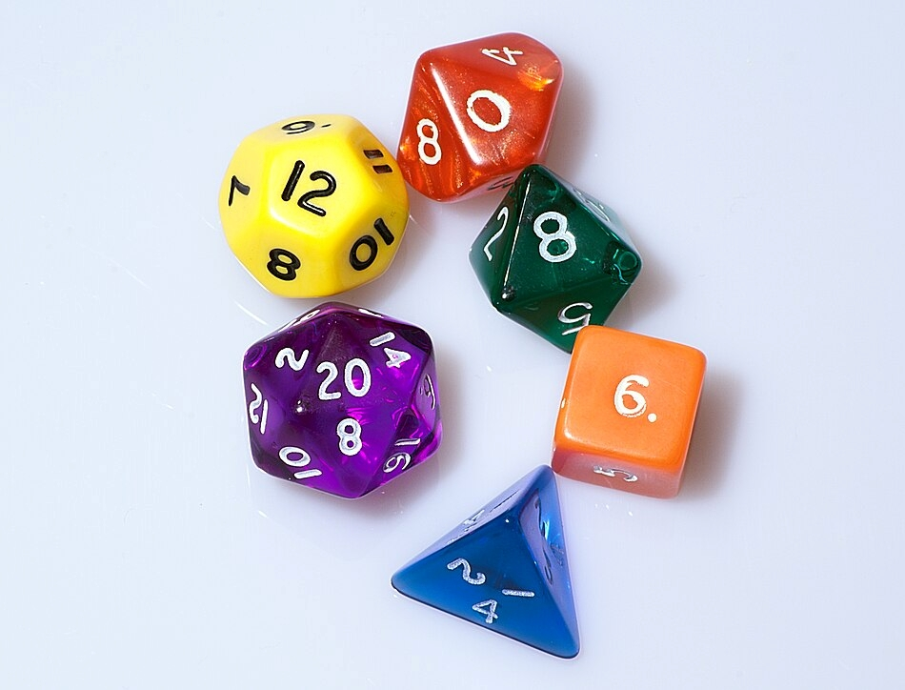
Can you make a die with any number of faces?

Slide 4
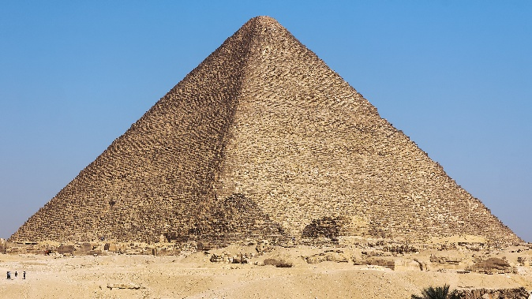
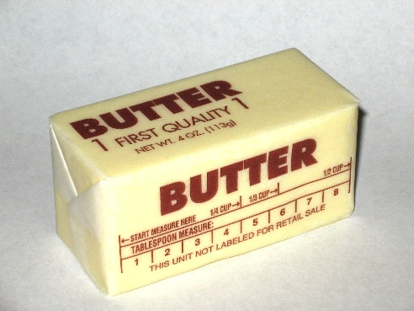
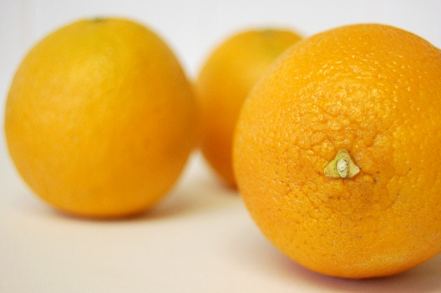
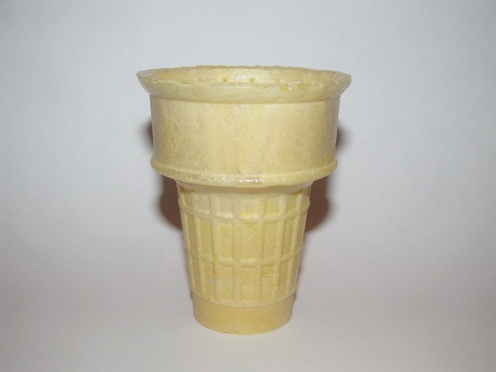
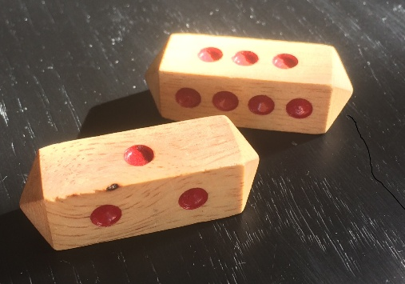
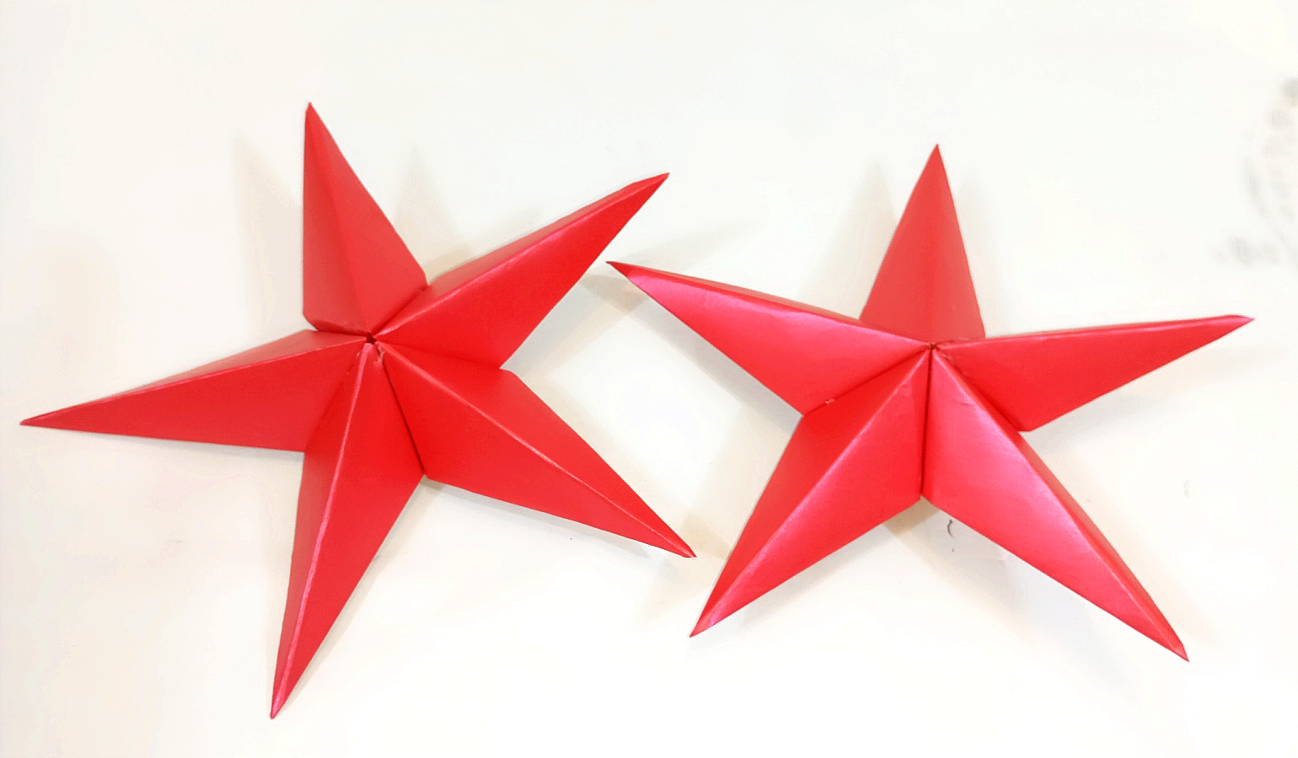
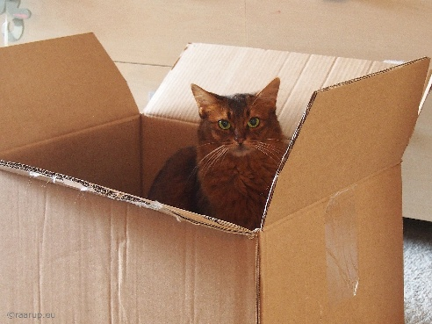
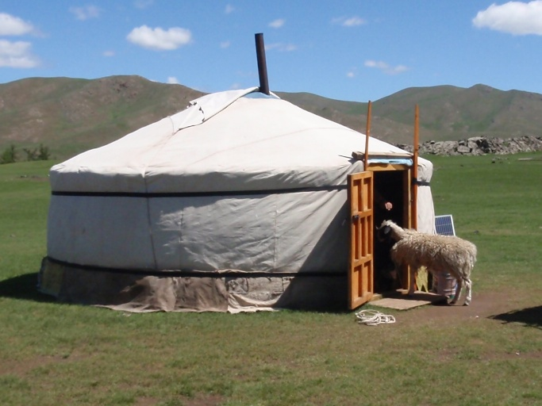
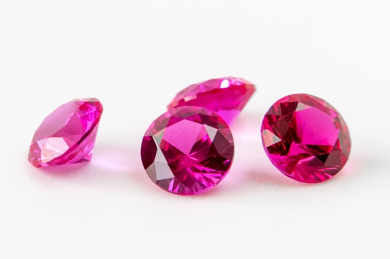
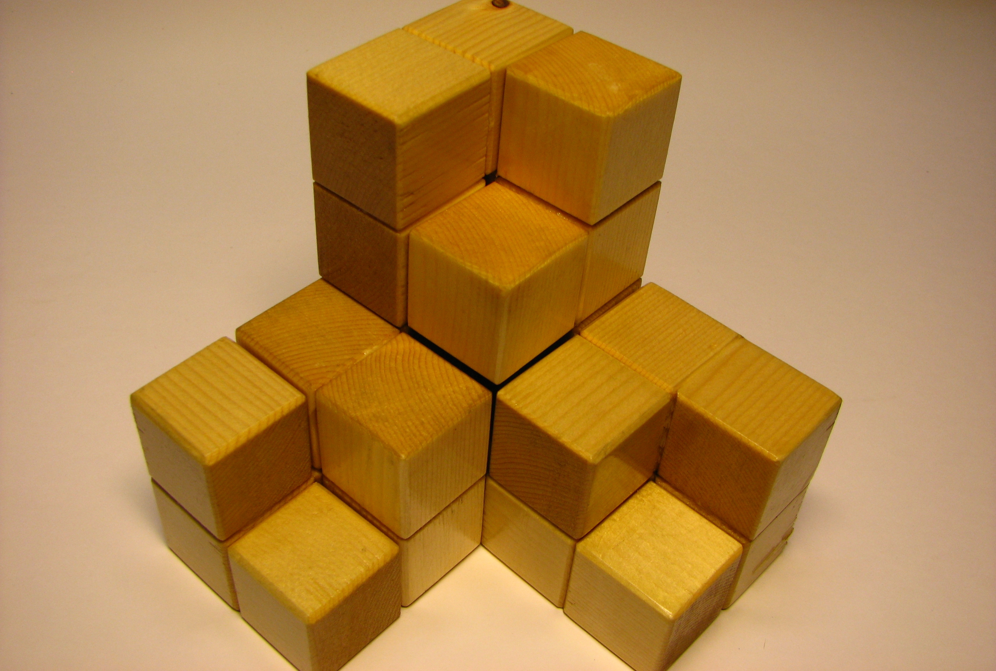


Build a definition
Polyhedra
Non-polyhedra
Notes:
https://commons.wikimedia.org/wiki/File:Children_playing_in_the_rice_mill_(edited).jpg

Slide 5
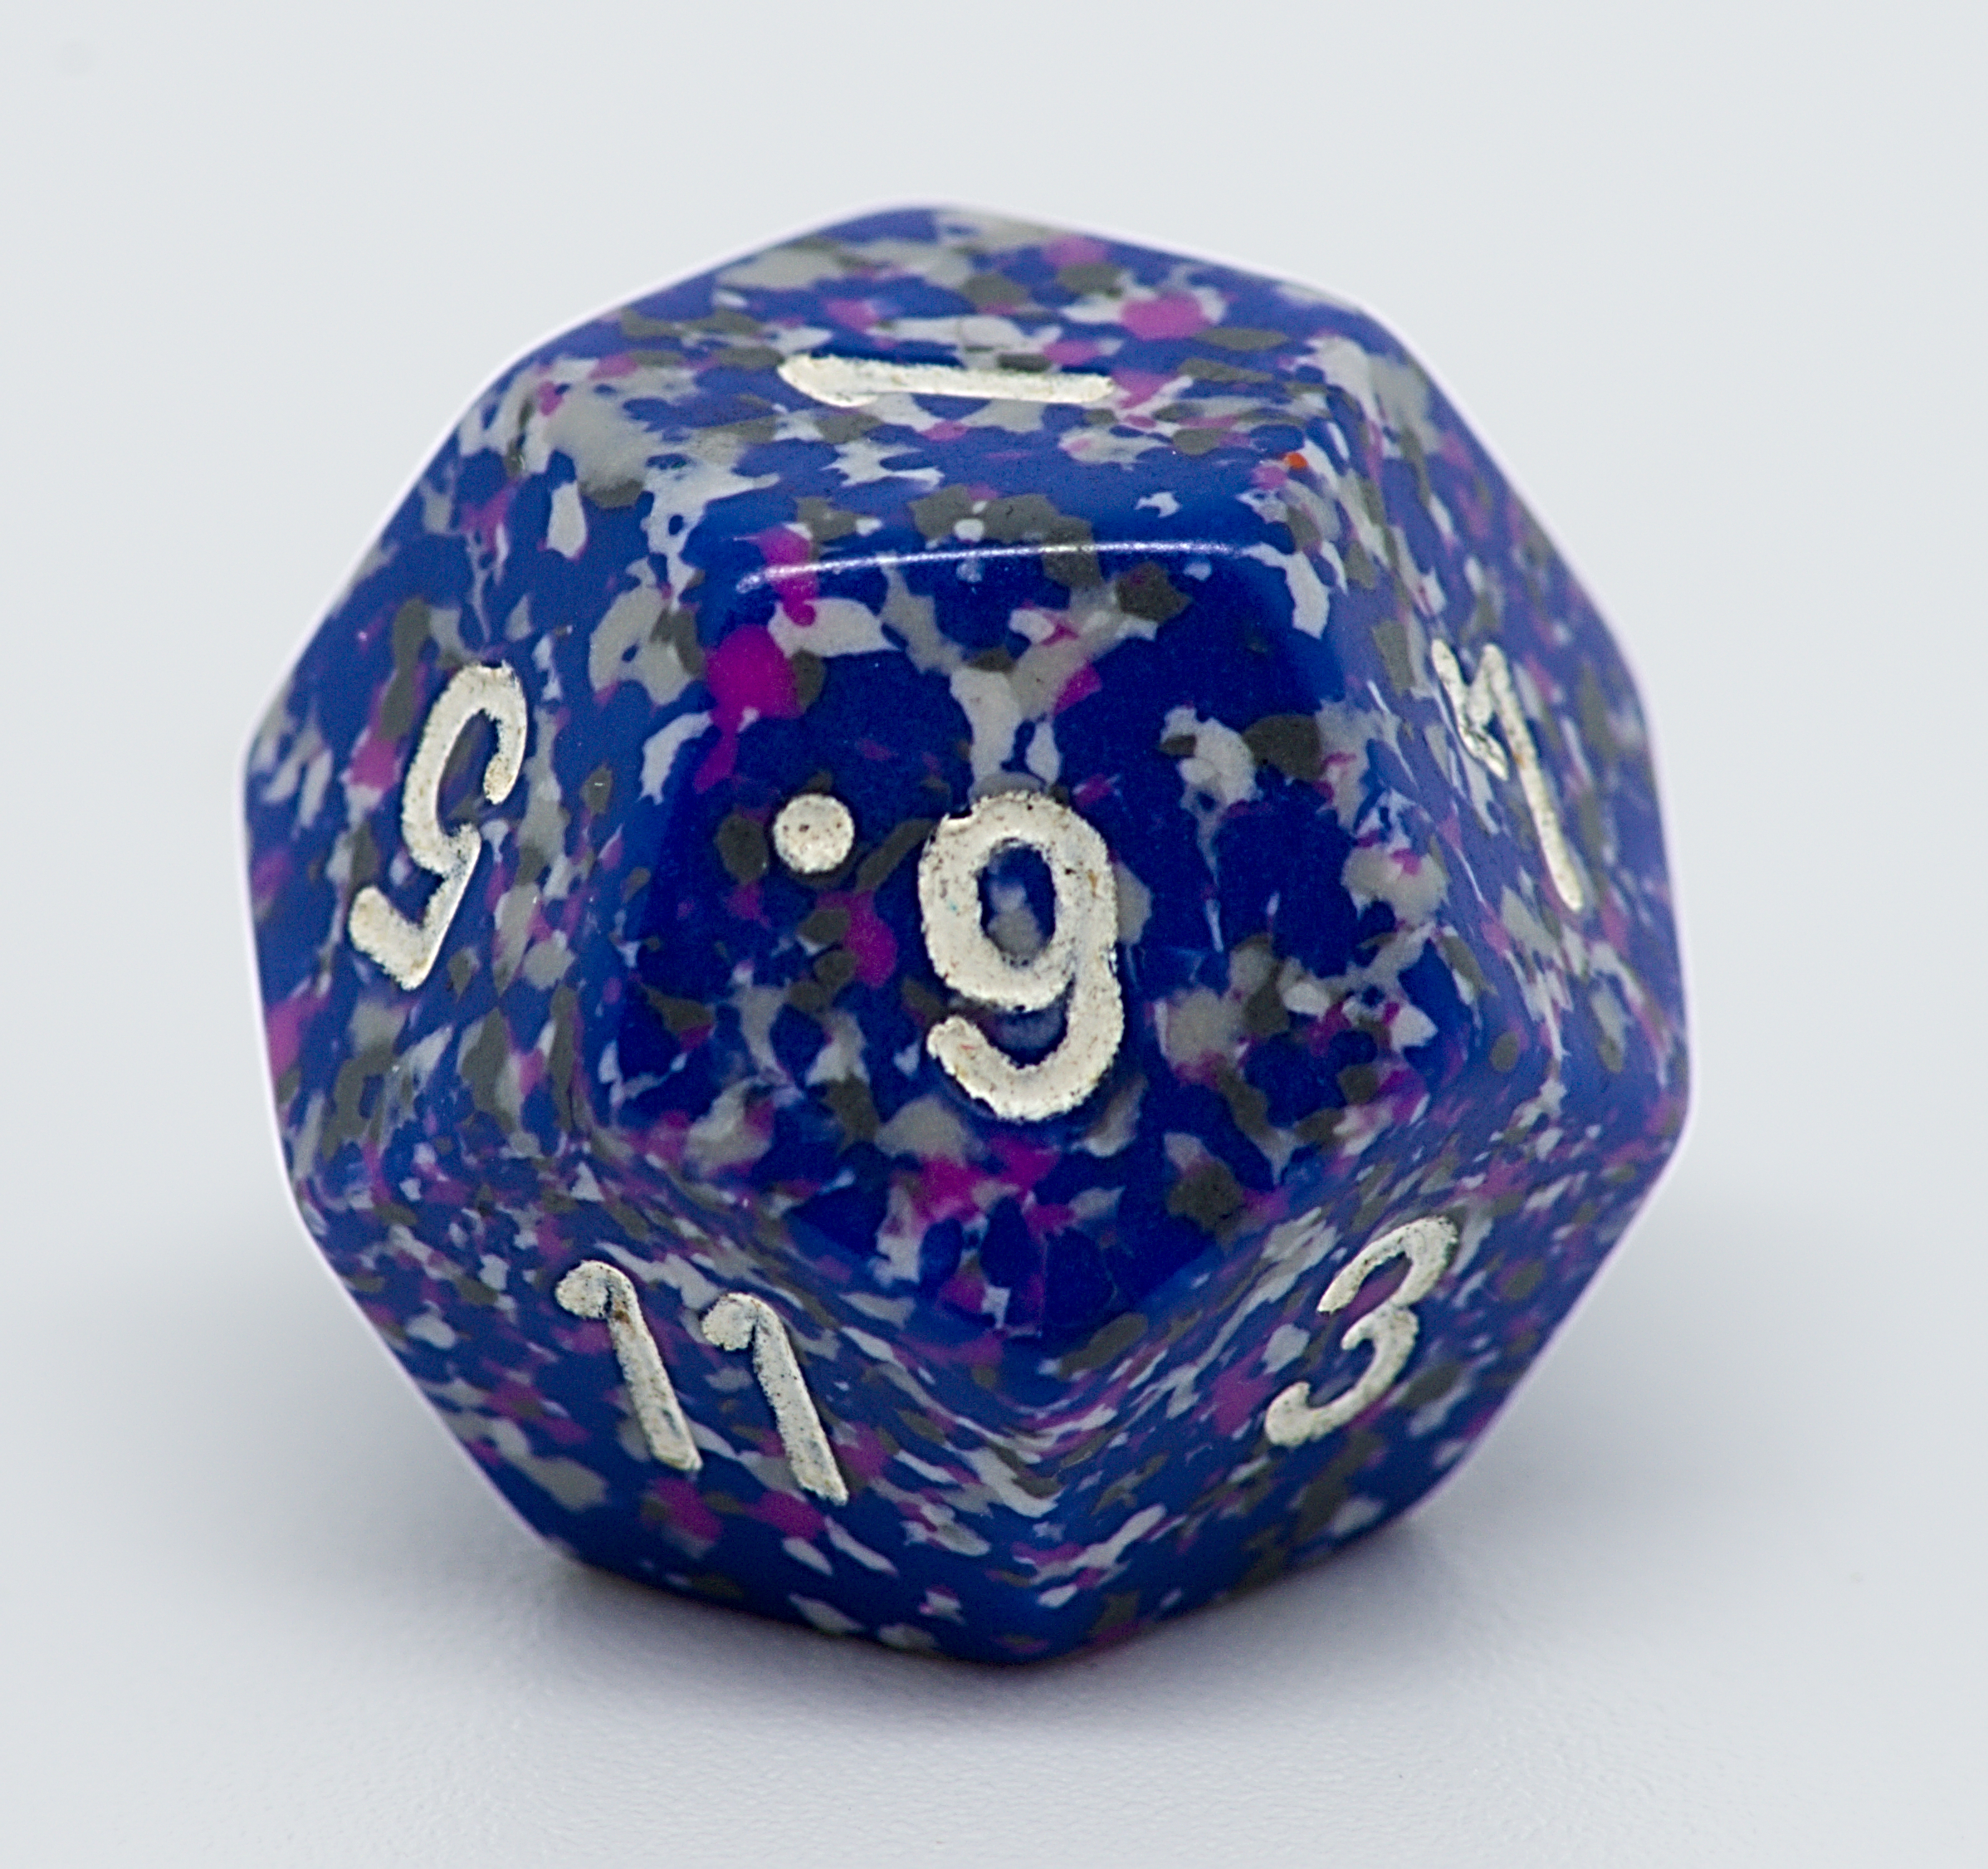
Is this object a polyhedron?
Polyhedra
Non-polyhedral solids

Slide 6

Is this object a polyhedron?
Polyhedra
Non-polyhedral solids

Slide 7
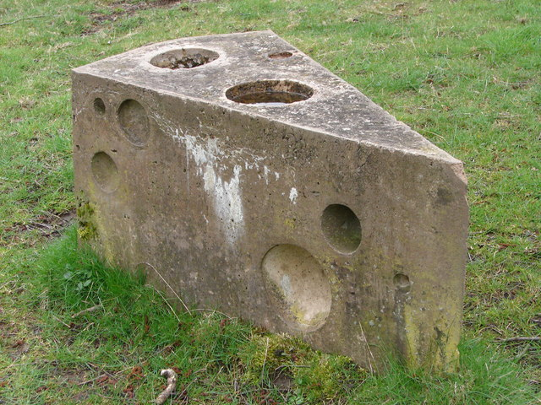
Is this object a polyhedron?
Polyhedra
Non-polyhedral solids

Slide 8
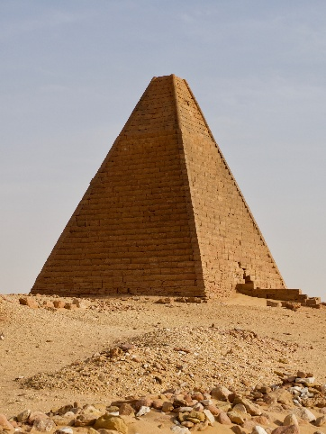
Is this object a polyhedron?
Polyhedra
Non-polyhedral solids

Slide 9

Is this object a polyhedron?
Polyhedra
Non-polyhedral solids

Slide 10
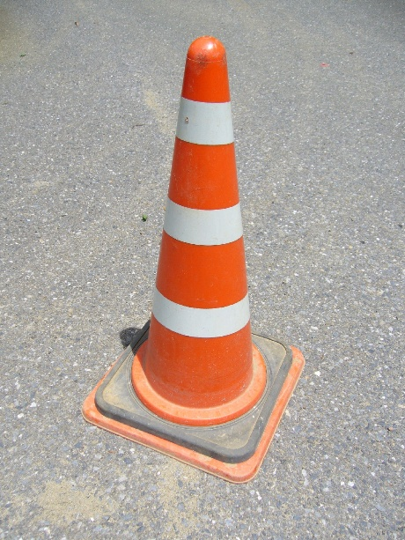
Is this object a polyhedron?
Polyhedra
Non-polyhedral solids

Slide 11
Is this object a polyhedron?
Polyhedra
Non-polyhedral solids

Slide 12
Polyhedron definition
A polyhedron is a 3D object enclosed entirely by flat faces, where every face is a polygon and every vertex is a point where three or more edges meet.

Slide 13
Is it a polyhedron?
Is every face a polygon?
(flat shape with straight edges)
No
3D object
Not a polyhedron
Yes
Is it fully enclosed?
(no gaps or openings)
No
Not a polyhedron
Yes
Polyhedron

Slide 14
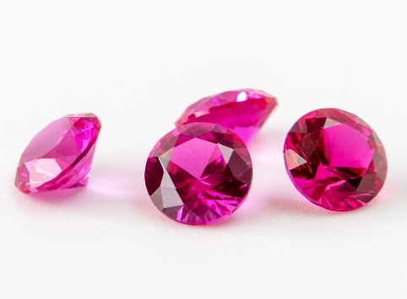
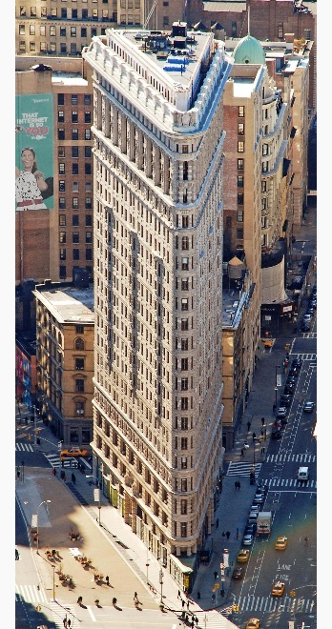
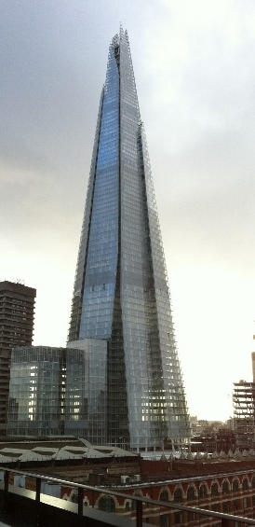
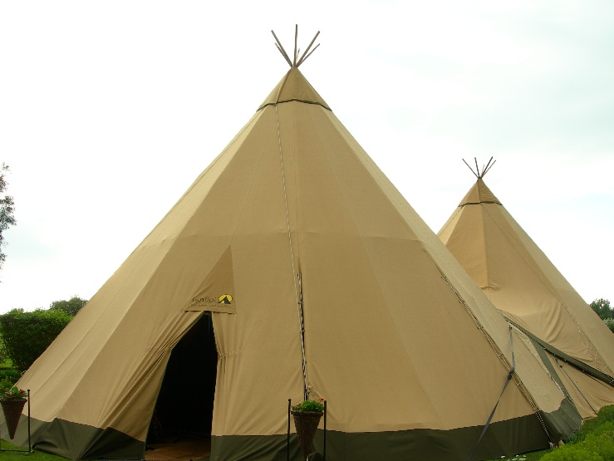
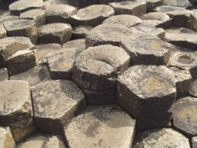
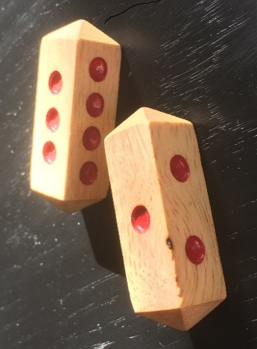



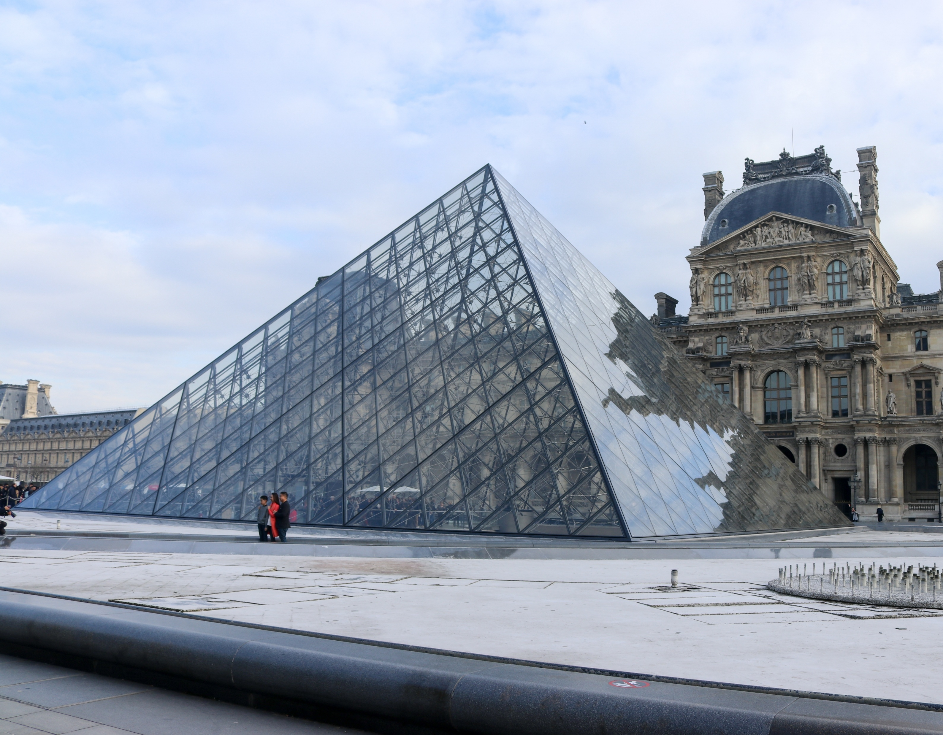
These are all polyhedra. Create a flowchart to classify objects.
Other
Prisms
Pyramids

Slide 15
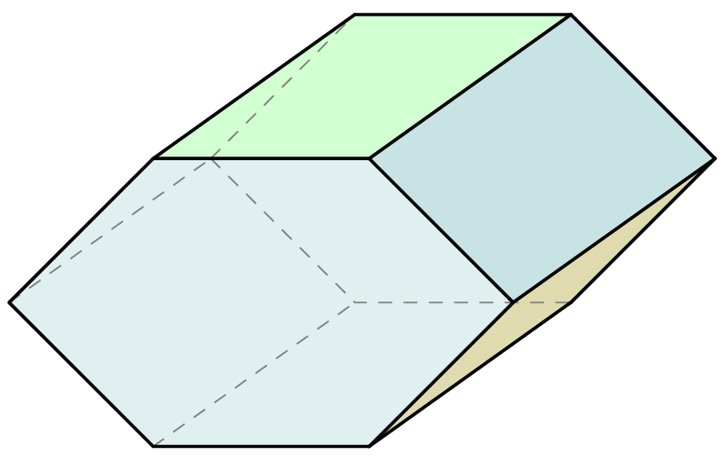
What type of polyhedron?
Prisms
Pyramids
Other
Notes:
https://commons.wikimedia.org/wiki/File:A_tent_on_a_bed.jpg

Slide 16
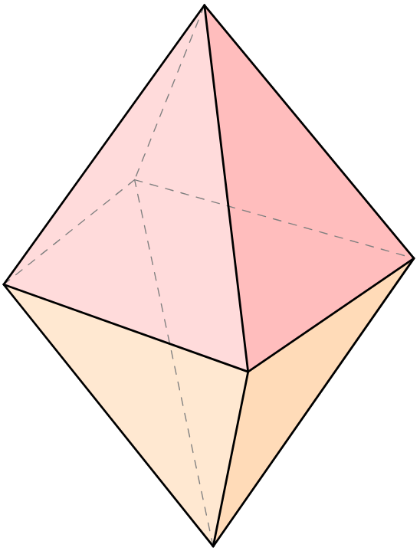
What type of polyhedron?
Prisms
Pyramids
Other
Notes:
https://commons.wikimedia.org/wiki/File:A_tent_on_a_bed.jpg

Slide 17
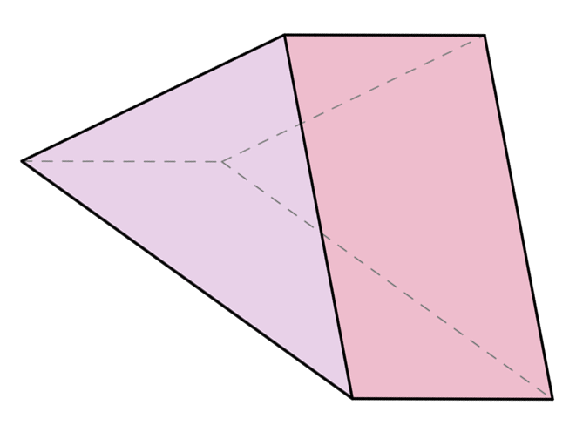
What type of polyhedron?
Prisms
Pyramids
Other
Notes:
https://commons.wikimedia.org/wiki/File:A_tent_on_a_bed.jpg

Slide 18
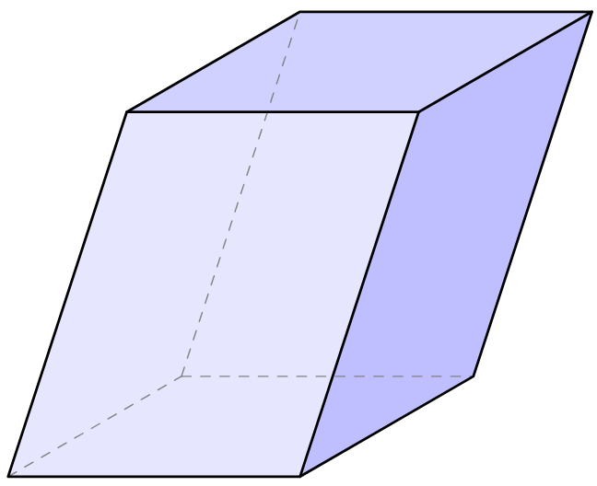
What type of polyhedron?
Prisms
Pyramids
Other
Notes:
https://commons.wikimedia.org/wiki/File:A_tent_on_a_bed.jpg

Slide 19
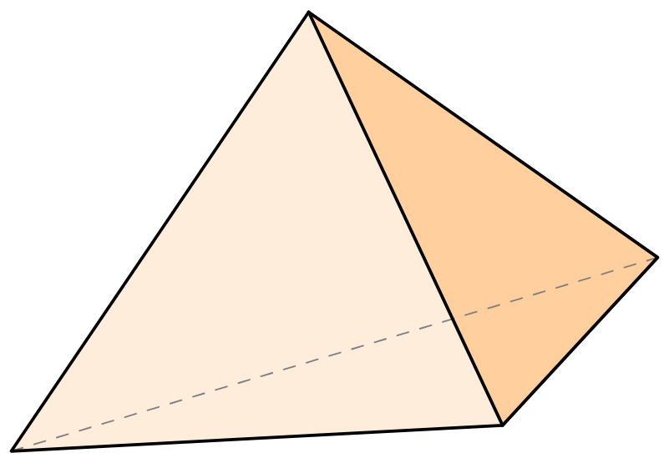
What type of polyhedron?
Prisms
Pyramids
Other
Notes:
https://commons.wikimedia.org/wiki/File:A_tent_on_a_bed.jpg

Slide 20
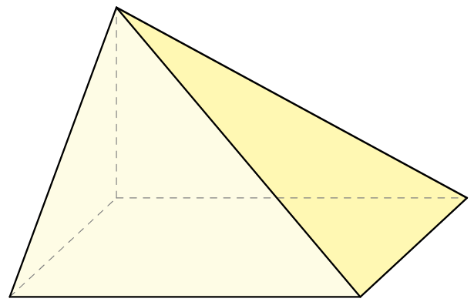
What type of polyhedron?
Prisms
Pyramids
Other
Notes:
https://commons.wikimedia.org/wiki/File:A_tent_on_a_bed.jpg

Slide 21
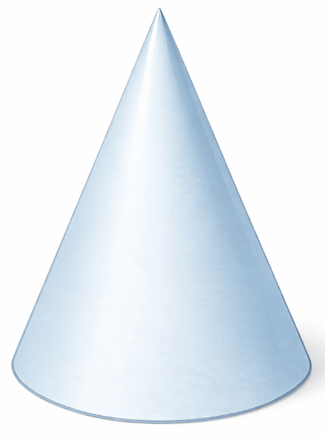
What type of polyhedron?
Prisms
Pyramids
Other
Notes:
https://commons.wikimedia.org/wiki/File:A_tent_on_a_bed.jpg

Slide 22
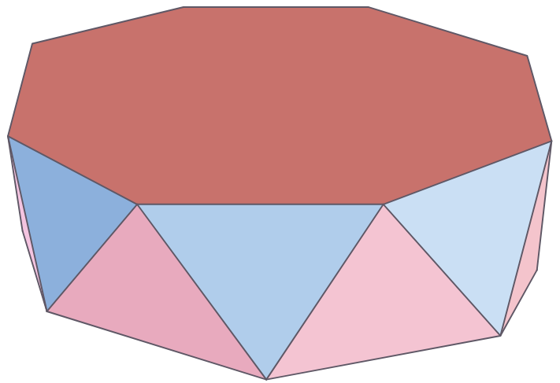
What type of polyhedron?
Prisms
Pyramids
Other
Notes:
https://commons.wikimedia.org/wiki/File:A_tent_on_a_bed.jpg

Slide 23
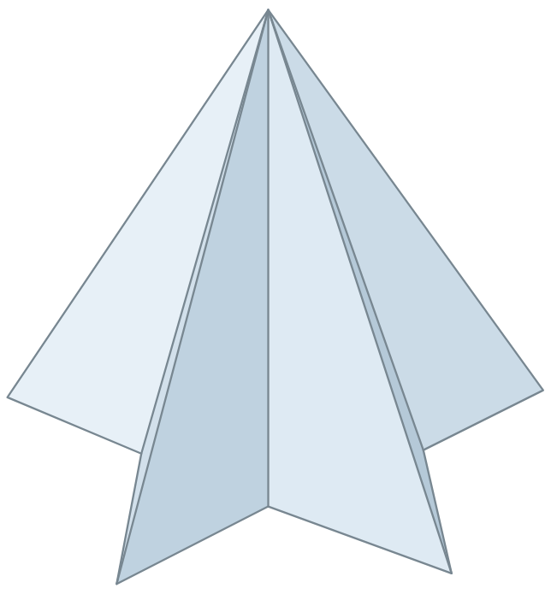
What type of polyhedron?
Prisms
Pyramids
Other
Notes:
https://commons.wikimedia.org/wiki/File:A_tent_on_a_bed.jpg

Slide 24
What type of polyhedron?
Prisms
Pyramids
Other
Notes:
https://commons.wikimedia.org/wiki/File:A_tent_on_a_bed.jpg

Slide 25
Definitions of prisms and pyramids
Prism
A 3D object with two identical, parallel, and flat faces called bases, where every other face is a parallelogram connecting the two bases.
Pyramid
A 3D object with one polygonal base, where every other face is a triangle meeting at a single vertex not on the base, called the apex.

Slide 26
Lesson 3

Slide 27


Fate and Fortune: Choose your number
The game designer is creating a board game called Fate and Fortune and needs a set of custom dice.
Each die must have a lucky or unlucky number of faces (a 7-faced die, a 13-faced die, and so on).
The faces are numbered starting at 1, with a different number on each face and no blanks.
Number | The superstition
3 | Good things come in threes
4 | Some buildings skip this floor entirely
7 | The luckiest roll
8 | The sound of prosperity
9 | Long life
12 | The number of completeness
13 | Some hotels have no 13th floor
17 | An unwelcome number between two perfect ones

