Slide 1
Margot’s macaroni
(Y1)

Slide 2
Lesson 1 • A handful of macaroni

Slide 3
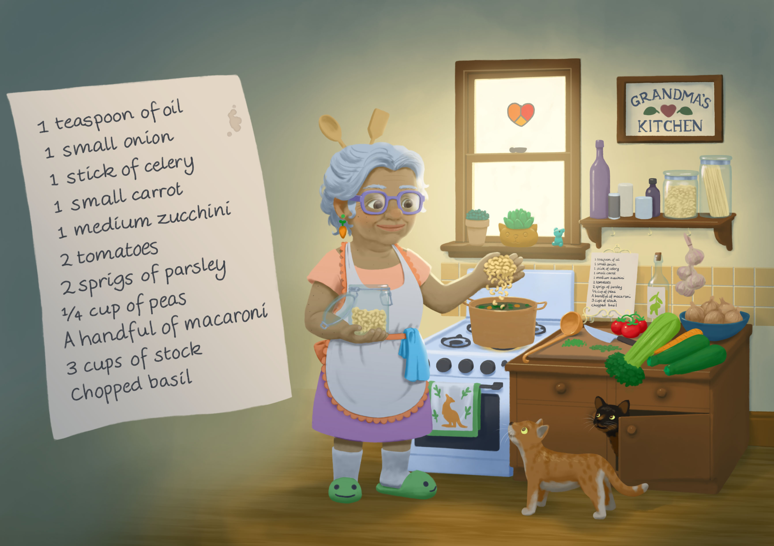

Slide 4
Lesson 2 • Macaroni grab

Slide 6
Margot’s macaroni
How can we grab a handful with 100 macaroni pieces, just like Grandma’s?
How can we quickly check if our handful has 100 pieces?

Slide 7
Lesson 3 • One last handful

Slide 9
Margot’s macaroni
How can we grab a handful with 100 macaroni pieces, just like Grandma’s handful?
How can we quickly check if our handful has 100 pieces?

