Slide 1
Statistics: How far can we jump?
(Y3)

Slide 2
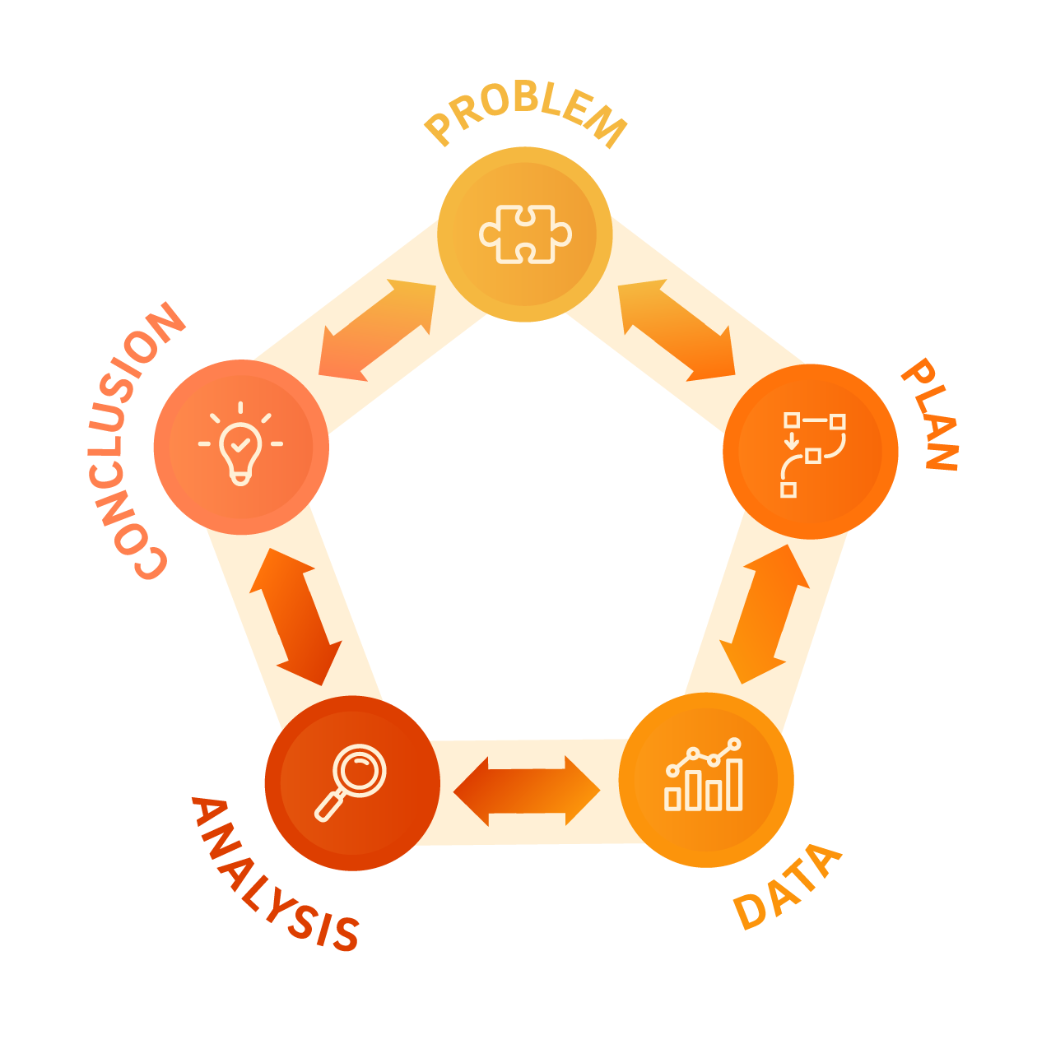

Slide 3
Lesson 1 • Jumping

Slide 5
Lesson 2 • Developing jumping protocols

Slide 7
Jumping and measuring protocols
How should we jump and measure, so we are consistent?
Our jumping protocols
Our measuring protocols

Slide 8
Lesson 3 • How far?

Slide 10
Lesson 4 • Our jump data

Slide 12
Lesson 5 • How far can we jump?

