Slide 1
Fractions: Lamington slice
(Y5)

Slide 2
Task 1 • Where will you stand?
resolve.edu.au
(2)

Slide 3
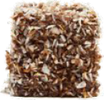
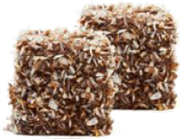
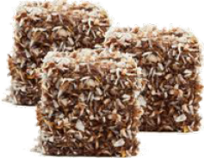
Sharing lamingtons
How much lamington does each student at each table get?

Slide 4
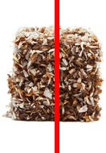
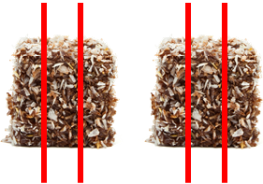
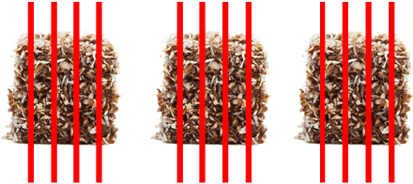
Strategy 1
Divide each lamington into the same number of parts as students.
Each student receives 1 half of a lamington.
Each student receives 2 one-thirds of a lamington.
Each student receives 3 one-fifths of a lamington.
Notes:
Click 1 to reveal number of parts
Click 2 to reveal fraction each student gets
Click 3 to reveal number of parts
Click 4 to reveal fraction each student gets
Click 5 to reveal number of parts
Click 6 to reveal fraction each student gets

Slide 5
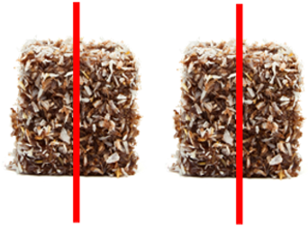
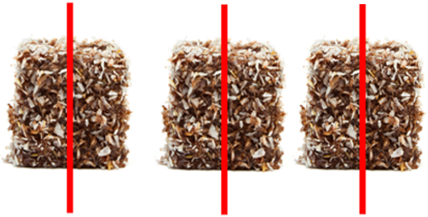
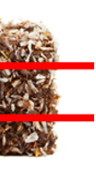
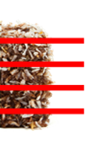
Strategy 2
Cut the lamingtons in half and share the halves equally. Then cut the remaining halves into smaller parts and share these.
Each student receives 1 half of a lamington.
Each student receives 1 half of a lamington and 1 one-sixth.
Each students receives 1 half of a lamington and 1 one-tenth.
Notes:
Click 1 to reveal number of parts
Click 2 to reveal fraction each student gets
Click 3 & 4 to reveal number of parts
Click 5 to reveal fraction each student gets
Click 6 & 7 to reveal number of parts
Click 8 to reveal fraction each student gets

Slide 6
Task 2 • Sharing lamingtons
resolve.edu.au
(6)

Slide 7
What share of lamington?
Four students share three lamingtons.
Five students share four lamingtons.
Six students share five lamingtons.
Eight students share six lamingtons.
What share of lamington does each student in each group get?
Who gets the most? How do you know?
Notes:
Click 1- Question- What share of lamington does each student in each group get?
Click 2- Question- Who gets the most? How do you know?

Slide 8

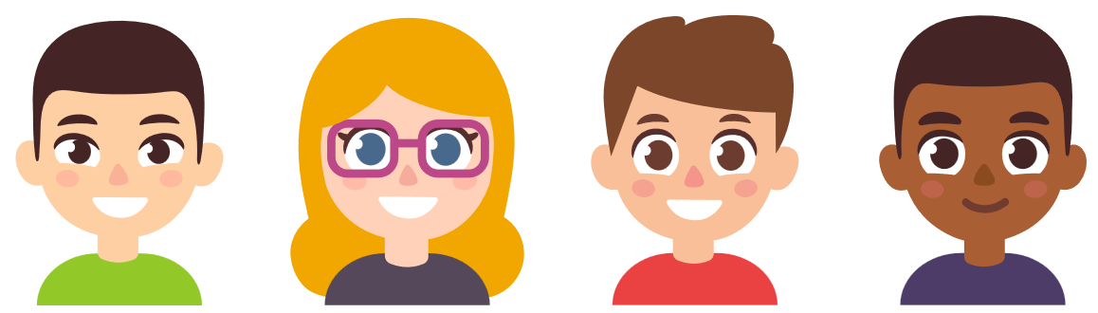
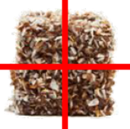

Ivan’s strategy
I counted how many people were in the group, and then I cut each lamington into that many parts!
$$\frac{3}{4}$$

Slide 9

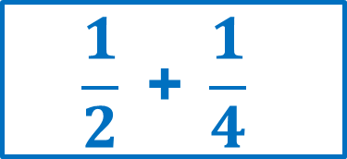
Isa’s strategy
I cut each lamington in half and gave everyone one half! Then I cut up the two leftover halves in half and gave everyone one quarter.
$$\frac{1}{2} \text{+ }\frac{1}{4}$$

Slide 10
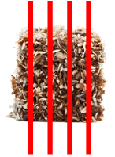
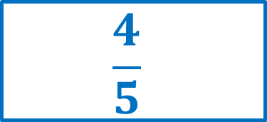
Ali’s strategy
I counted how many people were in the group, and then I cut each lamington into that many parts!
$$\frac{4}{5}$$

Slide 11
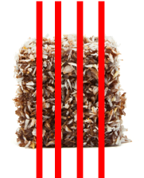
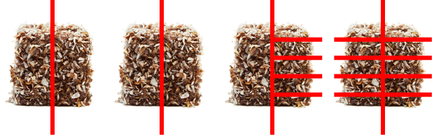
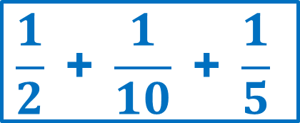
Amy’s strategy
I cut three lamingtons in half and gave everyone one half! Then I cut up any leftover into smaller pieces and shared those out, too.
$$\frac{1}{2} \text{+ }\frac{1}{10} \text{+ }\frac{1}{5}$$

Slide 12


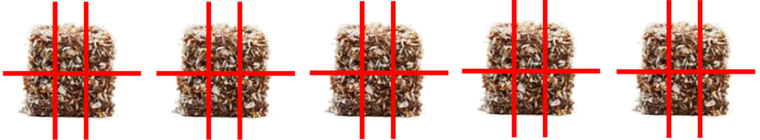

Tara’s strategy
I counted how many people were in the group, and then I cut each lamington into that many parts!
$$\frac{5}{6}$$

Slide 13

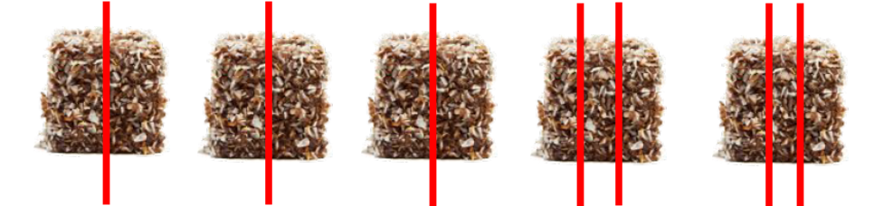
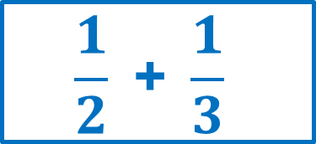
Ray’s strategy
I cut three lamingtons in half and gave everyone one half! Then I cut the two remaining lamingtons into three and gave everyone one third.
$$\frac{1}{2} \text{+ }\frac{1}{3}$$

Slide 14
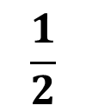
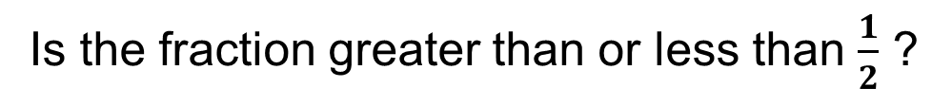


Comparing fractions on a number line
Is the fraction greater than or less than $\frac{1}{2}$ ?
$$\frac{1}{2}$$
$$0$$
$$1$$
Is the fraction closer to $\frac{1}{2}$ or closer to 1 whole?

Slide 15
Task 3 • Equal shares
resolve.edu.au
(15)

Slide 16
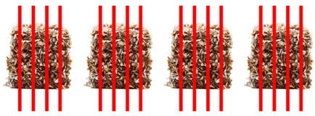
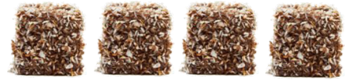
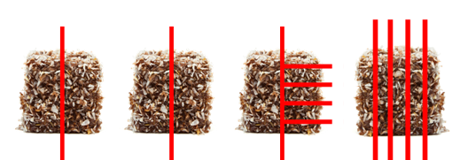
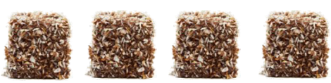
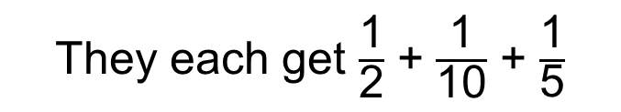
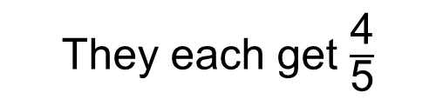
Sharing strategies
Five students share four lamingtons.
They each get $\frac{\text{4}}{\text{5}}$
OR
They each get $\frac{\text{1}}{\text{2}}$ + $\frac{\text{1}}{\text{10}}$ + $\frac{\text{1}}{\text{5}}$

Slide 17
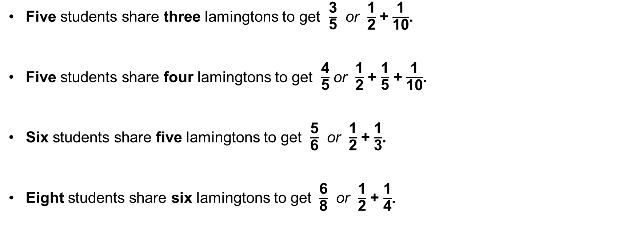
Does each group have an equal share?
Five students share three lamingtons to get $\frac{\text{3}}{\text{5}}$ $\text{or}$ $\frac{\text{1}}{\text{2}}$ + $\frac{\text{1}}{\text{10}}$.
Five students share four lamingtons to get $\frac{\text{4}}{\text{5}}$ or $\frac{\text{1}}{\text{2}}$ + $\frac{\text{1}}{\text{5}}$ + $\frac{\text{1}}{\text{10}}$.
Six students share five lamingtons to get $\frac{\text{5}}{\text{6}}$ or $\frac{\text{1}}{\text{2}}$ + $\frac{\text{1}}{\text{3}}$.
Eight students share six lamingtons to get $\frac{\text{6}}{\text{8}}$ or $\frac{\text{1}}{\text{2}}$ + $\frac{\text{1}}{\text{4}}$.

Slide 18
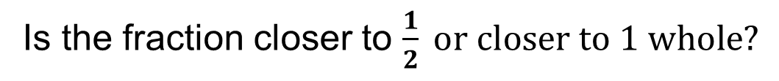
Comparing fractions on a number line
Is the fraction greater than or less than $\frac{1}{2}$ ?
$$\frac{1}{2}$$
$$0$$
$$1$$
Is the fraction closer to $\frac{1}{2} or closer to 1 whole?$

