Slide 1
Statistics: Loopy aeroplanes
(Y6)

Slide 2
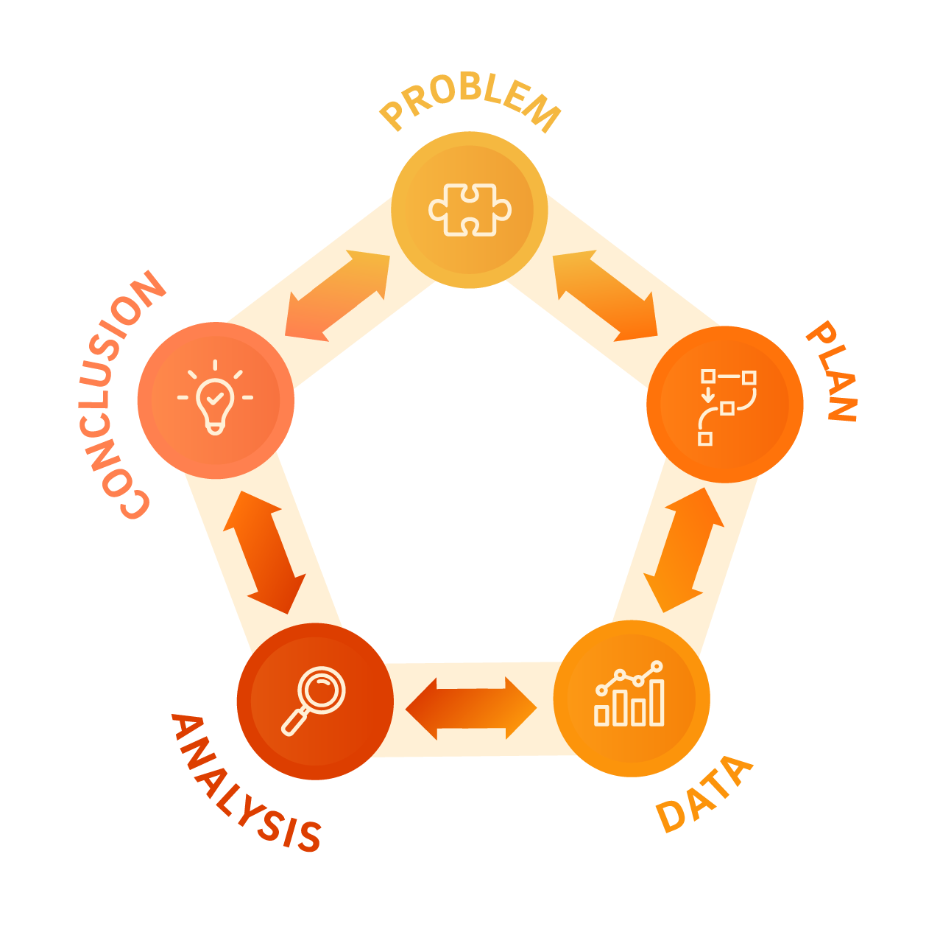

Slide 3
Lesson 1 • Making aeroplanes

Slide 5
Loopy aeroplanes

Slide 6
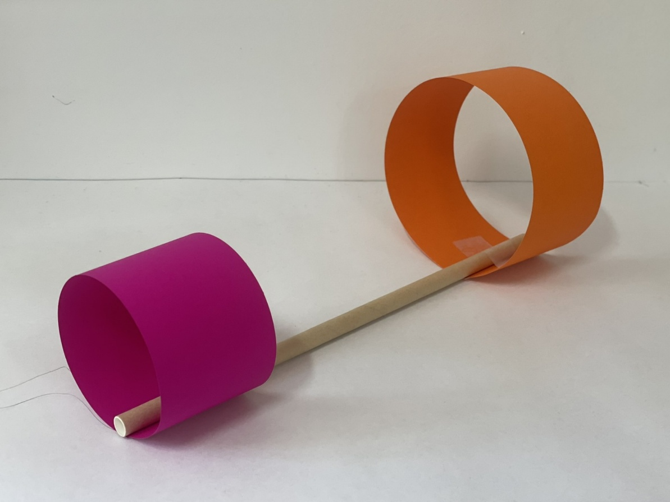
Making a loopy aeroplane
Make two loops from strips of paper:
Loop 1 – 15cm x 5cm
Loop 2 – 30cm x 5cm
Tape one loop onto the end of a paper straw. Tape the other loop to the other end of the straw.

Slide 7
Lesson 2 • Testing aeroplanes

Slide 9
Lesson 3 • A fair test

Slide 11
A Fair Test – Our loopy aeroplane protocols
Our production protocols | Our measuring protocols | Our throwing protocols

Slide 12
Lesson 4 • Analysing data

Slide 14
Lesson 5 • New loopy aeroplanes

Slide 16
Lesson 6 • Testing again

Slide 18
Lesson 7 • What is the best design?

Slide 20
Data analysis
If we went outside again now and flew our planes again, which one do you predict will fly the furthest? Why?
Which plane is the most unpredictable? What makes you say that?
How does the size of the loops impact the flight of a plane?
How does the width of the loops impact the flight of a plane?
Based on this data, what is the best loopy aeroplane design? Can you say this for certain?

Slide 21
Lesson 8 • Fly-off

