Slide 1
Statistics: Origami frogs
(Y4)

Slide 2
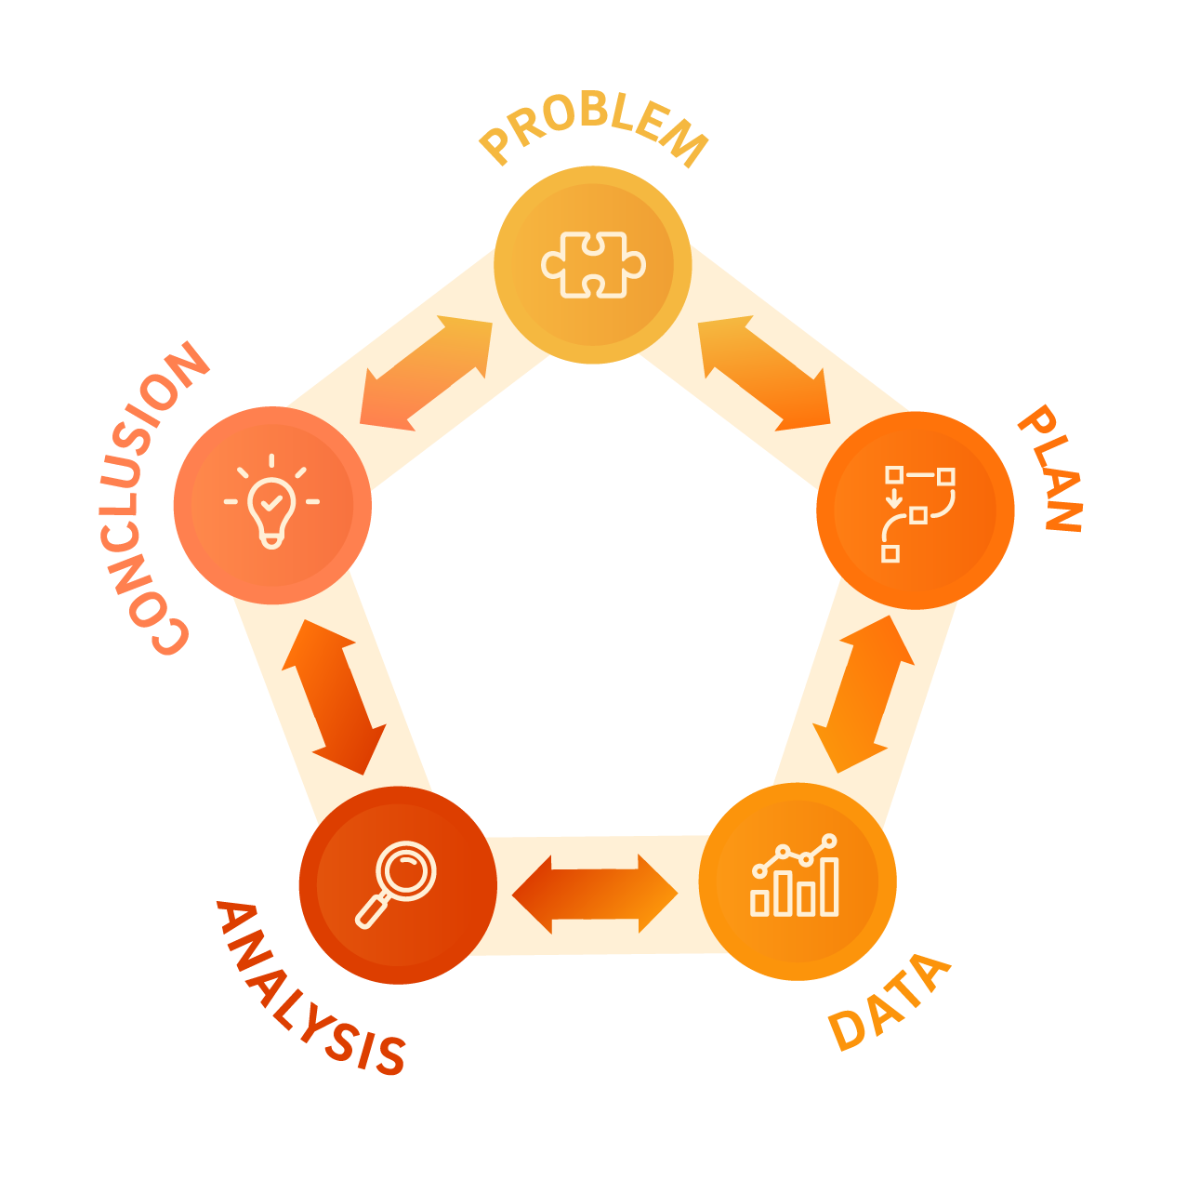

Slide 3
Lesson 1 • Making origami frogs

Slide 6
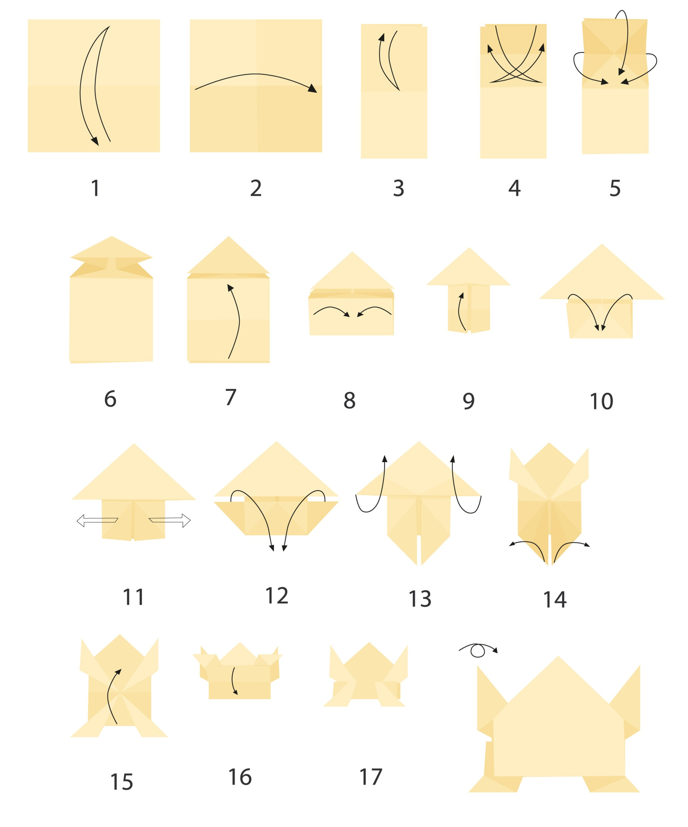

Slide 7
Lesson 2 • Jumping frogs

Slide 9
Jumping and measuring protocols
How can we be consistent in the way that we jump our frogs and measure the length of these jumps?
Our jumping protocols
Our measuring protocols

Slide 10
Lesson 3 • Four jumps

Slide 12
Lesson 4 • Our jump data

Slide 14
Accessing weather data
Insert video - short tutorial on how to access weather data

Slide 15
Lesson 5 • How far we can jump

