Slide 1

PLAYING WITH FIRE
Mathematical modelling
(Y9)

Slide 2
PROBLEM IN CONTEXT
Bushfire behaviour
Lesson 1

Slide 3


Slide 4
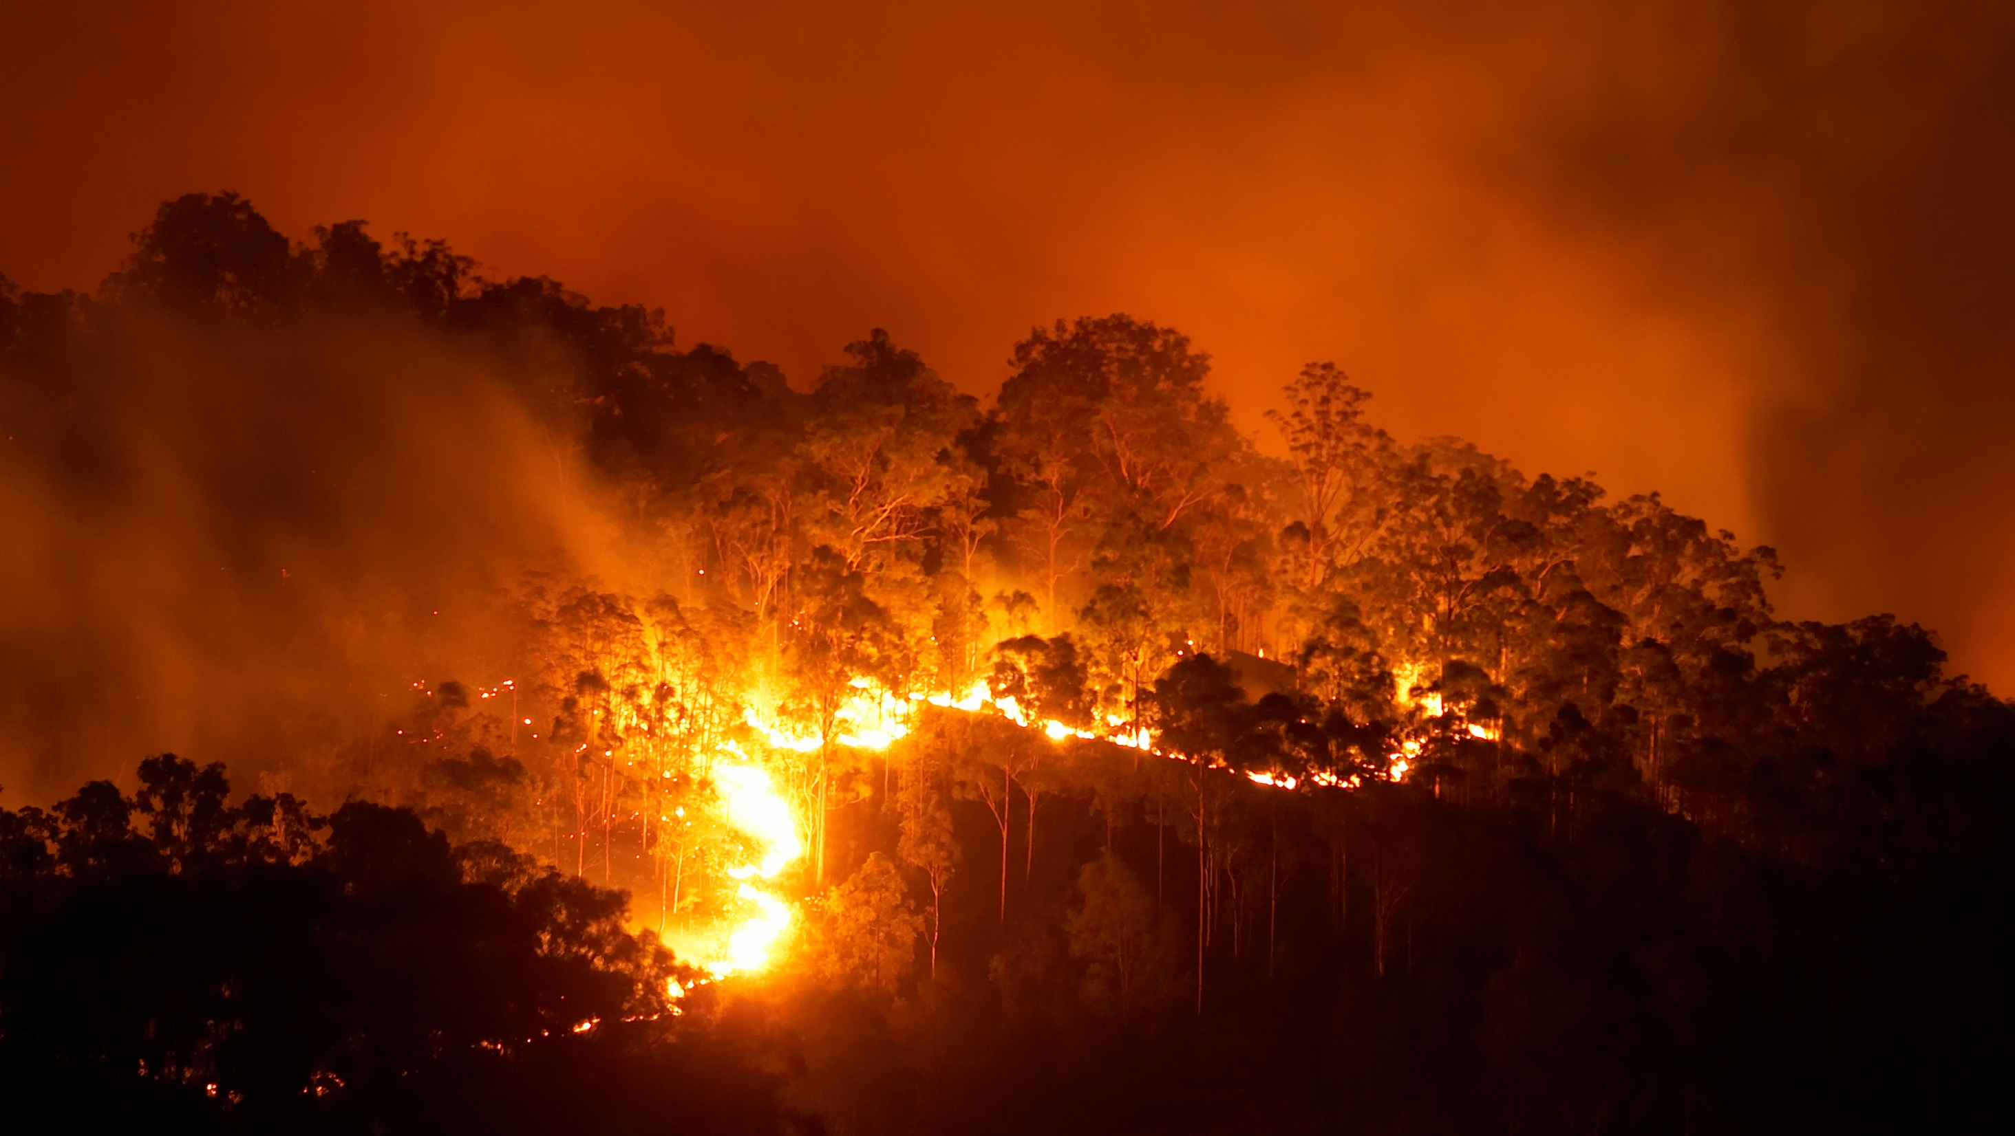
Fire pics

Slide 5
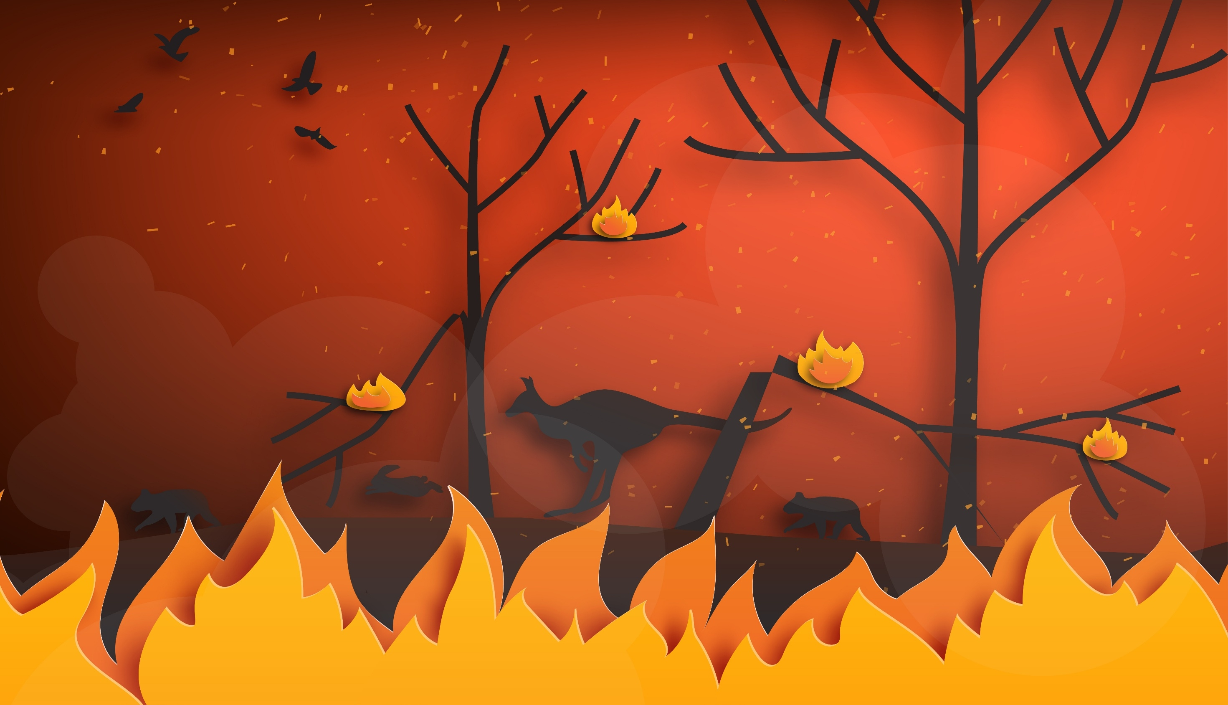

Slide 6


BUSHFIRE
SMALL TOWN

Slide 7

FUEL
WEATHER
TOPOGRAPHY
FIRE BEHAVIOUR TRIANGLE

Slide 8
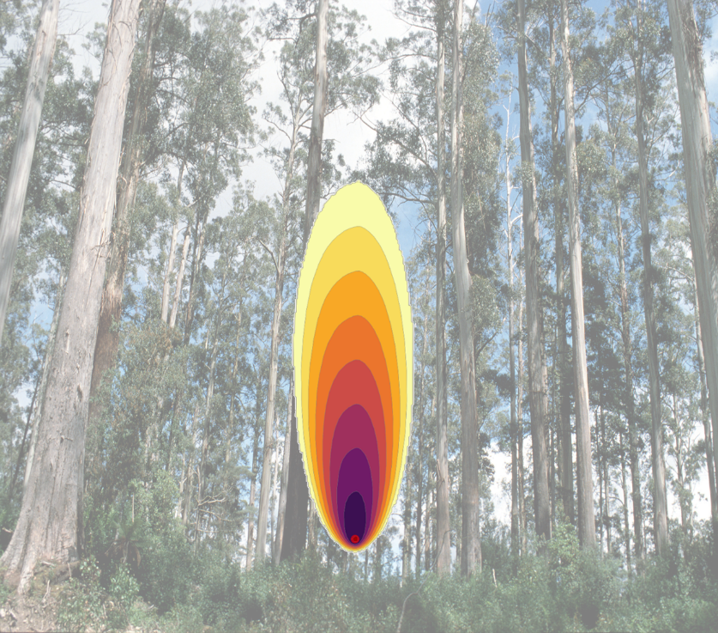
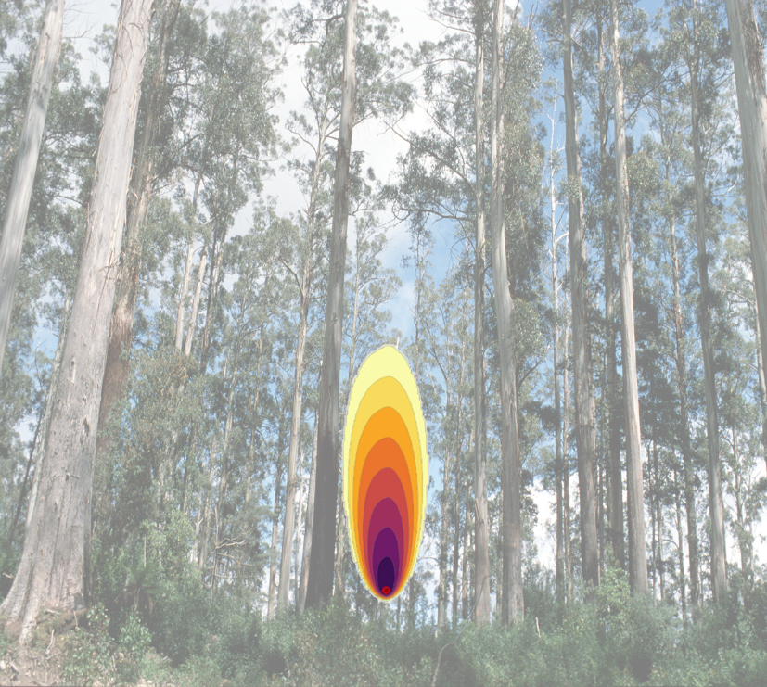
Fire Simulations
1km
1km
Temperature | High
Relative humidity | Medium-low
Wind speed | Medium
Temperature | Medium-high
Relative humidity | Medium
Wind speed | Medium

Slide 9
Weather conditions
  Air temperature - In Australia low temperatures could be from -10°C to 10°C depending on location and time of year. High temperatures might mean temperatures above 40°C.
  Relative humidity - High relative humidity means there is a large amount of moisture in the air. 100% humidity typically means it is raining. Low humidity means it is very dry.
  Windspeed - At low windspeeds you might hear rustling leaves or feel light breezes. At high windspeeds whole trees can shake and it may be difficult to walk.
How might each of these factors influence fire behaviour?
Which factor do you think would have the greatest impact of the rate of spread of a fire?

Slide 10
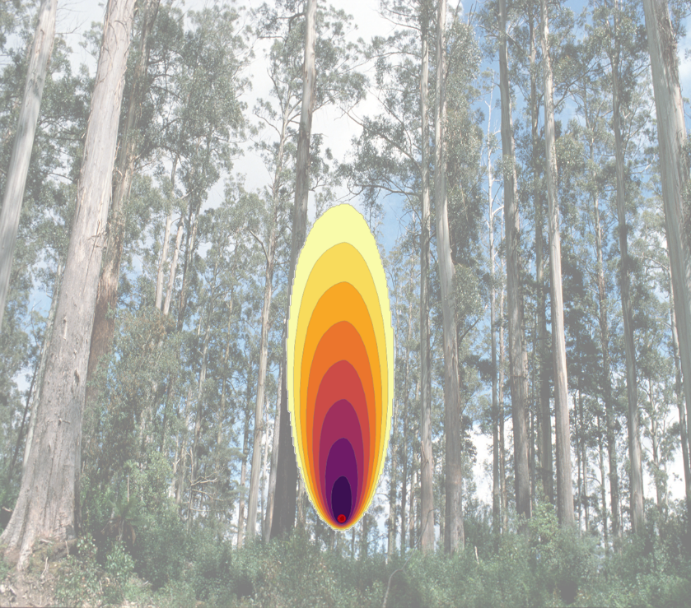

Weather conditions - TEMPERATURE
1km
1km
1km
Temperature | Low
Relative humidity | Medium-low
Wind speed | Medium
Temperature | Medium
Relative humidity | Medium-low
Wind speed | Medium
Temperature | High
Relative humidity | Medium-low
Wind speed | Medium

Slide 11
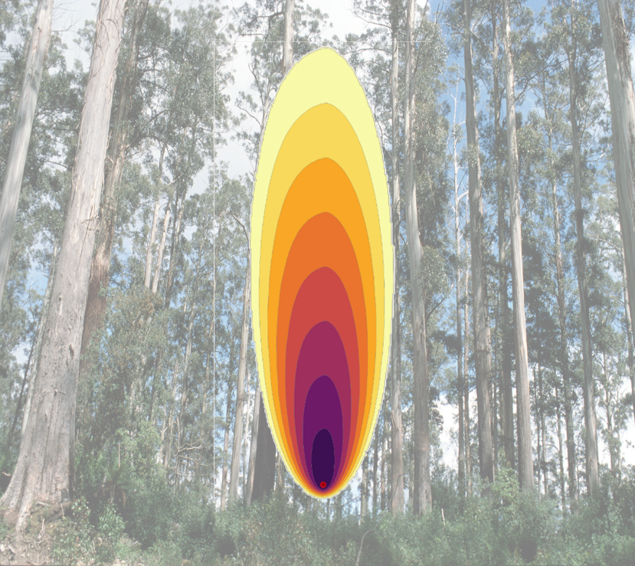
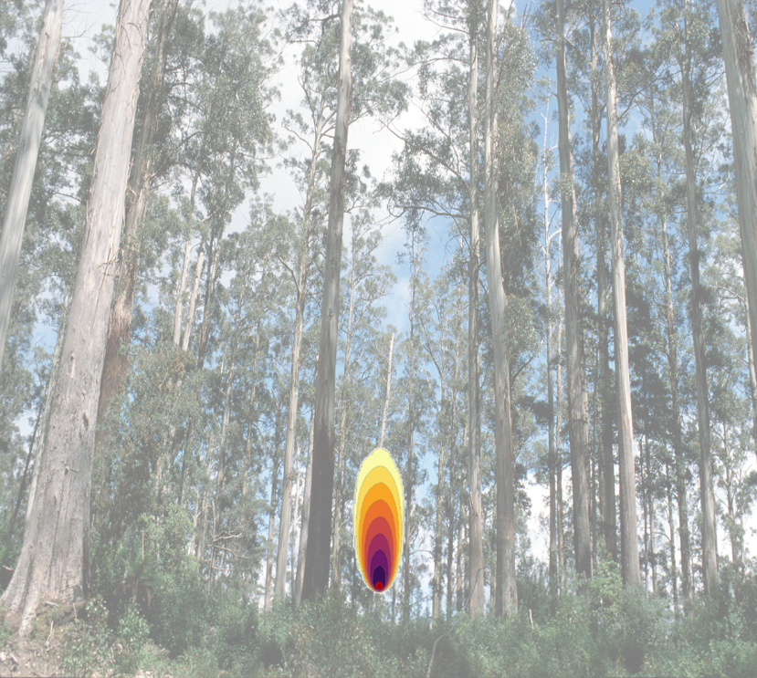
Weather conditions - HUMIDITY
1km
1km
1km
Temperature | Medium-high
Relative humidity | Low
Wind speed | Medium
Temperature | Medium-high
Relative humidity | Medium
Wind speed | Medium
Temperature | Medium-high
Relative humidity | High
Wind speed | Medium

Slide 12
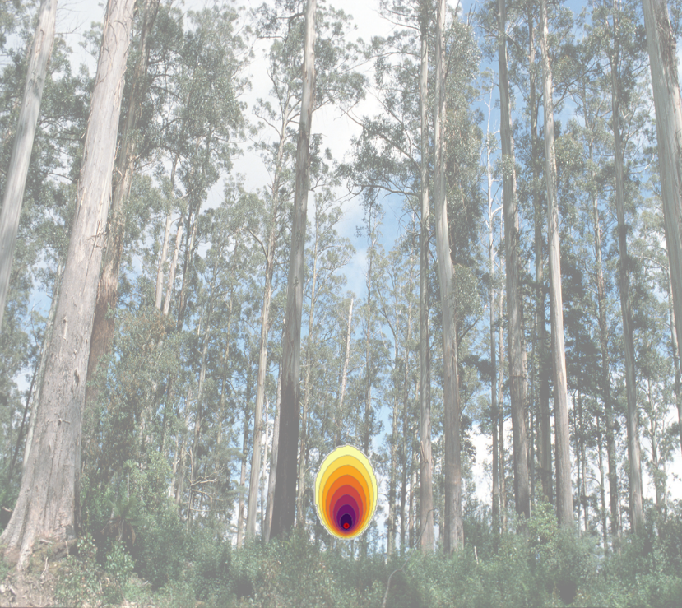
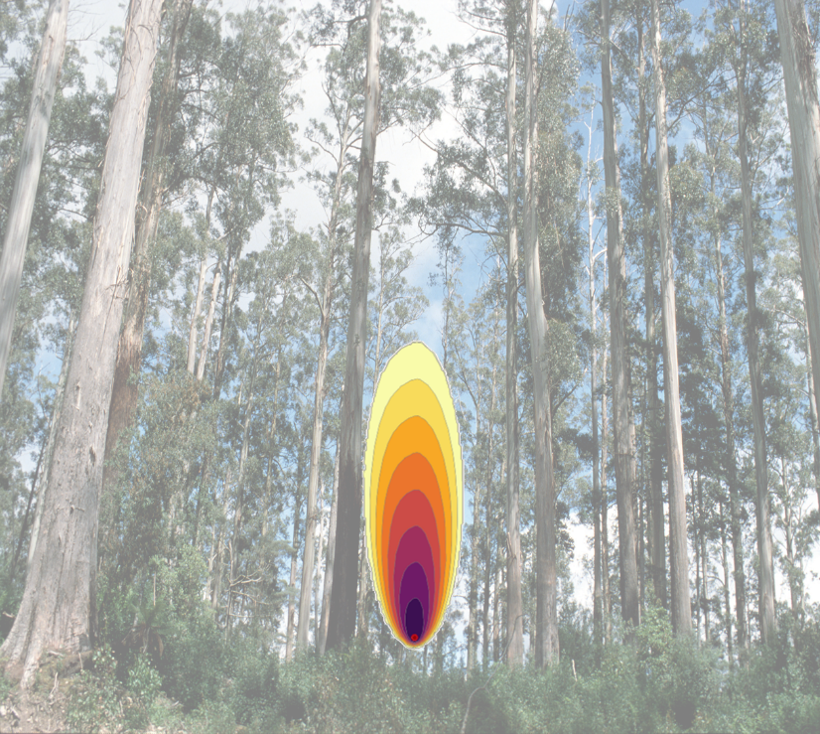
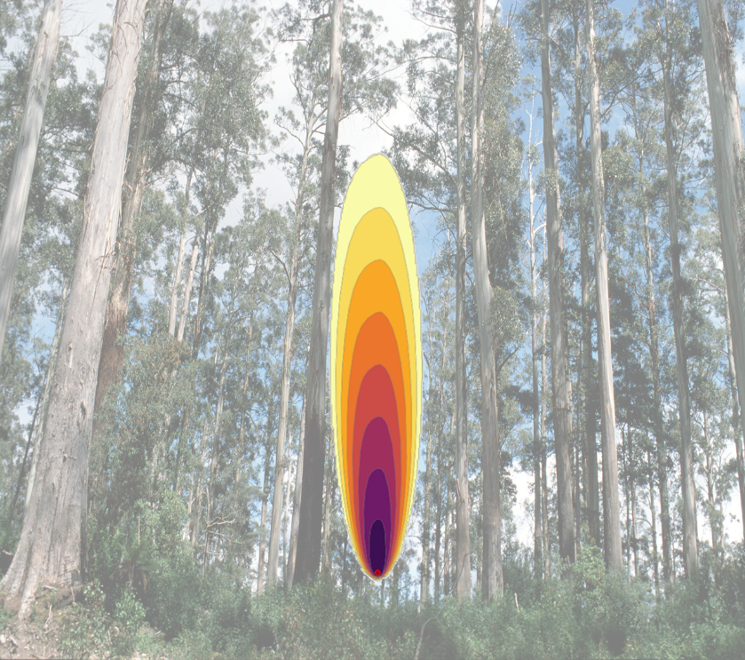
Weather conditions - WIND
1km
1km
1km
Temperature | Medium-high
Relative humidity | Medium-low
Wind speed | Low
Temperature | Medium-high
Relative humidity | Medium-low
Wind speed | Medium
Temperature | Medium-high
Relative humidity | Medium-low
Wind speed | High

Slide 13
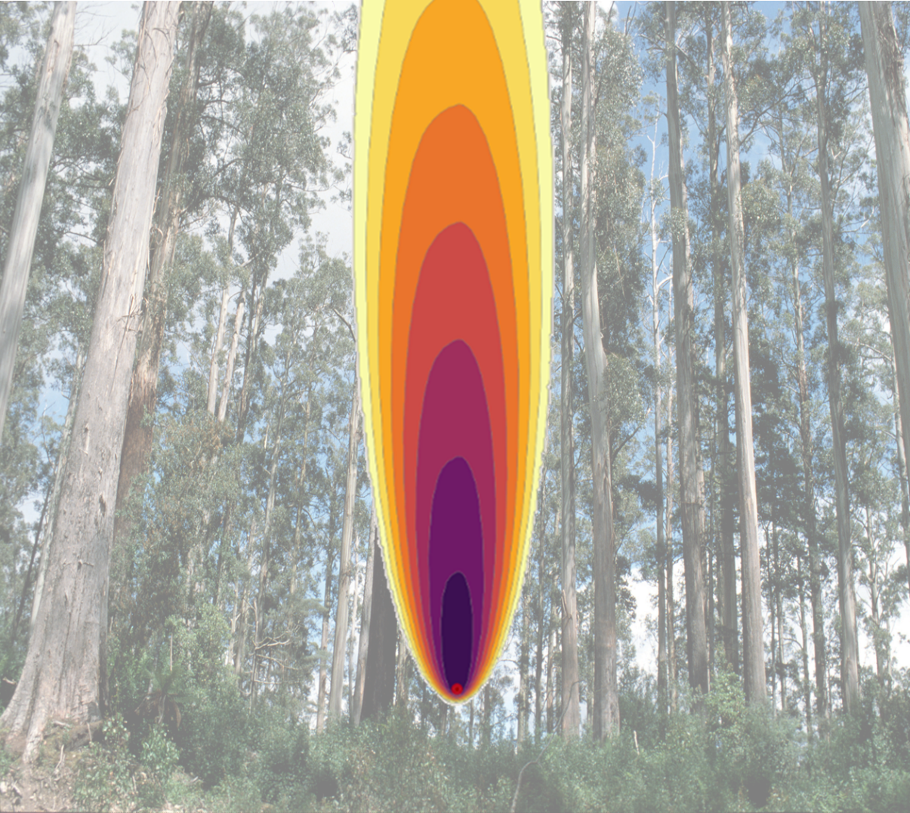
High temperature, low humidity, high wind
1km

Slide 14
MATHEMATICAL PROBLEM
The influence of wind
Lesson 2

Slide 16
How weather factors influence fire
Relative humidity has a big impact on the size of a bushfire.
Wind speed influences the shape and spread of a bushfire.
Relative humidity, air temperature and wind speed interact in different ways to influence bushfire behaviour.
Low humidity, high temperatures and strong winds make a fire very difficult to control.

Slide 17

Weather conditions - WIND
1km
1km
1km
Temperature | Medium-high
Relative humidity | Medium-low
Wind speed | Low
Temperature | Medium-high
Relative humidity | Medium-low
Wind speed | Medium
Temperature | Medium-high
Relative humidity | Medium-low
Wind speed | High

Slide 18
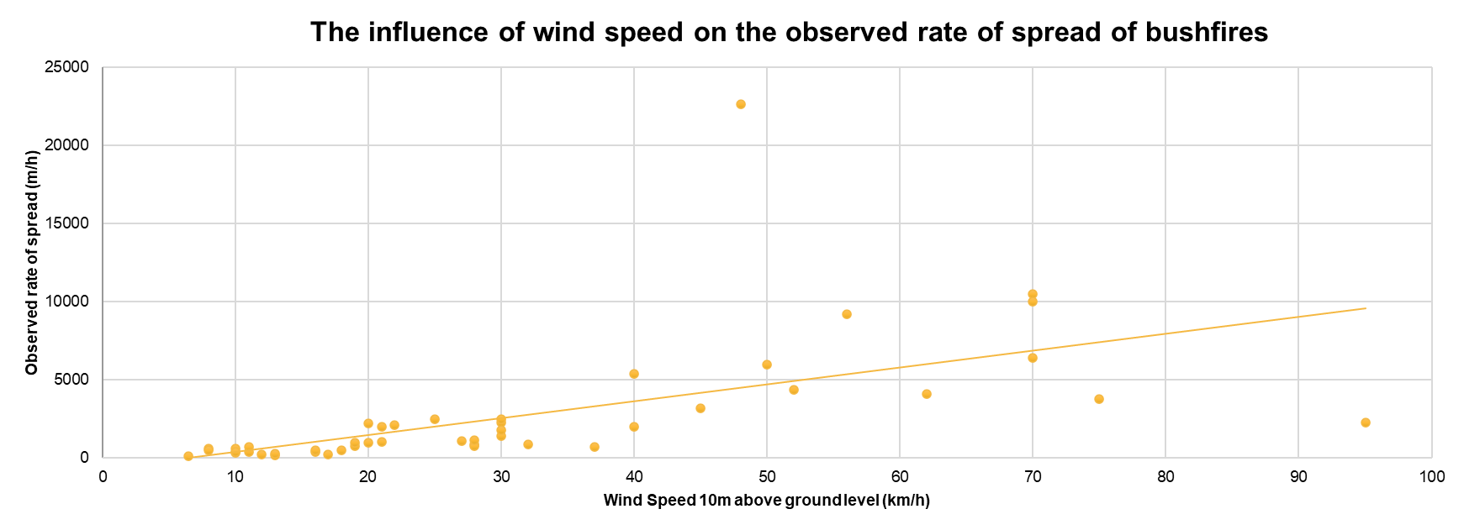

Slide 19
MATHEMATICAL RESULT
Rate of spread estimates
Lesson 3

Slide 22
Fire rate of spread for forests – Wind speed
2.518 x wind speed
Rate of spread =
60 – temperature + humidity
Where:
Temperature is measured in degrees Celsius (°C)
Wind speed is measured in kilometres per hour (km/h)
Relative humidity is measured in percent (%)

Slide 23
FUEL
WEATHER
TOPOGRAPHY
FIRE BEHAVIOUR TRIANGLE

Slide 24
MATHEMATICAL RESULT
The influence of topography
Lesson 4

Slide 26
FUEL
WEATHER
TOPOGRAPHY
FIRE BEHAVIOUR TRIANGLE

Slide 27
Fire simulations
These are the weather conditions for three separate fire simulations. For each simulation (Fire 1, Fire 2, and Fire 3), the fire was modelled on flat ground (0°), then on downward slopes (-5°, -10°, -15°, -20°), and finally on upward slopes (5°, 10°, 15°, 20°).
 | Fire 1 | Fire 2 | Fire 3
Temperature (°C) | 30 | 40 | 40
Relative humidity (%) | 10 | 30 | 10
10m wind speed (km/h) | 40 | 40 | 25

Slide 28
How does topography influence rate of spread?
Does a fire spread faster, slower, or at about the same speed when moving uphill?
Does a fire spread faster, slower, or at about the same speed when moving downhill?
By how much does the speed change on an upward slope?
By how much does the speed change on a downward slope?
Do different weather conditions further affect the rate of fire spread on slopes?
Is it possible to develop a rule of thumb for how slope affects a fire’s rate of spread?

Slide 29


Topography rule of thumb
The speed of a fire doubles for every 10° of upward slope.
10º
INCLINE

Slide 30
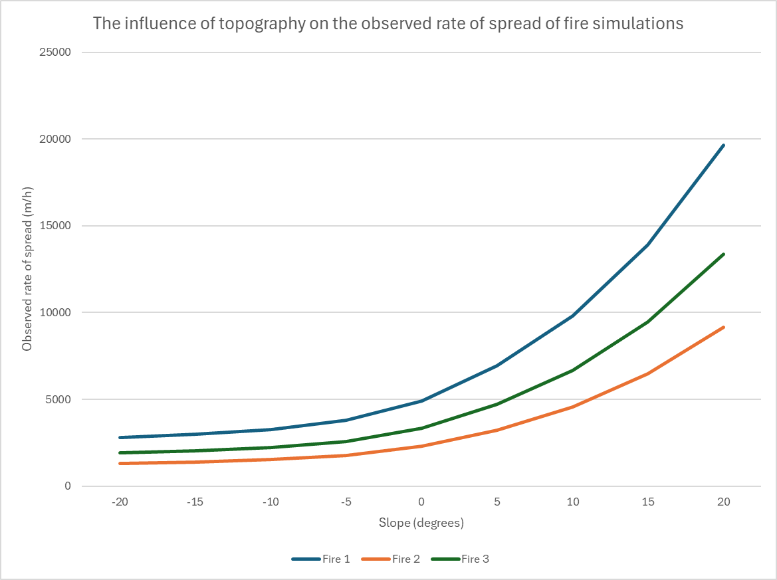
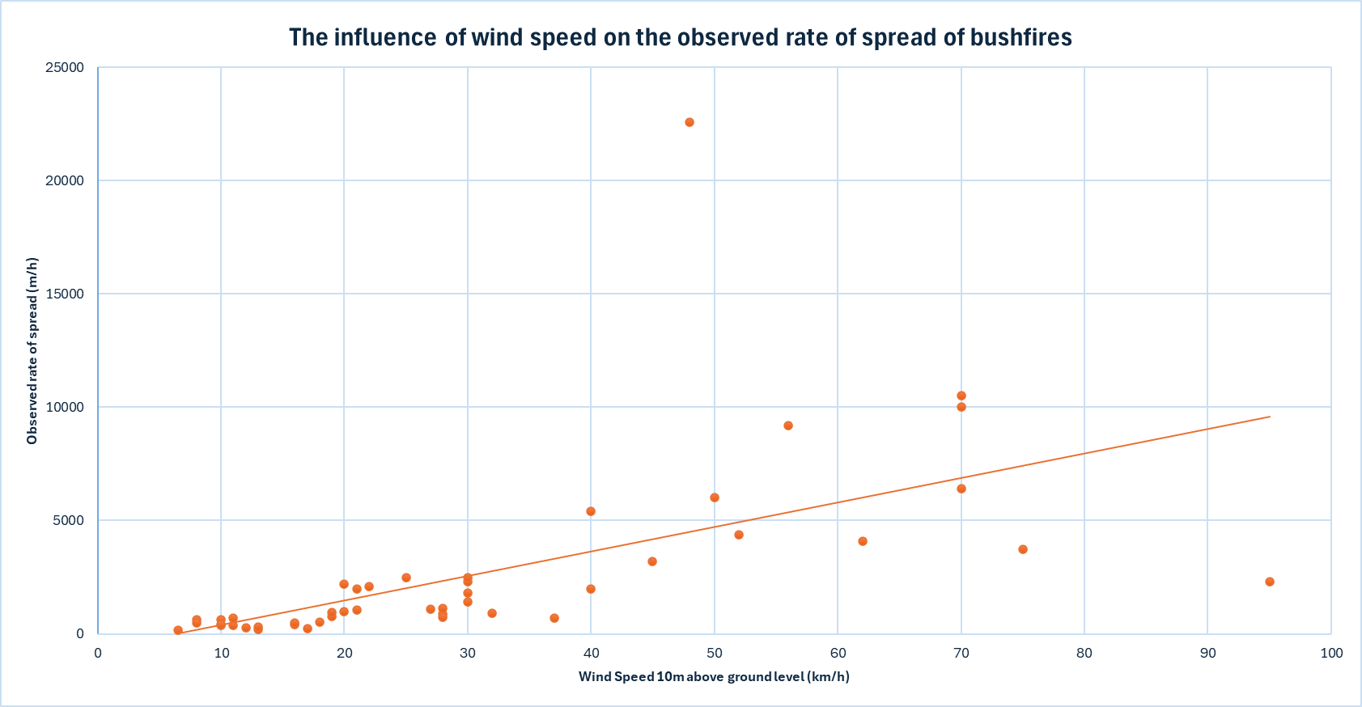

Slide 31
Fire rate of spread for forests
Rate of spread (upward slope) =
R₀ x 2 ^{(0.1 x slope angle)}
R₀ x 2 ^{(0.1 x slope angle)}
Rate of spread (downward slope) =
2 ^{0.1 x (slope angle + 10)} - 1
R₀ = rate of spread on flat ground

Slide 32
RESULTS IN CONTEXT
Evacuate!
Lesson 5

Slide 34
Temperature (°C) | 30
Relative humidity (%) | 10
10m wind speed (km/h) | 40
20km
Population 2000 people
BUSHFIRE
SMALL TOWN
on flat ground

Slide 35

Temperature (°C) | 30
Relative humidity (%) | 10
10m wind speed (km/h) | 40
Of the 20kms, 10km is on upward slope. This includes:
3.5km of 5° upward slope
5.4km of 10° upward slope
1.1km of 15° upward slope
20km
Population 2000 people
BUSHFIRE
SMALL TOWN
on top of a hill

