Slide 1
Screentime footprint
(Y8)

Slide 2
Mathematical modelling

Slide 3
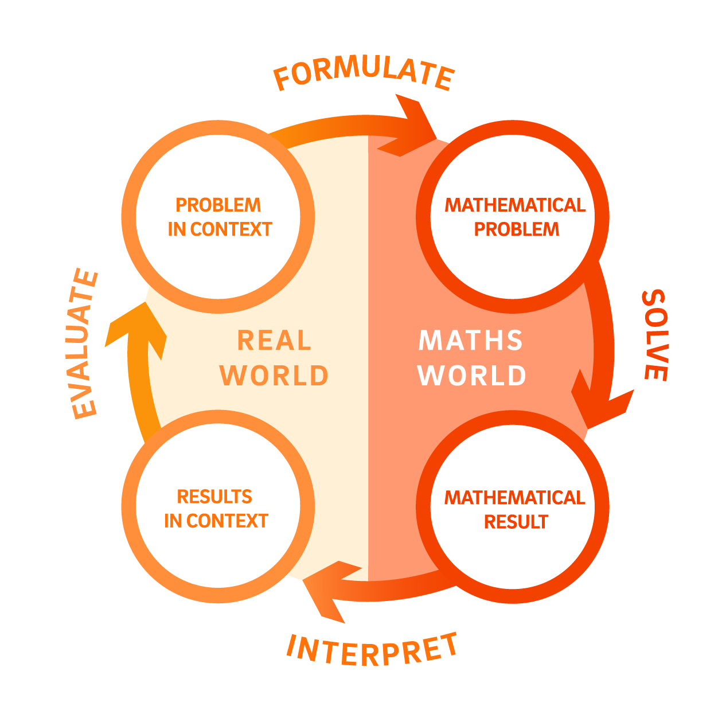

Slide 4
Lesson 1 • Comparing footprints

Slide 6
Comparing countries
Emissions Database for Global Atmospheric Research. (2025). EDGAR. https://edgar.jrc.ec.europa.eu/

Slide 7
Comparing countries and populations
Emissions Database for Global Atmospheric Research. (2025). EDGAR. https://edgar.jrc.ec.europa.eu/
United Nations Department of Economic and Social Affairs, Population Division. (n.d.). World Population Prospects. https://population.un.org/wpp/

Slide 8
Lesson 2 • Looking to the future

Slide 10
Carbon emissions from digital downloads
1GB produces 35-60g of CO₂
1 hour of high-definition (HD) video streaming typically requires the download of between 1.5GB and 3GB of data.
How much carbon would you produce in a week from streaming?

Slide 11
Downloads per premises in Australia
Year | Data downloaded per premises (GB per month)
2018 | 201
2019 | 255
2020 | 297
2021 | 331
2022 | 360
2023 | 424
2024 | 460
2025 | 508
NBN Co. (n.d.). Corporate information and reports. https://www.nbnco.com.au
Australian Competition and Consumer Commission. (n.d.). Telecommunications and internet reporting. https://www.accc.gov.au

Slide 12
Carbon emissions from digital downloads
1GB produces 35-60g of CO₂
What are the carbon implications for 10 years time if our digital downloads increase as predicted?

Slide 13
Lesson 3 • Growing downloads

Slide 15

Back in 2014…
The iPhone 6 was released in 2014. It had a 5-inch (12.7 cm) display with 16GB of storage.
How does this compare to current mobile phones?
As our phones have changed, so have app sizes. How significantly do you think these changes have been?

Slide 16
iOS app size changes over time
App | Size in MB
 | May 2015 | Nov 2015 | May 2016 | Nov 2016 | May 2017
Netflix | 20 | 30 | 35 | 80 | 110
Instagram | 10 | 20 | 32 | 60 | 100
YouTube | 50 | 50 | 60 | 100 | 120
Google Maps | 20 | 45 | 50 | 100 | 120
Messenger | 60 | 65 | 90 | 280 | 280
Spotify | 80 | 90 | 95 | 130 | 130
Snapchat | 20 | 80 | 100 | 140 | 190
Facebook | 100 | 110 | 150 | 300 | 390
Sensor Tower. The Size of iPhone’s Top Apps Has Increased by 1,000% in Four Years. Sensor Tower Blog, June 2017.

Slide 17
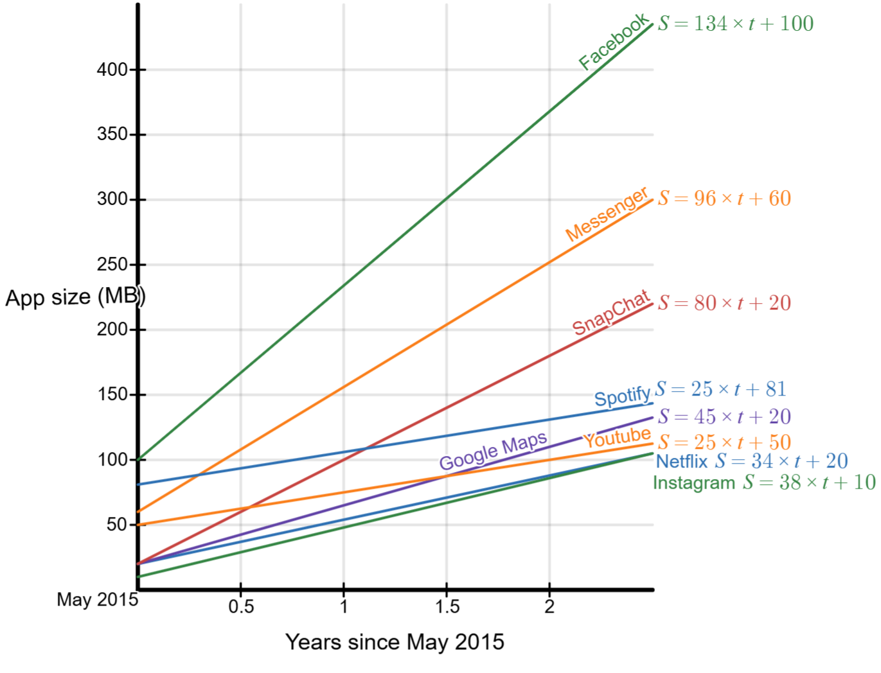
iOS app size changes over time

Slide 18
Lesson 4 • My screentime footprint

Slide 20
CO₂ emissions by activity
Activity | CO₂ emission rate | What if I did this in a day? | Daily emissions (kgs) | Ranking (1 = activity with highest CO2 emissions)
Sending a text message | 0.015g/message | 85 texts
Making a mobile call | 1.5g/min | 15 minutes
Streaming TV/video (HD) | 55g/hr | 70 minutes
Using GenAI (e.g. ChatGPT) | 2g/query | 6 queries
Online gaming (e.g. playing Fortnite) | 78g/hr | 30 minutes
Listening to a podcast | 8g/hr | 1 hour
Playing a mobile game (e.g. Candy Crush) | 2g/10 mins | 30 minutes
Making a video call | 12g/10 mins | 50 minutes
Scrolling social media | 2g/10 mins | 2.5 hours
Sending an email (no attachment) | 0.3g/email | 30 emails
Sending an email (with attachment) | 35g/email | 2 emails
Streaming music | 10g/hr | 2 hours 20 minutes

Slide 21
Estimated CO₂ emissions per person in Australia in 2024
Estimated CO₂ emissions – 380 million tonnes
Estimated population – 27 million people
What is the approximate rate of CO₂ emissions (in kgs) per person per year?
Approximately, what proportion of a person’s annual CO₂ emissions can be attributed to their online activity?
Emissions Database for Global Atmospheric Research. (n.d.). EDGAR. https://edgar.jrc.ec.europa.eu/
United Nations Department of Economic and Social Affairs, Population Division. (n.d.). World Population Prospects. https://population.un.org/wpp/

Slide 22
CO2 emissions reduction strategies
Activity | CO₂ emission rate | Reduction Strategy
Sending a text message | 0.015g/text
Making a mobile call | 1.5g/min
Streaming TV/video (HD) | 55g/hr
Using GenAI (e.g. ChatGPT) | 2g/query
Online gaming (e.g. playing Fortnite) | 78g/hr
Listening to a podcast | 8g/hr
Playing a mobile game (e.g. Candy Crush) | 2g/10 min
Making a video call | 12g/10 min
Scrolling social media | 2g/10 min
Sending an email (no attachment) | 0.3g/email
Sending an email with an attachment | 35g/attachment
Streaming music | 10g/hr

Slide 23
CO2 emissions reduction strategies
Activity | CO₂ emission rate | Reduction Strategy
Sending a text message | 0.015g/text | Send less messages with images and videos; use traditional SMS when possible
Making a mobile call | 1.5g/min | Avoid making unnecessary calls
Streaming TV/video (HD) | 55g/hr | Lower video resolution; download rather than stream
Using GenAI (e.g. ChatGPT) | 2g/query | Use pre-trained models
Online gaming (e.g. playing Fortnite) | 78g/hr | Lower in-game graphic settings
Listening to a podcast | 8g/hr | Download rather than stream
Playing a mobile game (e.g. Candy Crush) | 2g/10 min | Lower in-game graphic settings
Making a video call | 12g/10 min | Use voice calls instead of video calls
Scrolling social media | 2g/10 min | Use lower resolutions; disable video autoplay
Sending an email (no attachment) | 0.3g/email | Send fewer emails; unsubscribe from junk emails
Sending an email with an attachment | 35g/attachment | Save large files to a cloud service and send a link instead of attaching
Streaming music | 10g/hr | Download rather than stream

