Slide 1
The secret patterns behind string art
(Y6)

Slide 2
Task 1 • One line

Slide 3
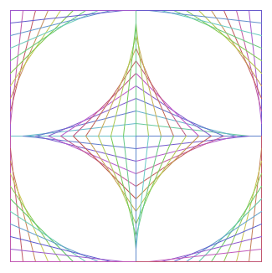
String art
What do you notice?
What do you wonder?

Slide 4

Where is it?

Slide 5

Making the problem easier
Let’s make just this section first.

Slide 6
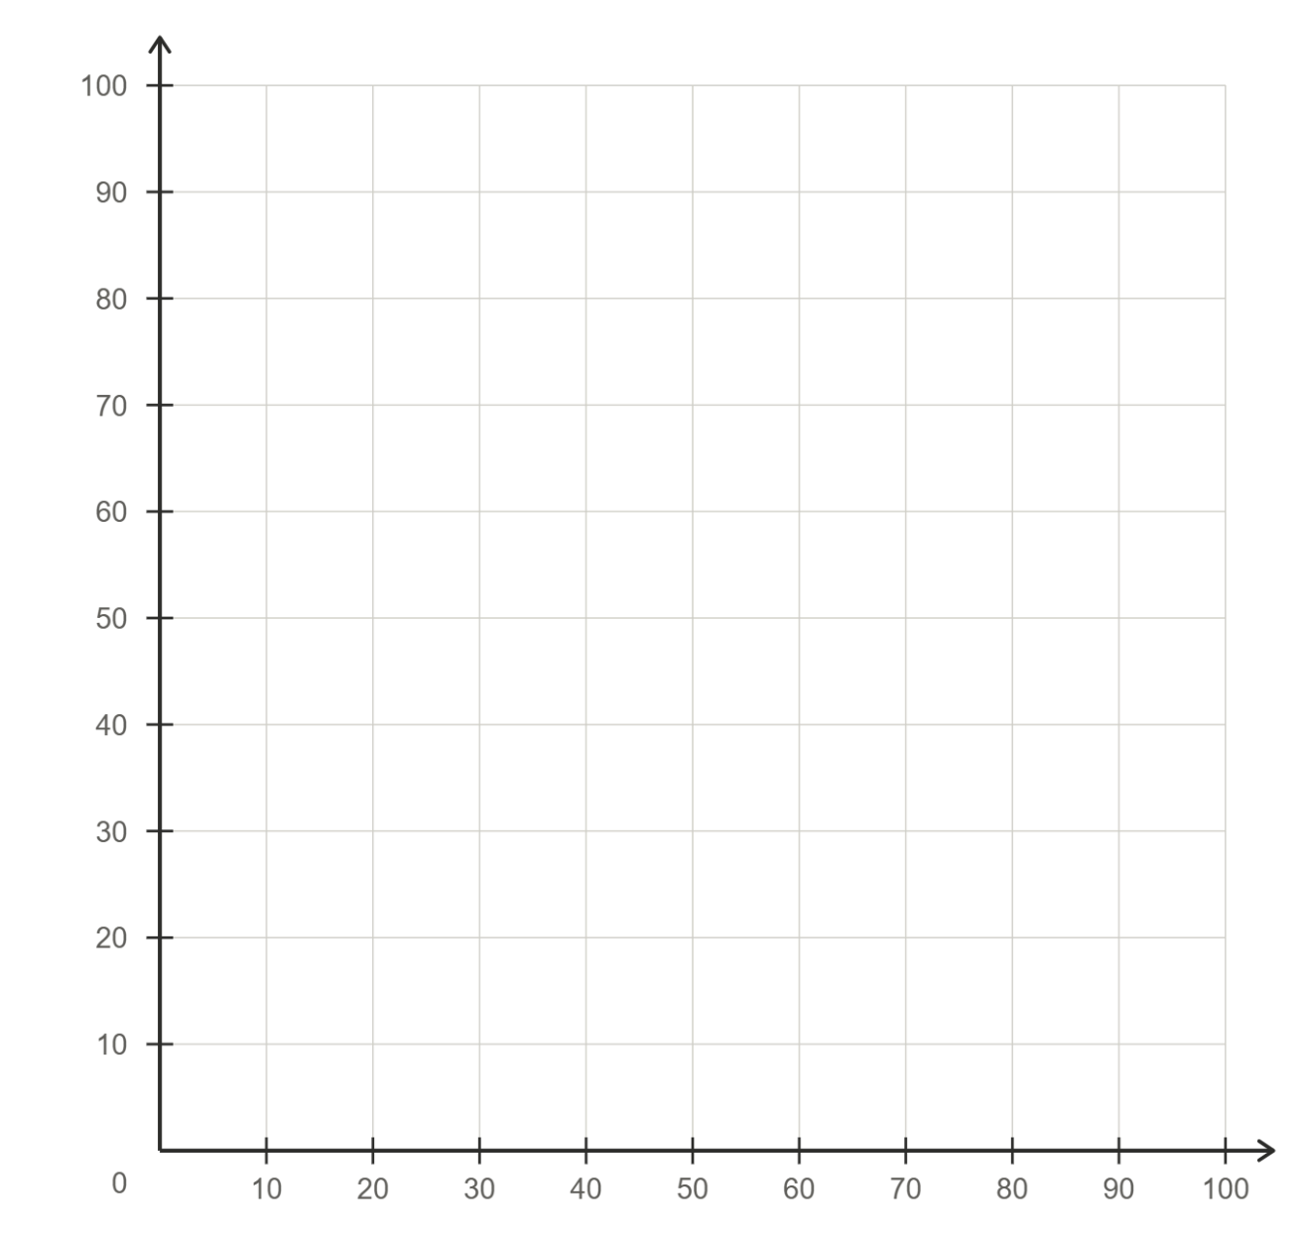
Finding patterns
What’s the same? What’s different?
Start point | End point

Slide 7
Finding patterns
What’s the same? What’s different?
Start point | End point
(100, 0) | (0, 0)

Slide 8
Finding patterns
What’s the same? What’s different?
Start point | End point
(100, 0) | (0, 0)
(90, 0) | (0, 10)

Slide 9
Finding patterns
What’s the same? What’s different?
Start point | End point
(100, 0) | (0, 0)
(90, 0) | (0, 10)
(80, 0) | (0, 20)

Slide 10
Finding patterns
What’s the same? What’s different?
Start point | End point
(100, 0) | (0, 0)
(90, 0) | (0, 10)
(80, 0) | (0, 20)
(70, 0) | (0, 30)
(60, 0) | (0, 40)
(50, 0) | (0, 50)
(40, 0) | (0, 60)
(30, 0) | (0, 70)
(20, 0) | (0, 80)
(10, 0) | (0, 90)
(0, 0) | (0, 100)

Slide 11
Task 2 • Drawing Scratch

Slide 12
Finding patterns
What’s the same? What’s different?
Start point | End point
(100, 0) | (0, 0)
(90, 0) | (0, 10)
(80, 0) | (0, 20)
(70, 0) | (0, 30)
(60, 0) | (0, 40)
(50, 0) | (0, 50)
(40, 0) | (0, 60)
(30, 0) | (0, 70)
(20, 0) | (0, 80)
(10, 0) | (0, 90)
(0, 0) | (0, 100)

Slide 13
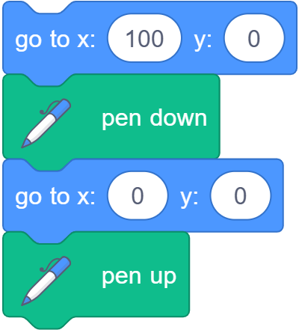
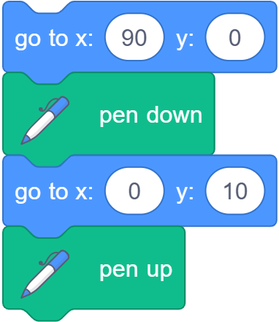

Looking for patterns in our code

Slide 14
Task 3 • One instruction, 11 lines

Slide 15
Looking for patterns in our code

Slide 16
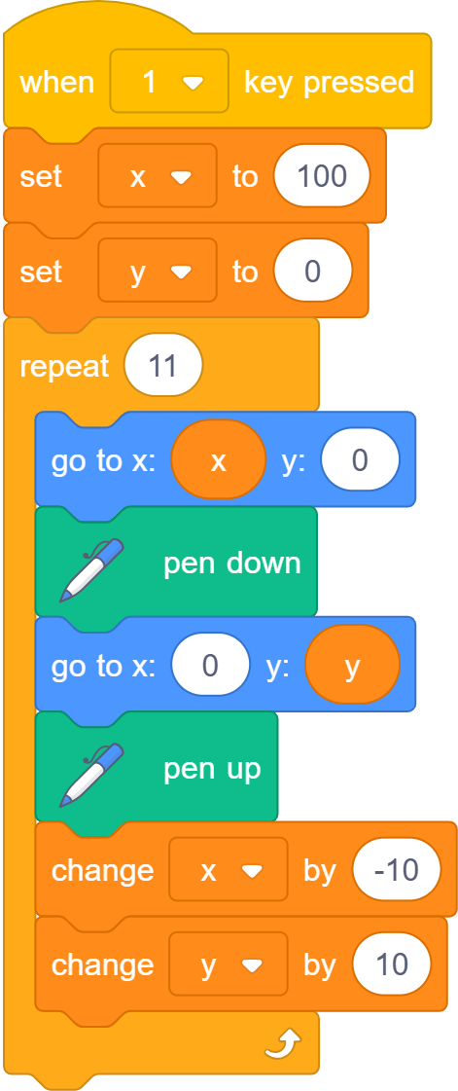
Walking through a loop
Start point | End point
(100, 0) | (0, 0)
x = 100
y = 0
100
0
x becomes 100 – 10
y becomes 0 + 10

Slide 17
Walking through a loop
Start point | End point
(100, 0) | (0, 0)
(90, 0) | (0, 10)
x = 90
y = 10
90
10
x becomes 90 – 10
y becomes 10 + 10

Slide 18
Walking through a loop
Start point | End point
(100, 0) | (0, 0)
(90, 0) | (0, 10)
(80, 0) | (0, 20)
x = 80
y = 20
80
20
x becomes 80 – 10
y becomes 20 + 10

Slide 19
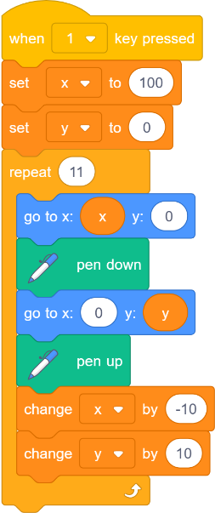
Are loops worth it?

Slide 20
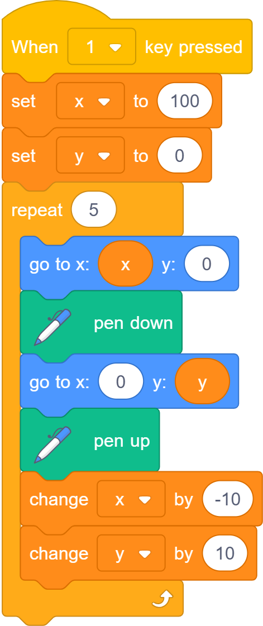
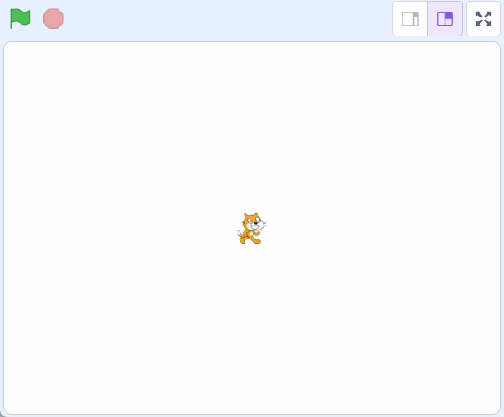
1. How will our picture change?

Slide 21

2. How will our picture change?

Slide 22

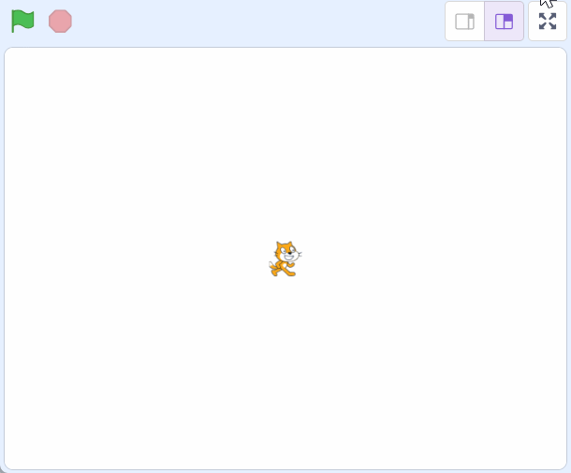
3. How will our picture change?

Slide 23
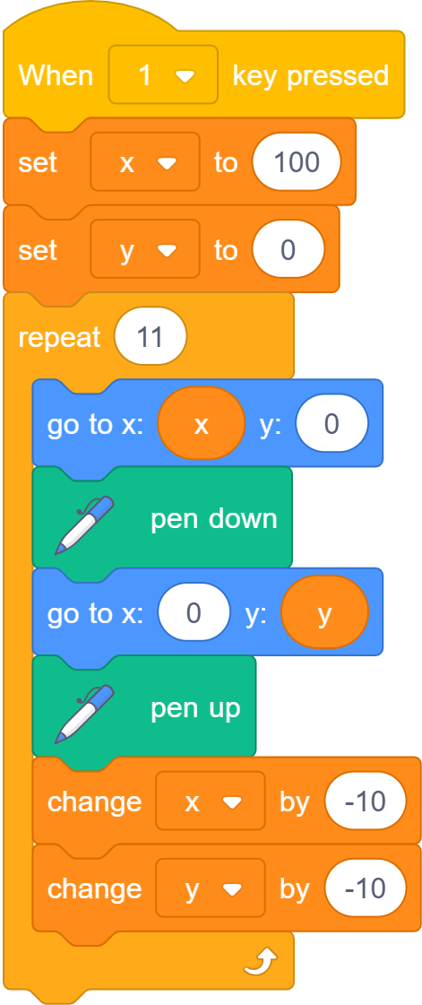
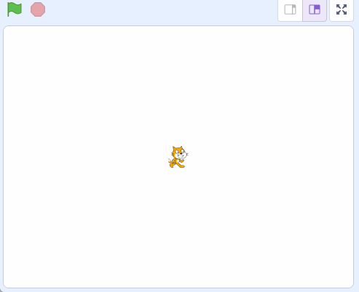
4. What code produces this picture?

Slide 24
Task 4 • The other side of zero

Slide 25
How can we make the whole picture?
We’ve drawn the first section. How can we draw the rest?

Slide 26
Where is it?
(↔, ↕)

Slide 27
Where is it?
(↔, ↕)
(-5, 2)
(5, 1)
The origin: (0, 0)
(3, -2)
(-2, -3)

Slide 28
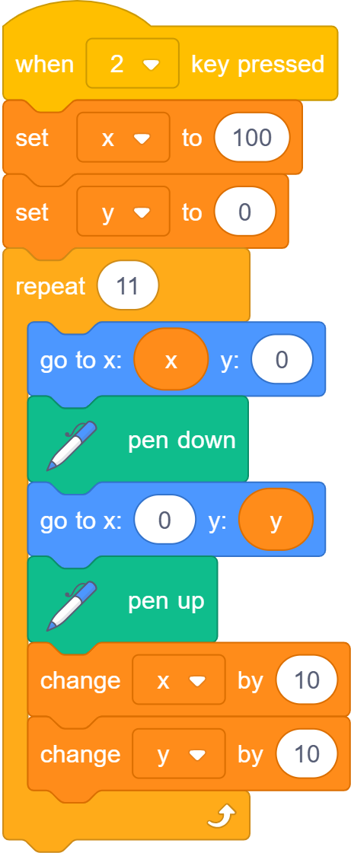
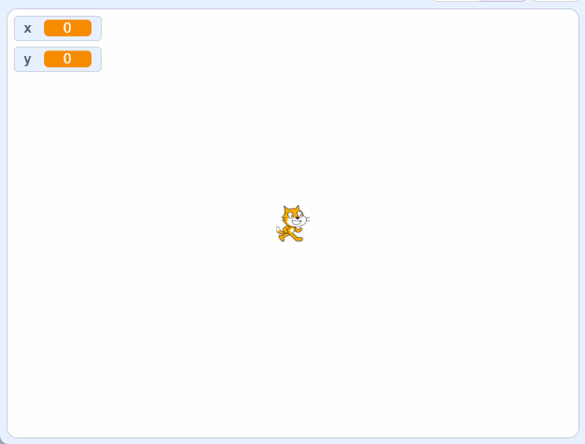
1. What will happen?

Slide 29
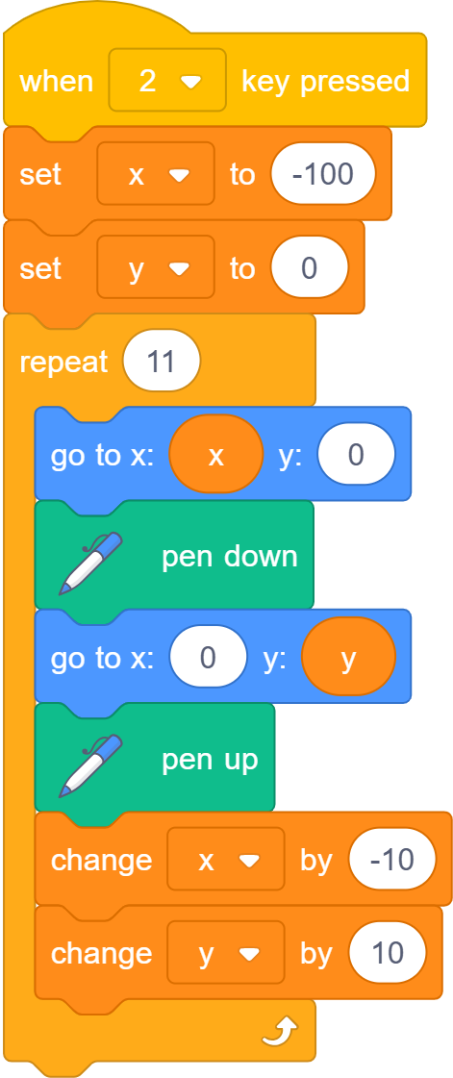
2. What will happen?

Slide 30
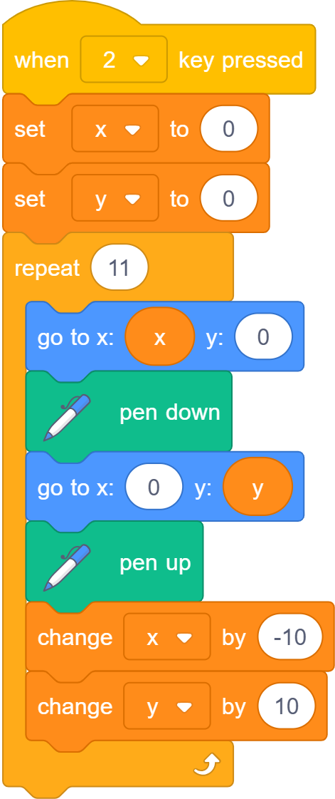
3. What will happen?

Slide 31
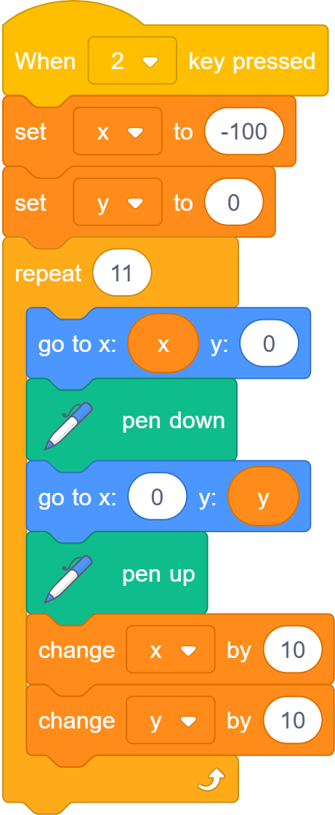
What’s the same? What’s different?

Slide 32
Task 5 • The whole picture

Slide 33
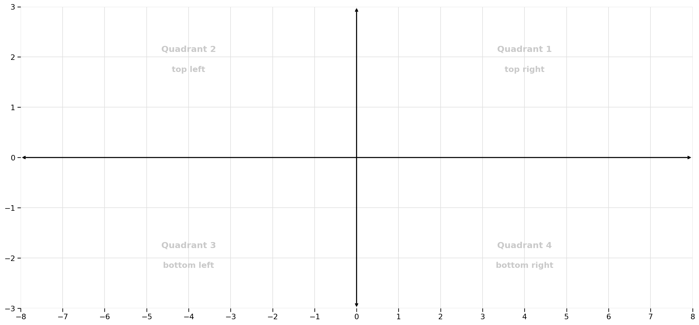
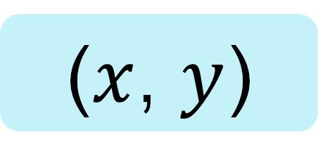




Where would you find…
($x$, $y$)
(↔, ↕)
$$y$$
$$−x$$
$$x$$
$$−y$$

Slide 34
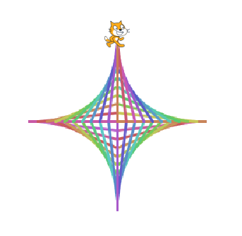
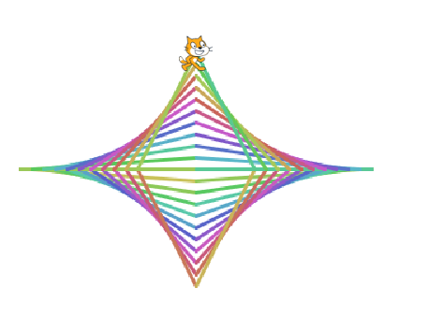

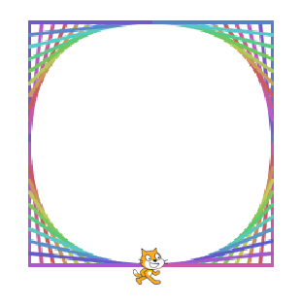
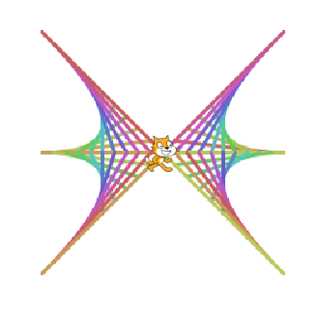
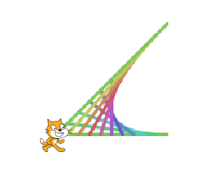
String art designs to try

Slide 35
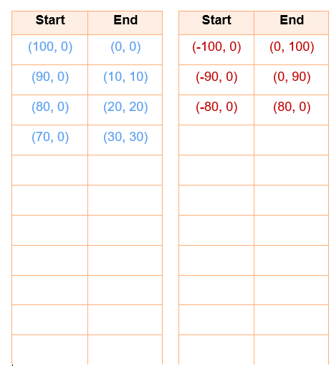
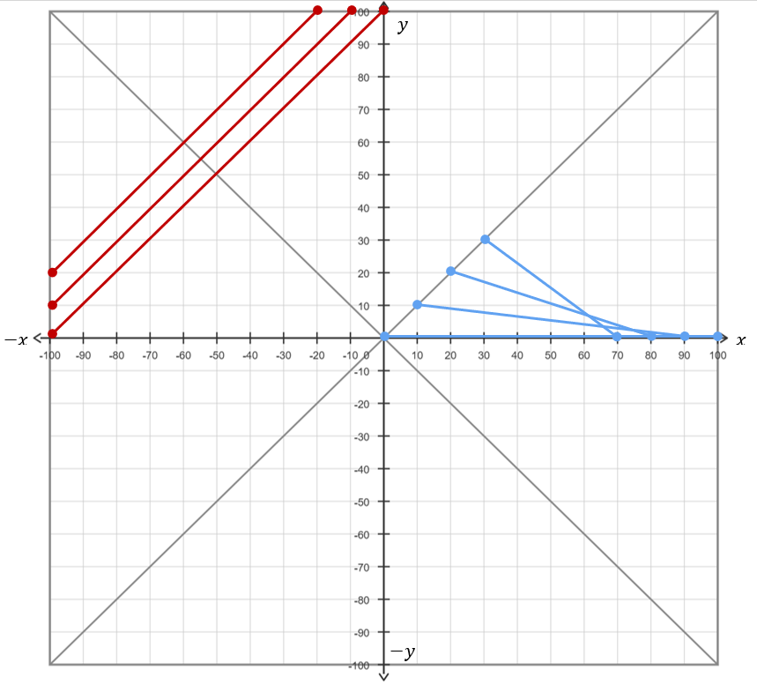
Designing your own art

