Slide 1
Space: Supermarket networks
(Y10)

Slide 2
Task 1 • Supermarket navigation

Slide 3
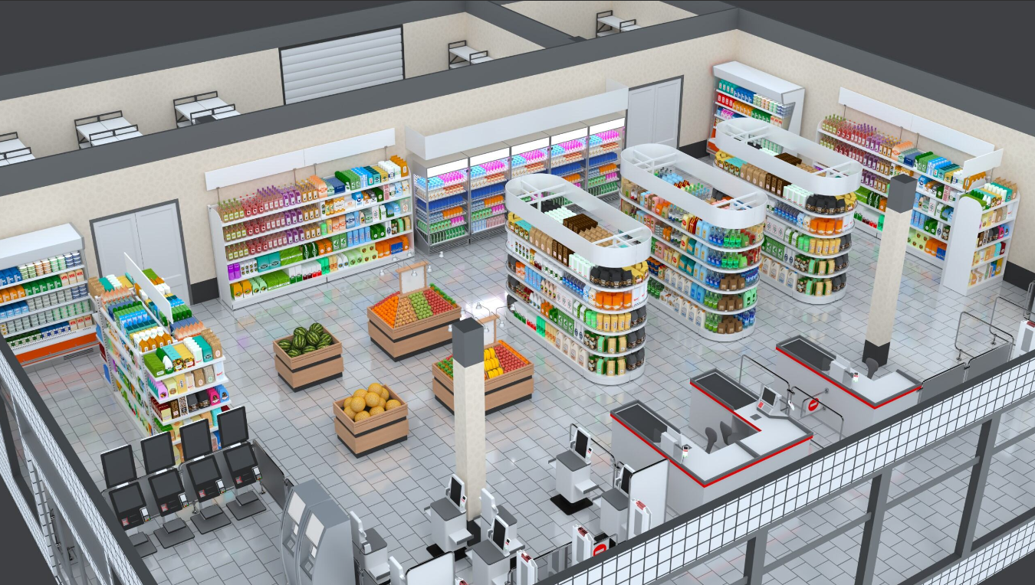
The supermarket
wir0man Stock Image and Video Portfolio – iStock

Slide 4
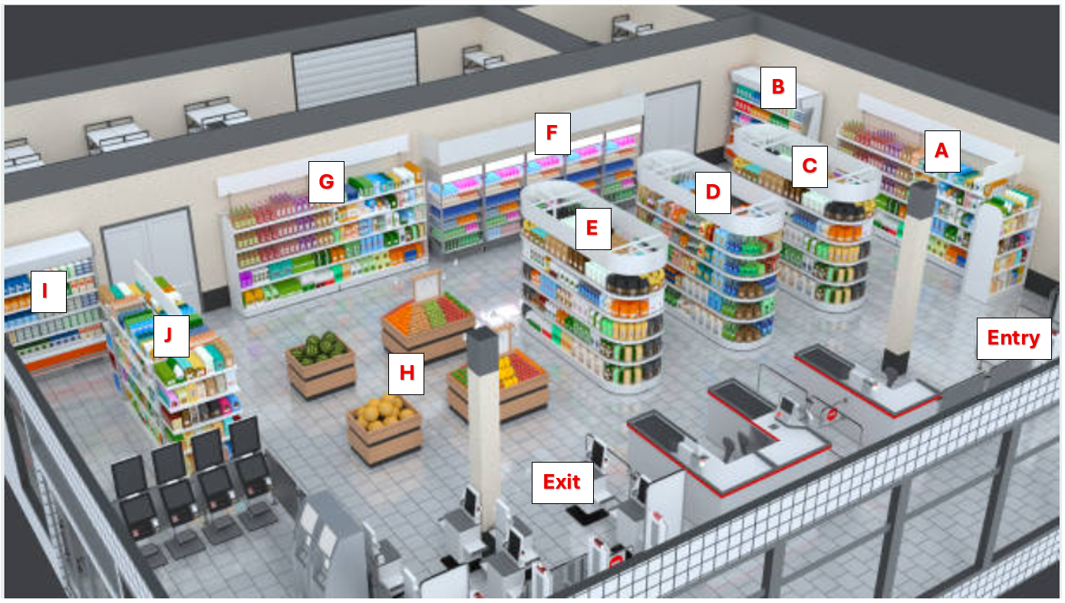
A quick shopping trip
Grocery item | Location
Ice cream | A
Yoghurt | F
Bread | J
Soap | D

Slide 5
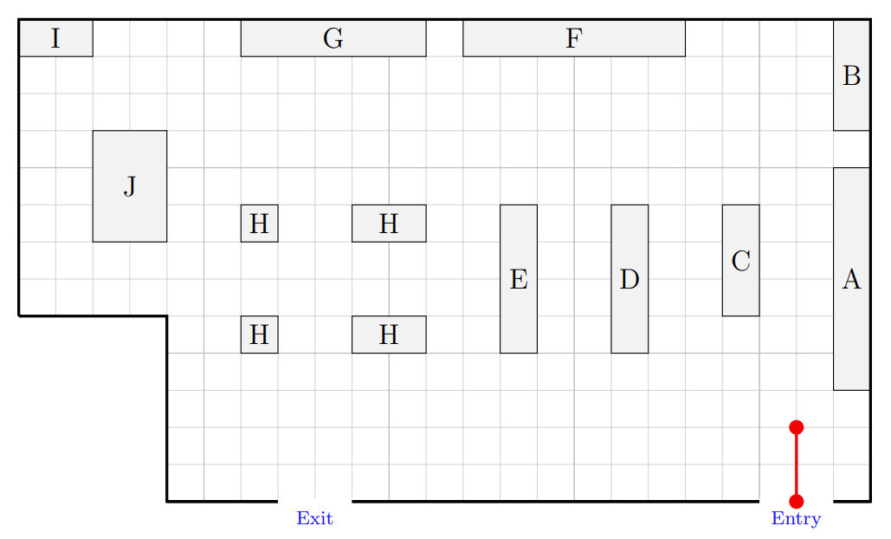
2D representation

Slide 6
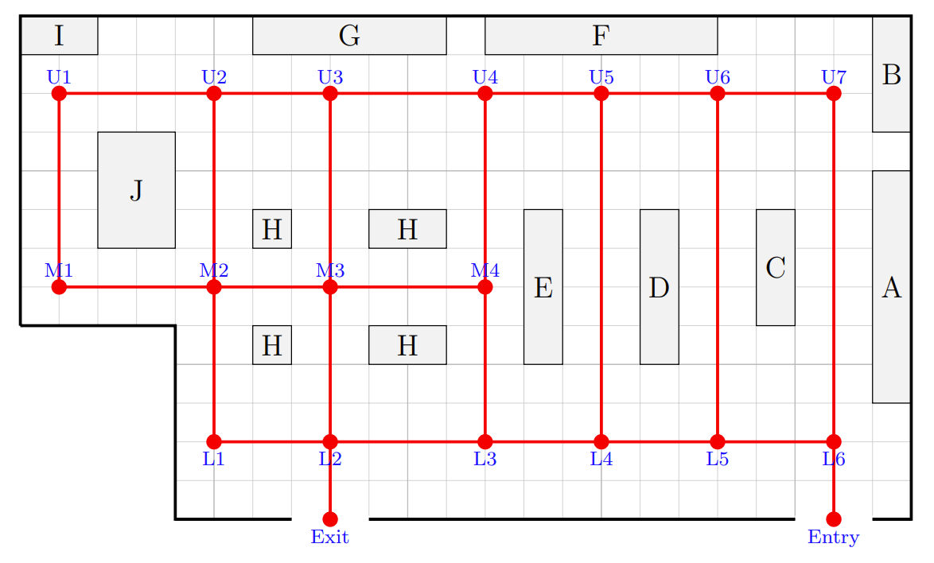
A possible network

Slide 7
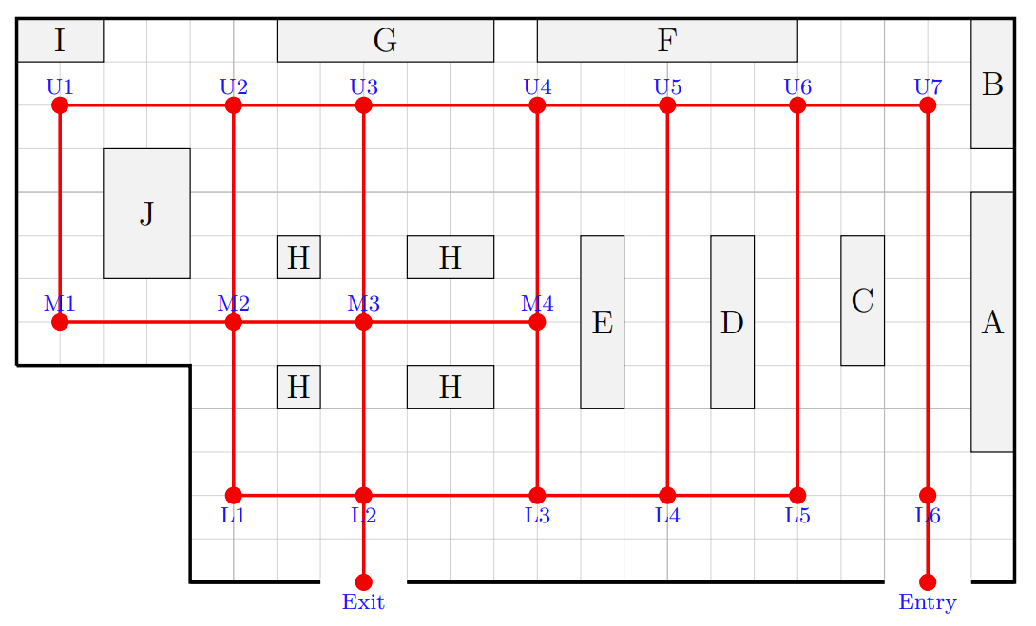
Spill blocking L6 to L5

Slide 8
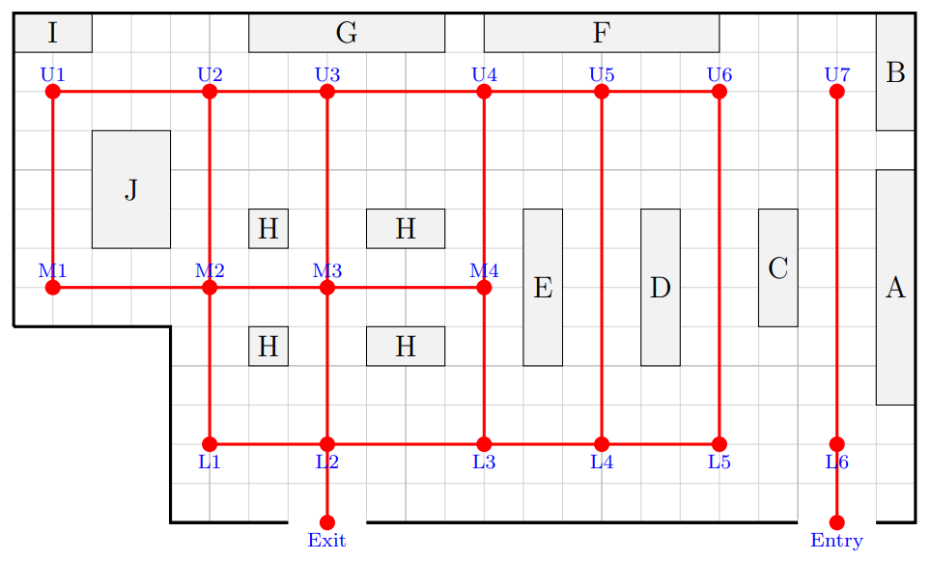
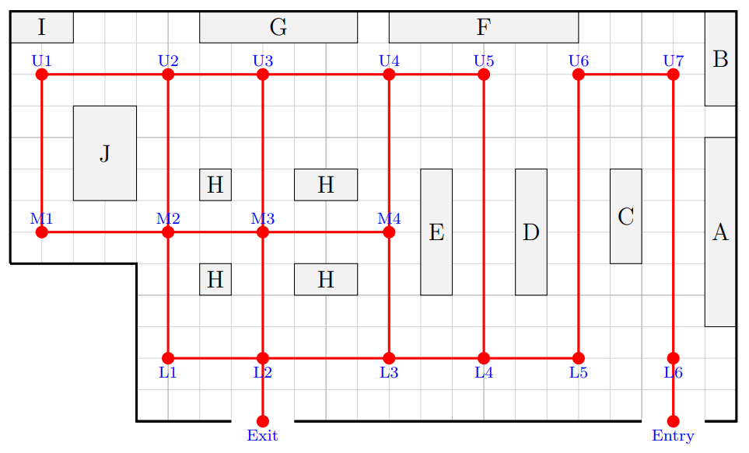
Cutting more edges

Slide 9
Task 2 • Network diagrams

Slide 10
Supermarket paths
How many different paths are possible from entry to exit if no vertex is passed through more than once?

Slide 11
Algorithm
Complete the algorithm to generate all possible Entry to Exit paths.
If a branch gets stuck, go back to the last choice point.
1
If a branch reaches Exit, record the full path.
2
Continue until every branch has been explored.
3
If there is only one possible next move, follow it.
4
If there is more than one possible next move, create a new branch for each option.
5
Move to a connected vertex that has not already been used in that path.
6
7
Start at Entry.

Slide 12
Using the algorithm
Start at Entry.
Move to a connected vertex that has not already been used in that path.
If there is only one possible next move, follow it.
If there is more than one possible next move, create a new branch for each option.
If a branch reaches Exit, record the full path.
If a branch gets stuck, go back to the last choice point.
Continue until every branch has been explored.
Entry →
L6 → U7 → U6
→ U5…
→ L5
→ L4
→ U5…
→ L3
→ M4…
→ L2
→ M3…
→ L1…
→ Exit
Entry → L6 → U7 → U6 → L5 → L4 → L3 → L2 → Exit

Slide 13
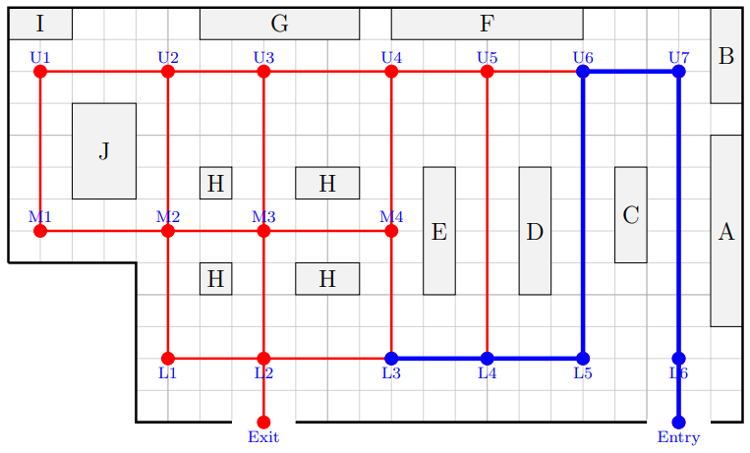
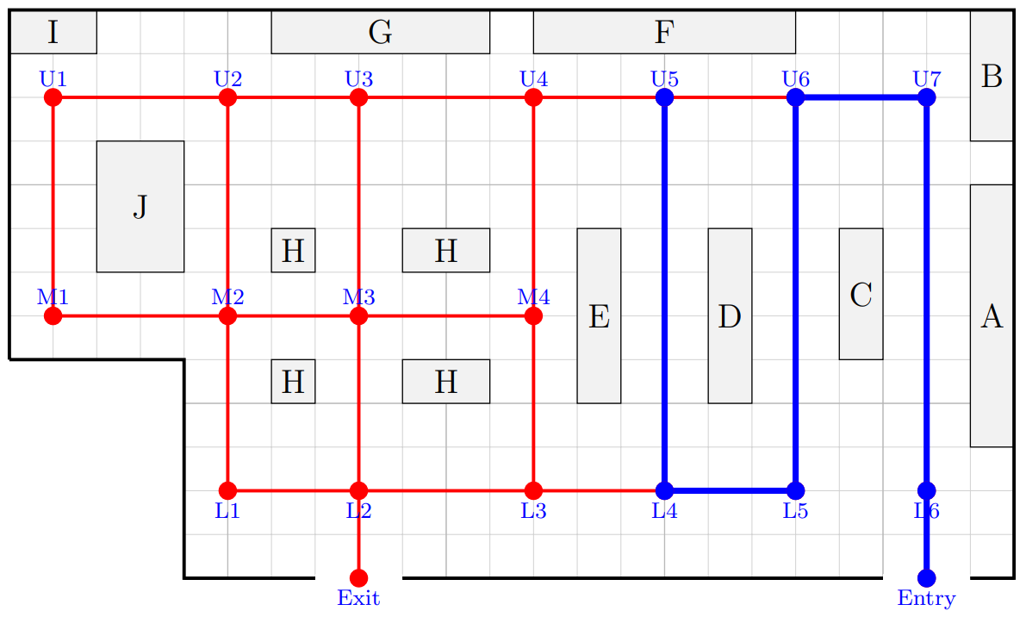
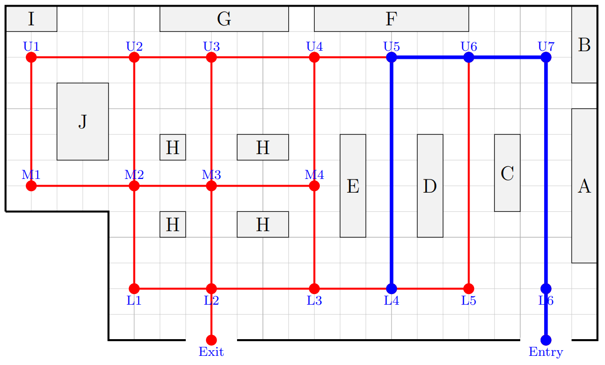
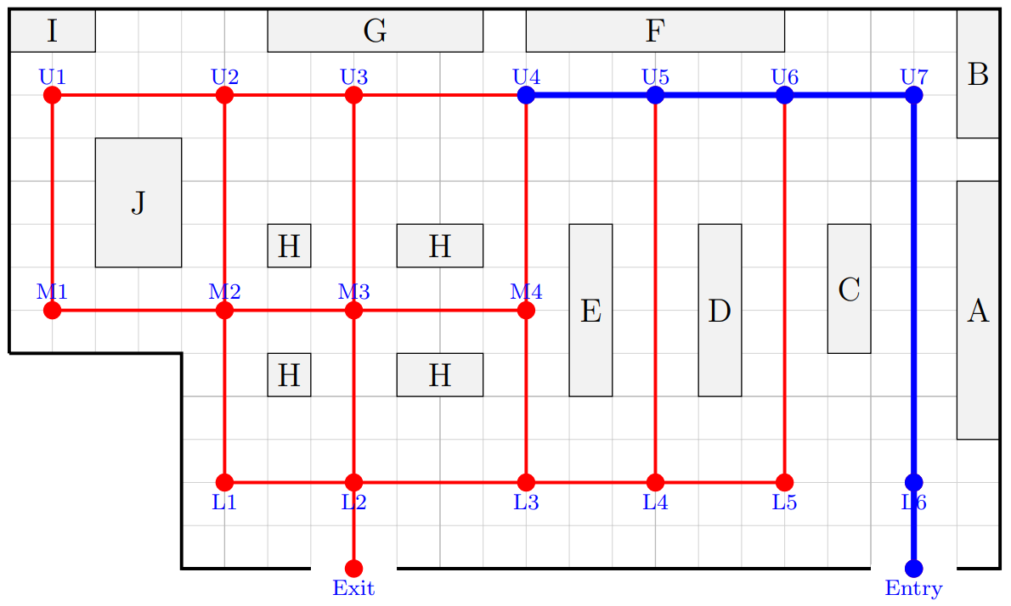
Breaking into sub-networks
Group 1: Entry → L6 → U7 → U6 → L5 → L4 → L3 → | Group 2: Entry → L6 → U7 → U6 → L5 → L4 → U5 →
Group 3: Entry → L6 → U7 → U6 → U5 → L4 → | Group 4: Entry → L6 → U7 → U6 → U5 → U4 →

Slide 14
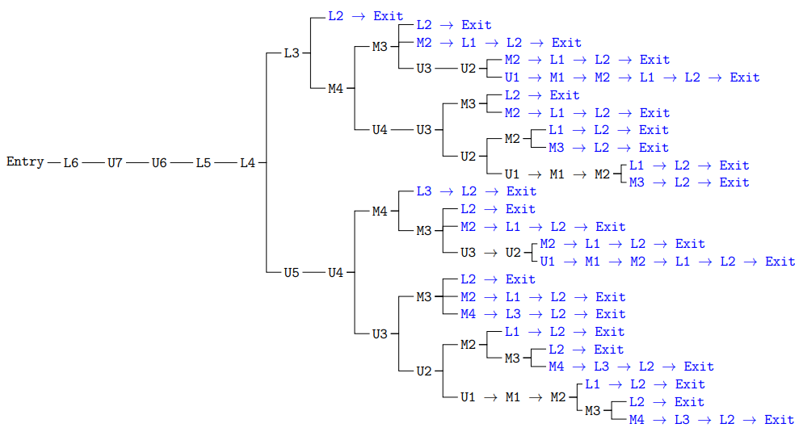
Total paths from Entry to Exit (Groups 1 & 2)
Group 1 → 11 paths
Group 2 → 14 paths

Slide 15
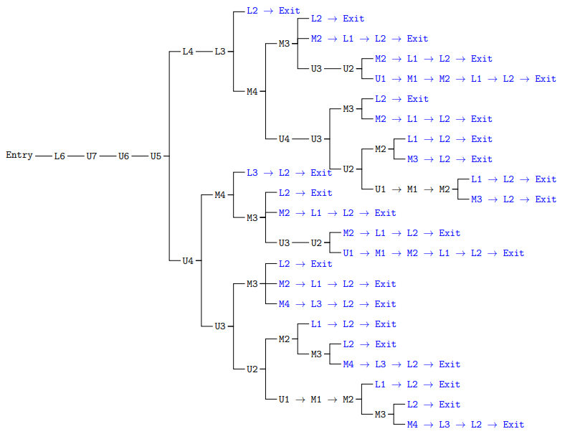
Total paths from Entry to Exit (Groups 3 & 4)
Group 3 → 11 paths
Group 4 → 14 paths

Slide 16
Total paths from Entry to Exit
The spill is now cleared up. How many ways can we travel from Entry to Exit without moving through a vertex more than once?

Slide 17
Task 3 • Shortest paths

Slide 18
Entry to Exit
What is the shortest path from Entry to Exit?

Slide 19
Edge distances
Each grid square represents one metre. Label the length of each edge.
4
3
4
3
3
3
5
5
5
5
4
3
4
9
9
9
4
4
4
3
4
3
3
2
2

Slide 20
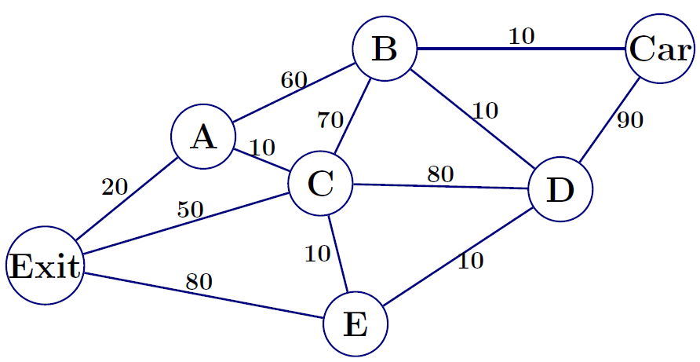
Carpark network 1

Slide 21
Carpark network 1 – greedy algorithm
Apply the algorithm to find a path from Exit vertex to the Car vertex.
Start at the Exit vertex.
From your current vertex, choose the shortest connected edge to an unused vertex.
Move to that next vertex.
Repeat until you reach the Car vertex.
Distance using Greedy algorithm = 20 + 10 + 10 + 10 + 10 + 10
= 70 metres

Slide 22
Carpark network 1 – all paths
There are 28 paths from Exit to Car that don’t repeat a vertex.
Path | Distance
Exit → A → B → Car | 90
Exit → A → B → D → Car | 180
Exit → A → B → C → D → Car | 320
Exit → A → B → C → E → D → Car | 260
Exit → A → C → B → Car | 110
Exit → A → C → B → D → Car | 200
Exit → A → C → D → Car | 200
Exit → A → C → D → B → Car | 130
Exit → A → C → E → D → Car | 140
Exit → A → C → E → D → B → Car | 70
Exit → C → B → Car | 130
Exit → C → B → D → Car | 220
Exit → C → A → B → Car | 130
Exit → C → A → B → D → Car | 220
Path | Distance
Exit → C → D → Car | 220
Exit → C → D → B → Car | 150
Exit → C → E → D → Car | 160
Exit → C → E → D → B → Car | 90
Exit → E → D → Car | 180
Exit → E → D → B → Car | 110
Exit → E → D → C → B → Car | 250
Exit → E → D → C → A → B → Car | 250
Exit → E → C → B → Car | 170
Exit → E → C → B → D → Car | 260
Exit → E → C → A → B → Car | 170
Exit → E → C → A → B → D → Car | 260
Exit → E → C → D → Car | 260
Exit → E → C → D → B → Car | 190

Slide 23
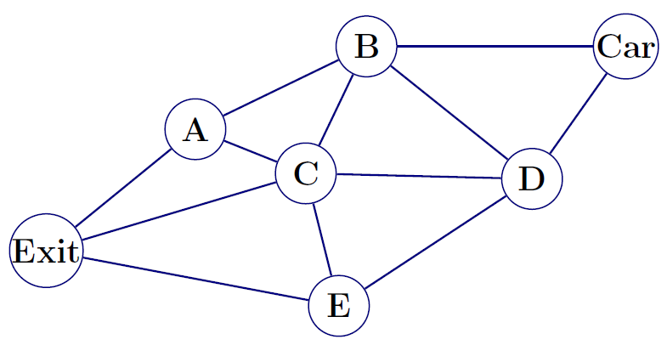
Carpark network 2
Can you assign edge distances to this network so the greedy algorithm fails?

Slide 24
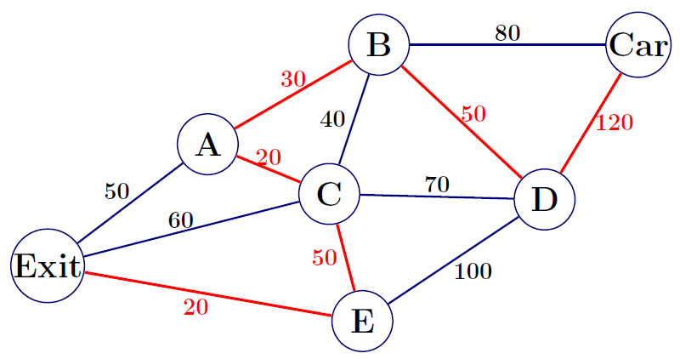
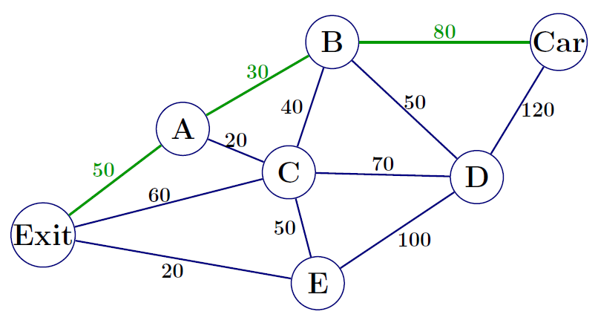
Greedy algorithm failure
Greedy algorithm Distance by greedy algorithm = 290 metres | Actual shortest path Shortest path distance = 160 metres

Slide 25
Task 4 • Shortest path algorithms

Slide 26
Greedy algorithm failure
Greedy algorithm Distance by greedy algorithm = 290 metres | Actual shortest path Shortest path distance = 160 metres

Slide 27
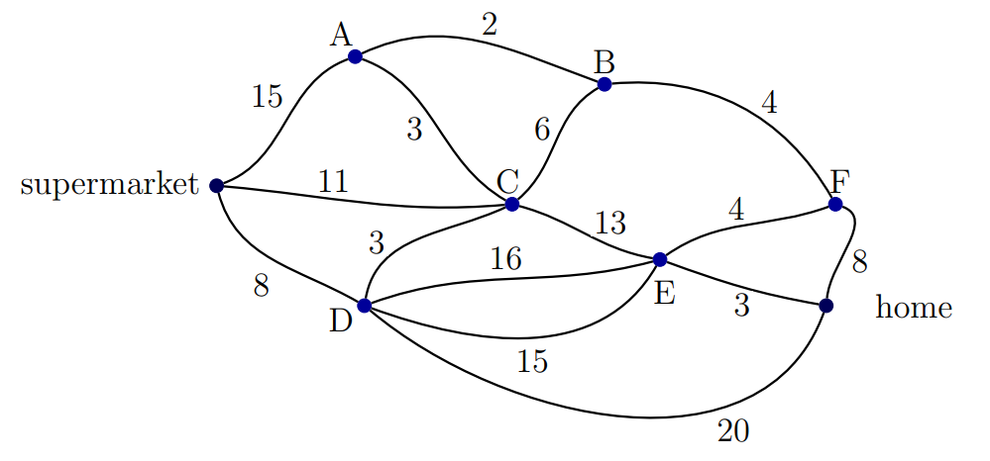
Journey home – road network 1

Slide 28
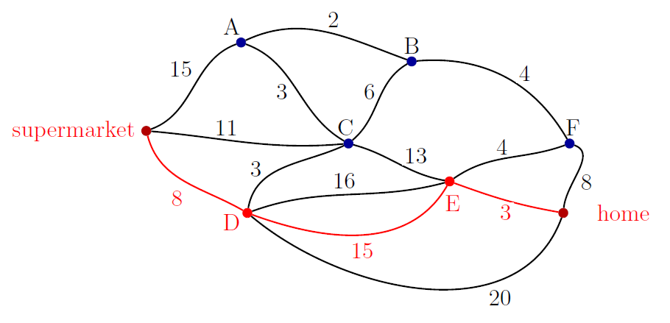
Journey home – Road network 1 solution
Shortest path = supermarket → D → E → home
Quickest time = 8 + 15 + 3 = 26 minutes

Slide 29
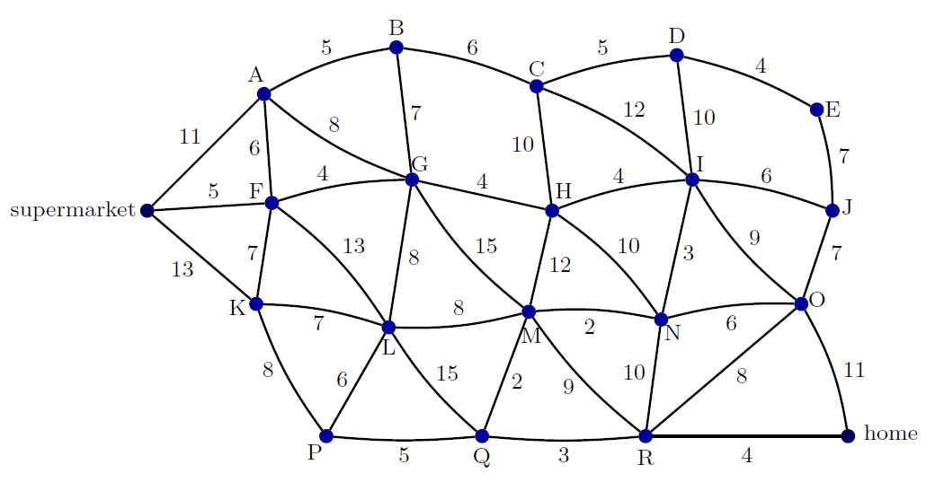
Journey home – Road network 2

Slide 30
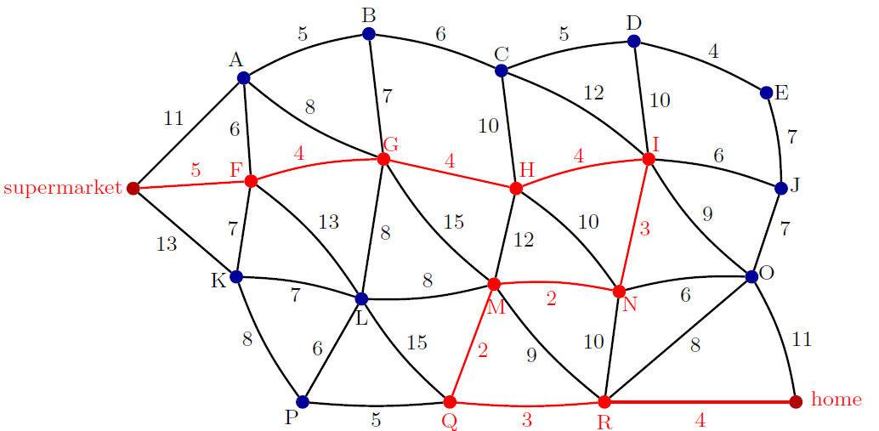
Journey home – Road network 2 solution
Shortest Path = supermarket → F → G → H → I → N → M → Q → R → 4 → home
Quickest time = 5 + 4 + 4 + 4 + 3 + 2 + 2 + 3 + 4 = 31 minutes

Slide 31
Dijkstra’s Algorithm
Write 0 at the starting vertex and draw a box around it.
For all connecting vertices from this newly boxed vertex, add the value of the edge and write this at the connected vertex.
Draw a box around the smallest unboxed distance at any vertex in the network.
For all unboxed vertices that can be reached from the newly boxed vertex, add the value of each edge. If an unboxed vertex already has a value, replace it with the new value only if the new value is smaller.
Repeat steps 3 and 4 until the end vertex is boxed.
To find the path, record where each shortest distance came from.
60
70
80
20
140
0
50
110
30
50
80
40
Shortest Path = Exit → A → B → Car
Shortest distance = 70 metres

Slide 32
Task 5 • Supermarket checkouts

Slide 33
Single shared queues or individual queues
Shared queue
Individual queues
Two checkouts, working at the same speed
One line of customers
Customer at front of line goes to next available checkout
All customers are already at the checkout area
Each customer has an allocated service time
Two checkouts, working at the same speed
Two lines of customers
Each new customer joins the queue with the fewest people
If two queues are the same length, the customer joins the queue for Checkout 1
Each customer has an allocated service time

Slide 34
Individual queues
Each customer is now in a queue.
Customer | Service Time (seconds)
1 | 60
2 | 80
3 | 30
4 | 120
5 | 80
6 | 50
7 | 150
8 | 100
Checkout 1
6
7
5
3
1
4
2
8
Checkout 2

Slide 35
Individual queues solutions
Customer | Service time (s) | Checkout | Start time (s) | Finish time (s) | Waiting time (s)
1 | 60 | 1 | 0 | 60 | 0
2 | 80 | 2 | 0 | 80 | 0
3 | 30 | 1 | 60 | 90 | 60
4 | 120 | 2 | 80 | 200 | 80
5 | 80 | 1 | 90 | 170 | 90
6 | 50 | 2 | 200 | 250 | 200
7 | 150 | 1 | 170 | 320 | 170
8 | 100 | 2 | 250 | 350 | 250
Average wait time = 106.25s

Slide 36
Single shared queue
Each customer waits for the next available checkout.
Checkout 1
Customer | Service Time (seconds)
1 | 60
2 | 80
3 | 30
4 | 120
5 | 80
6 | 50
7 | 150
8 | 100
8
7
6
5
4
3
2
1
Checkout 2

Slide 37
Shared queue solutions
Customer | Service time (s) | Checkout | Start time (s) | Finish time (s) | Waiting time (s)
1 | 60 | 1 | 0 | 60 | 0
2 | 80 | 2 | 0 | 80 | 0
3 | 30 | 1 | 60 | 90 | 60
4 | 120 | 2 | 80 | 200 | 80
5 | 80 | 1 | 90 | 170 | 90
6 | 50 | 1 | 170 | 220 | 170
7 | 150 | 2 | 200 | 350 | 200
8 | 100 | 1 | 220 | 320 | 220
Average wait time = 102.5s

Slide 38
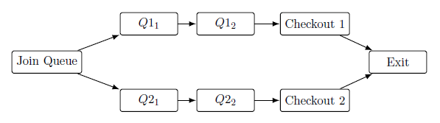
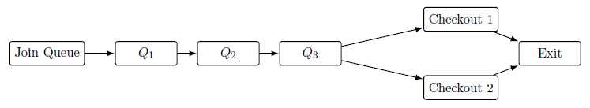
Modelling the checkouts as networks
Individual queues
Shared queues

Slide 39
Shared queue with staggered arrivals
Customer | Arrival time | Service time | Checkout | Start time | Finish time | Waiting time
1 | 0 | 60
2 | 30 | 80
3 | 60 | 30
4 | 90 | 120
5 | 120 | 80
6 | 150 | 50
7 | 180 | 150
8 | 210 | 100
1
0
60
0
2
30
110
0

Slide 40
Shared queue with staggered arrivals (answers)
Customer | Arrival time | Service time | Checkout | Start time | Finish time | Waiting time
1 | 0 | 60 | 1 | 0 | 60 | 0
2 | 30 | 80 | 2 | 30 | 110 | 0
3 | 60 | 30 | 1 | 60 | 90 | 0
4 | 90 | 120 | 1 | 90 | 210 | 0
5 | 120 | 80 | 2 | 120 | 200 | 0
6 | 150 | 50 | 2 | 200 | 250 | 50
7 | 180 | 150 | 1 | 210 | 360 | 30
8 | 210 | 100 | 2 | 250 | 350 | 40
Average waiting time = 15 seconds

Slide 41
Queueing simulation
How does the average service time affect waiting times?
How does the arrival rate of customers affect waiting times?
At what point does the average service time make customer waiting times too large? How long do you think customers are prepared to wait?
What would you recommend to the supermarket manager?

Slide 42
Computational thinking processes
Abstracting real-world situations by representing them as mathematical models such as networks
Decomposing complex problems into smaller, more manageable parts
Recognising patterns and using them to develop systematic algorithms
Testing, debugging and refining algorithms and models to improve their reliability
Using digital tools to simulate models, test ideas and explore the effect of changing variables

