Slide 1
Statistics: Time to play
(Y5)

Slide 2
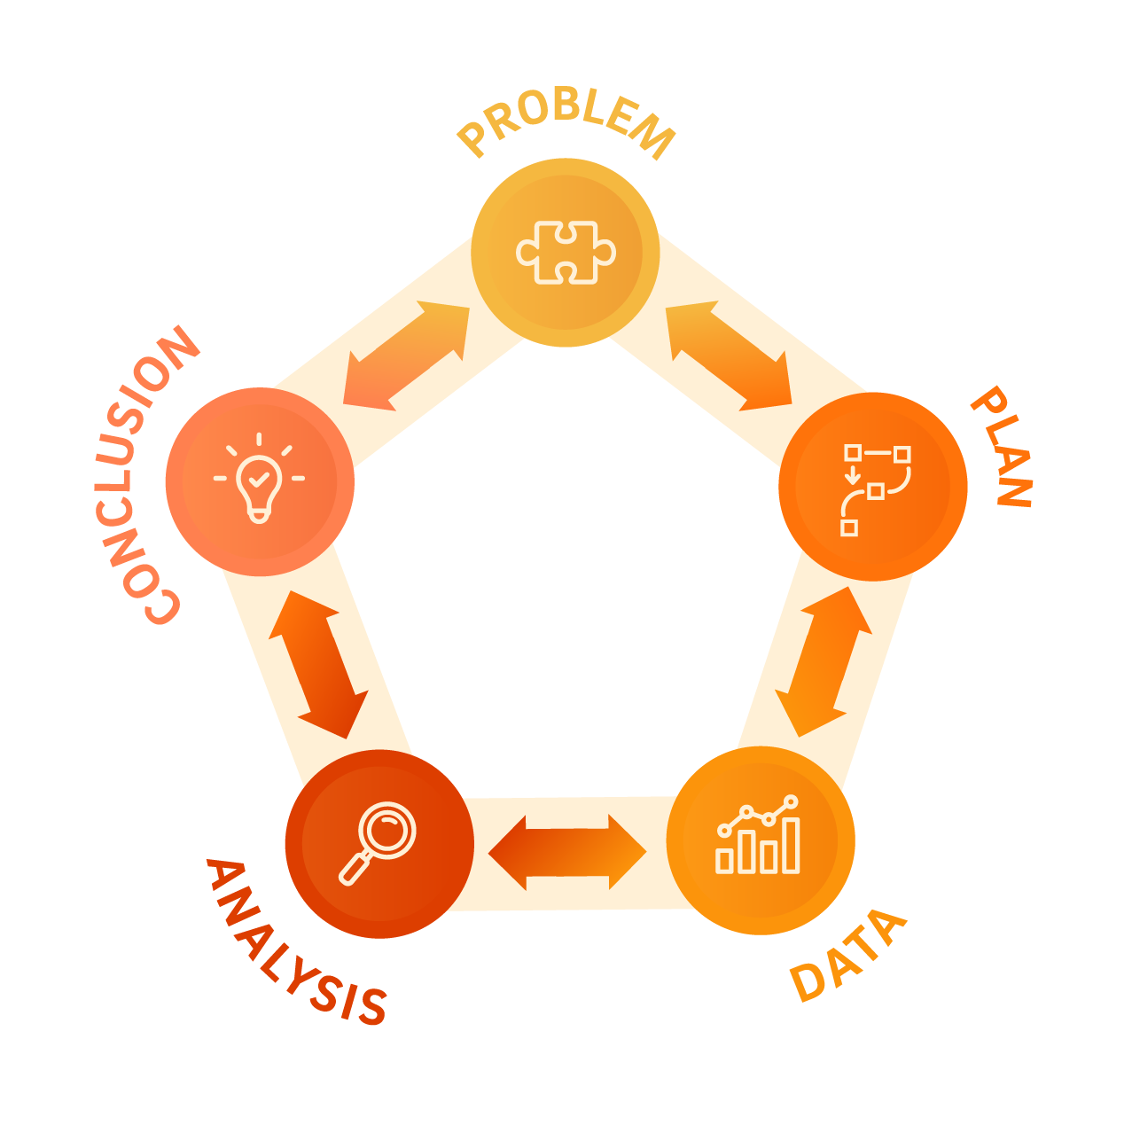

Slide 3
Lesson 1 • Playing outside

Slide 5
Data collection plan
What was the best time of day to play outside yesterday during school hours?
What information do we need to collect to answer the question?
How will we collect our data?
How will we record our data?

Slide 6
Lesson 2 • Weather data

Slide 8
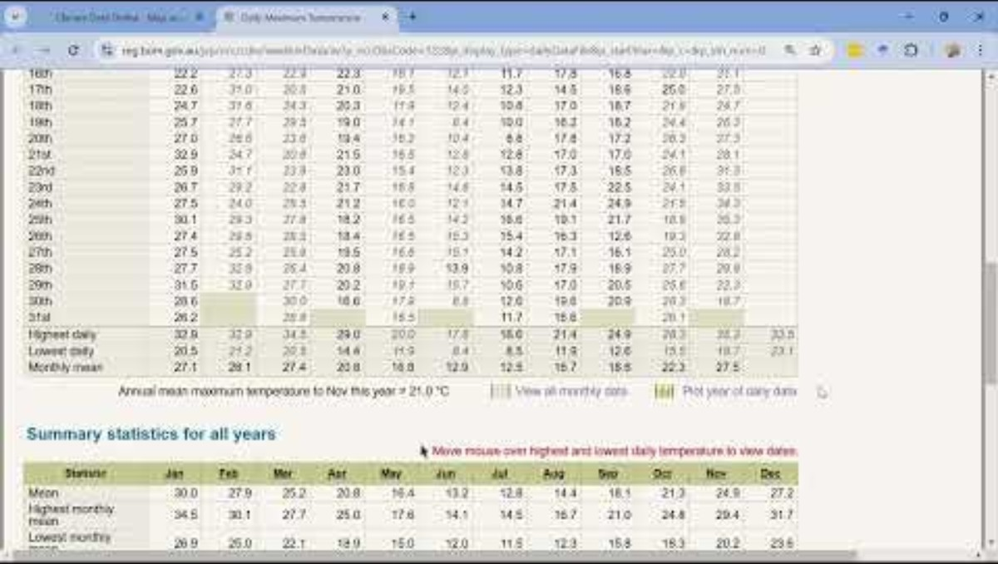
Accessing weather data

Slide 9
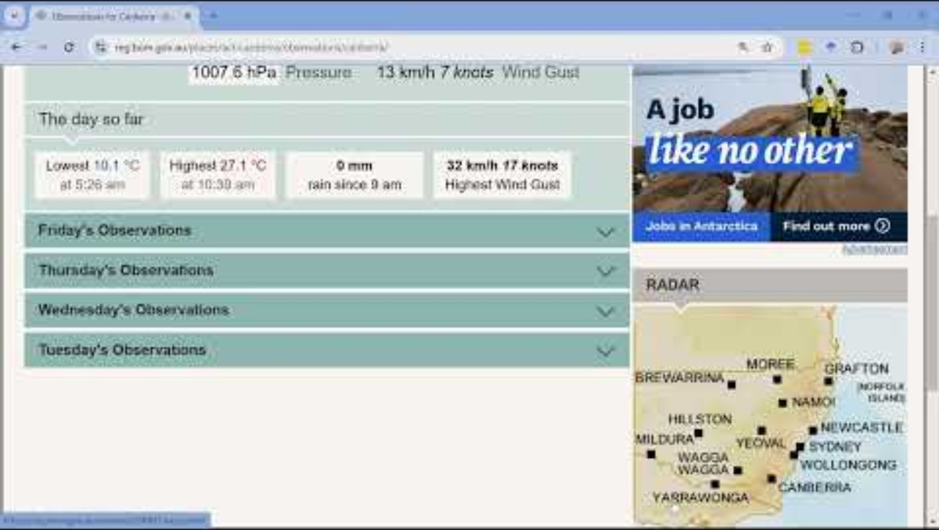
Importing data into Excel

Slide 10
Lesson 3 • Analysing weather data

Slide 12
Lesson 4 • Yearly data

Slide 14
Data collection plan
What is the best time of day to play outside for each month of the year?
What information do we need to collect to answer the question?
How will we collect our data?
How will we record our data?

Slide 15
Accessing weather data

Slide 16
Lesson 5 • The shape of our data

Slide 18
Data analysis
What is the best time of day to play outside for each month of the year?
Describe the shape of your data. How does the shape of your data help inform your predictions?
Look at the range of the data, that is the warmest and coolest temperatures. How does the range of the data help inform your predictions?
Is there data that seems surprising or different from the rest of the data? How might these observation impact your prediction/s?

Slide 19
