Slide 1
Multiplication: Trays of Arrays
(F4)

Slide 2
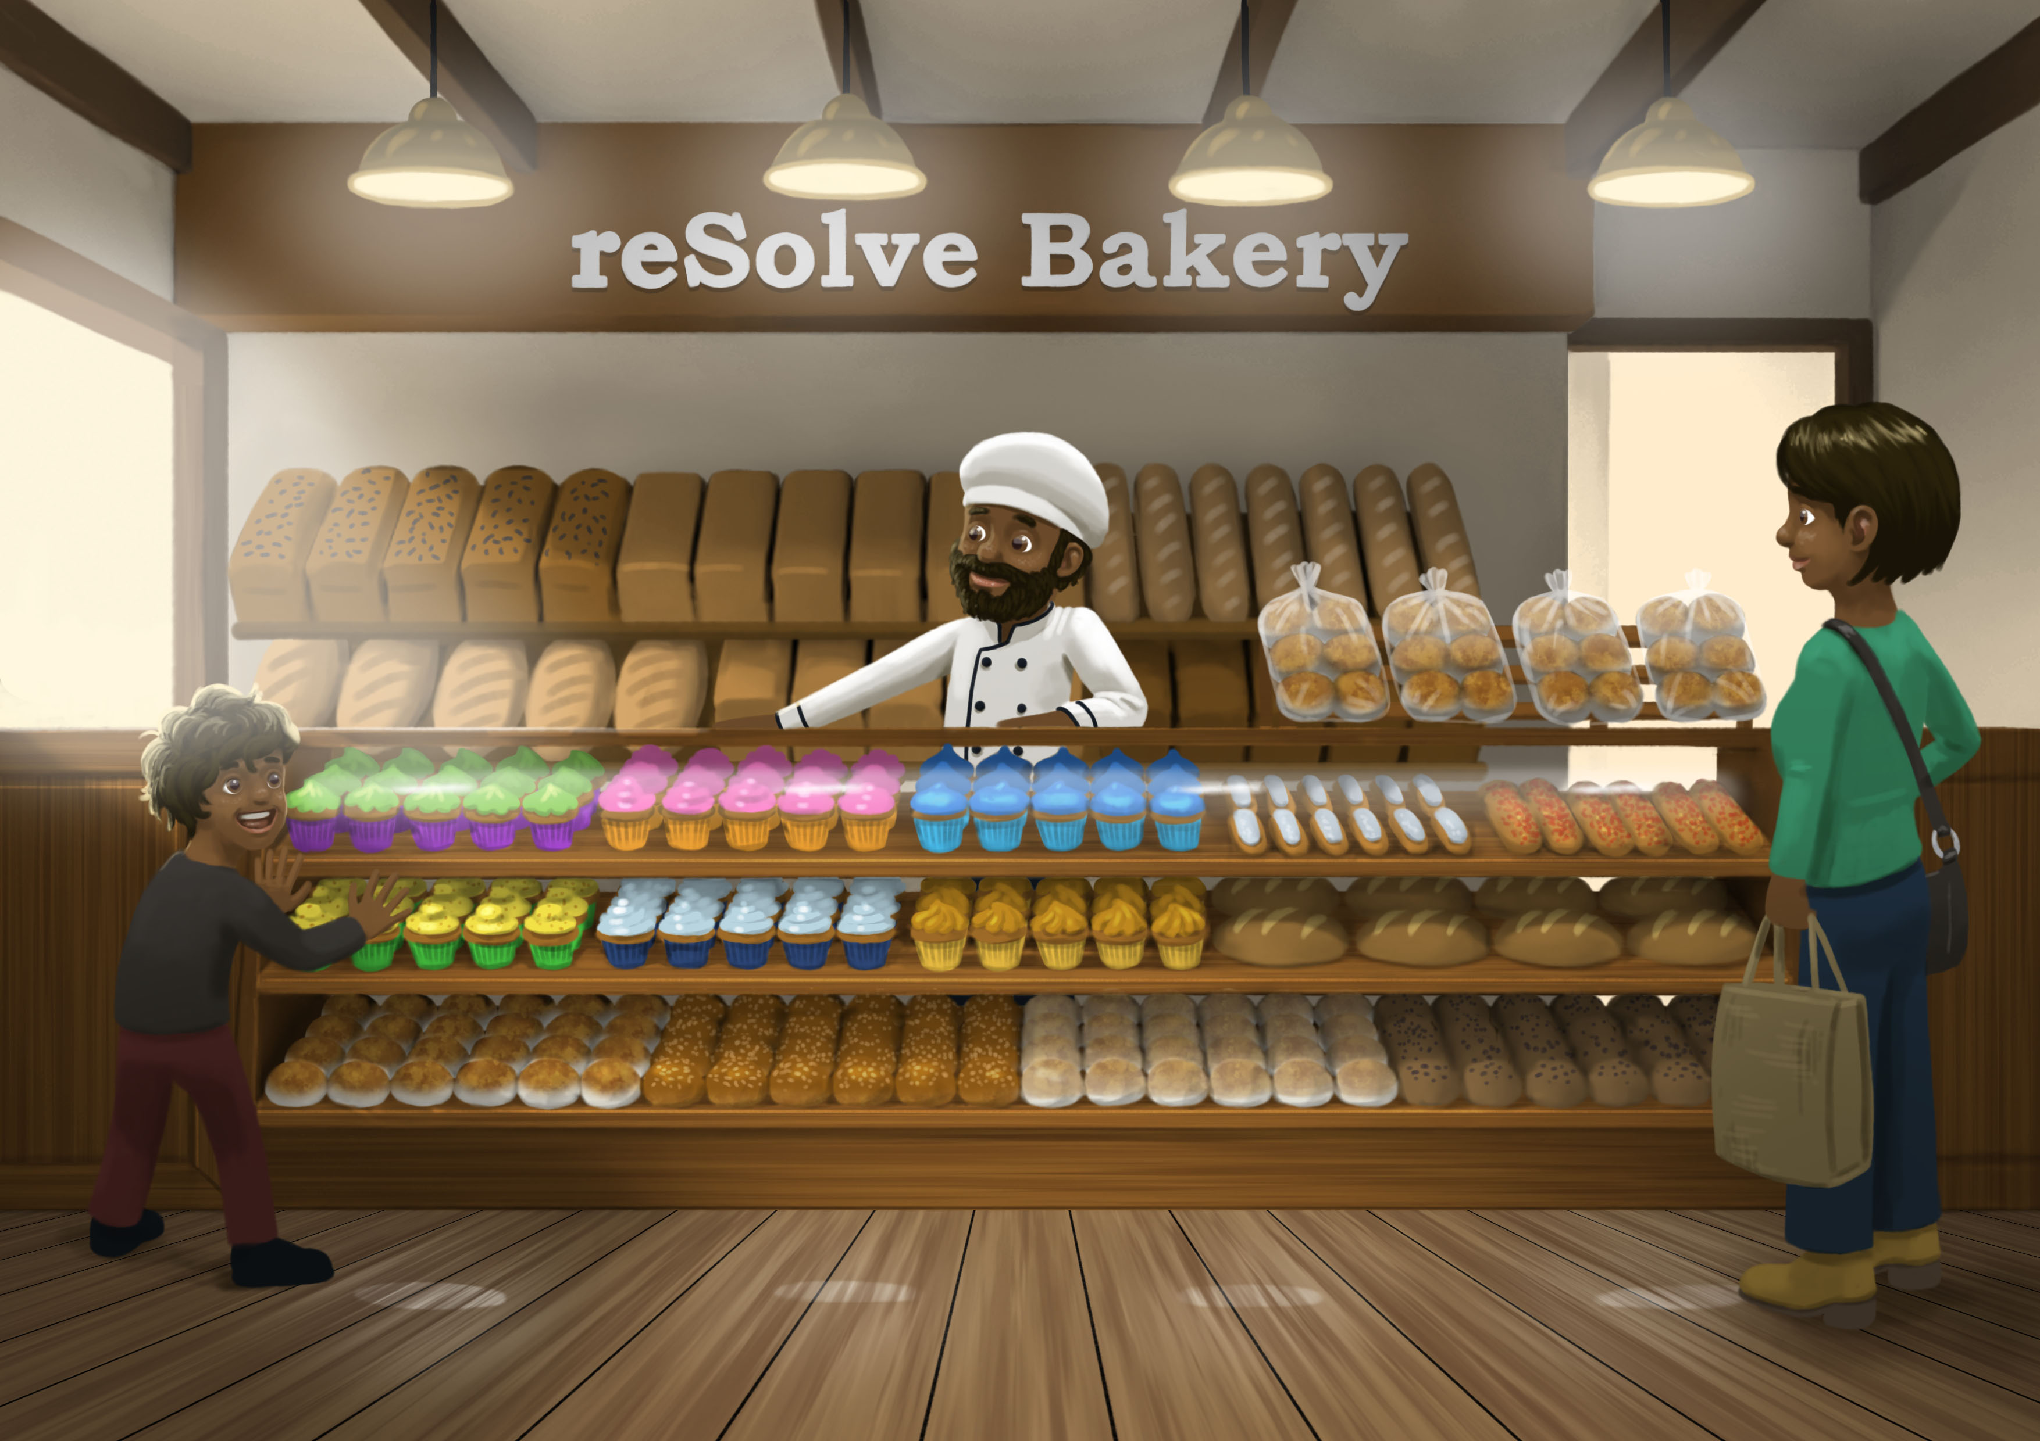

Slide 3
Task 1 • How many cupcakes?

Slide 5



Slide 6


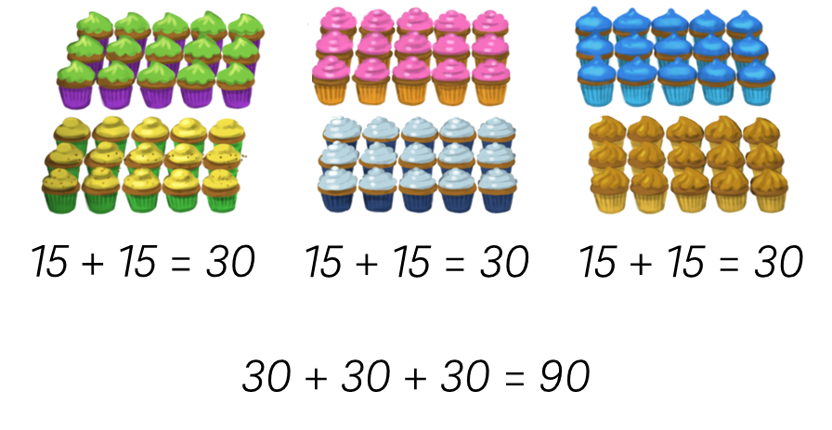
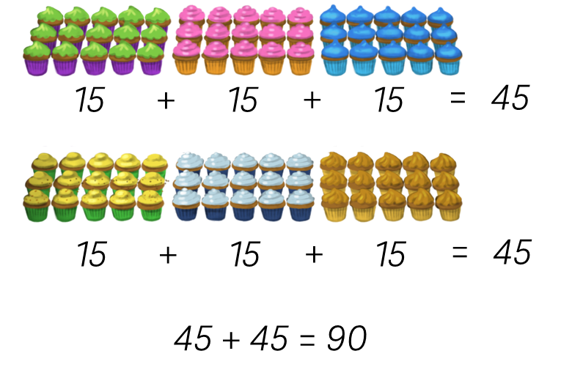
Zachary and Maddie’s strategies
Zachary’s Strategy
Maddie’s Strategy

Slide 7


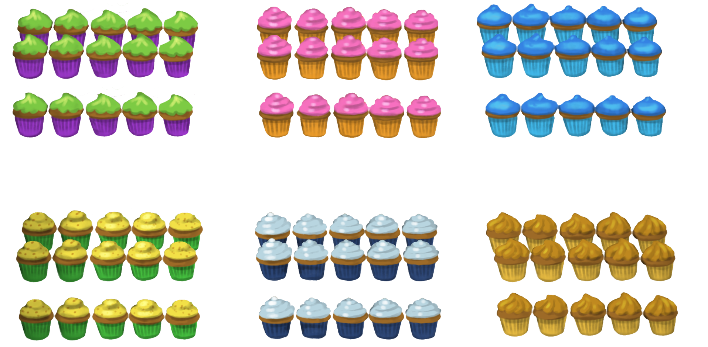
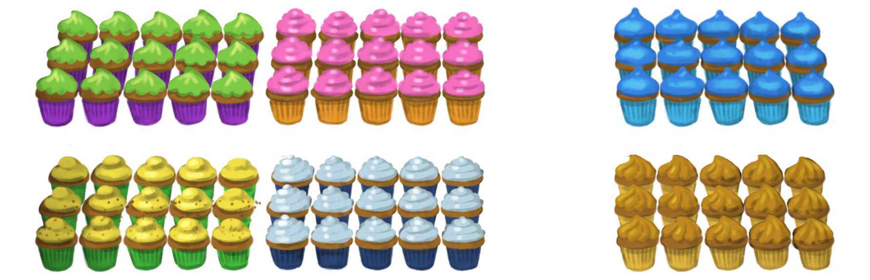
Isabella and Archie’s strategies
Isabella’s Strategy
Archie’s Strategy
2 x 5 = 10
10 x 6 = 60
6 x 5 = 30
1 x 5 = 5
6 groups of 10 + 6 groups of 5 = 90
6 x 10 + 6 x 5 = 90

Slide 8
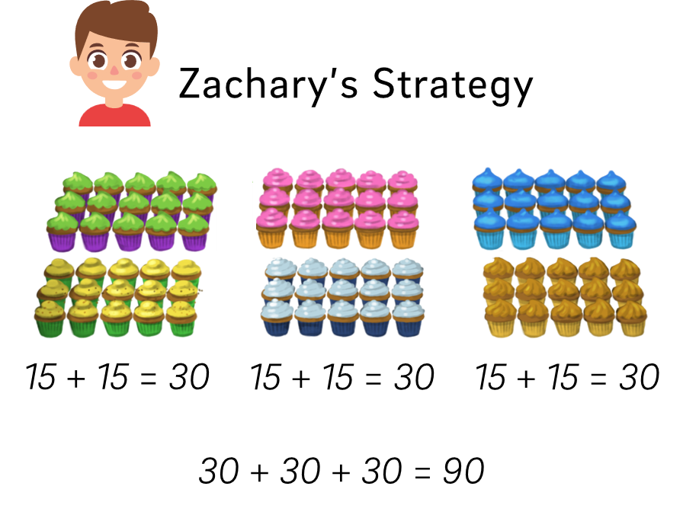
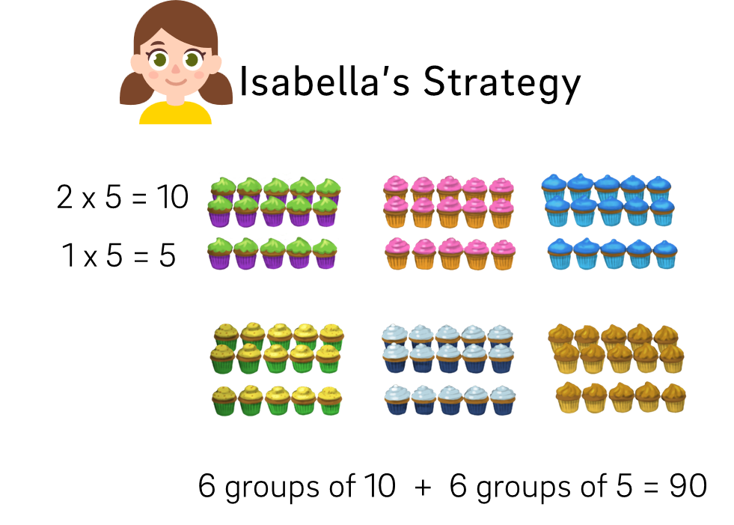
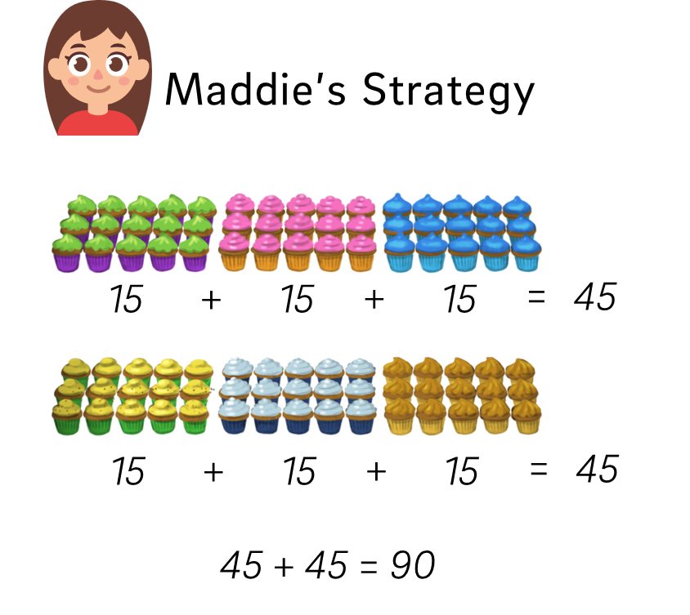
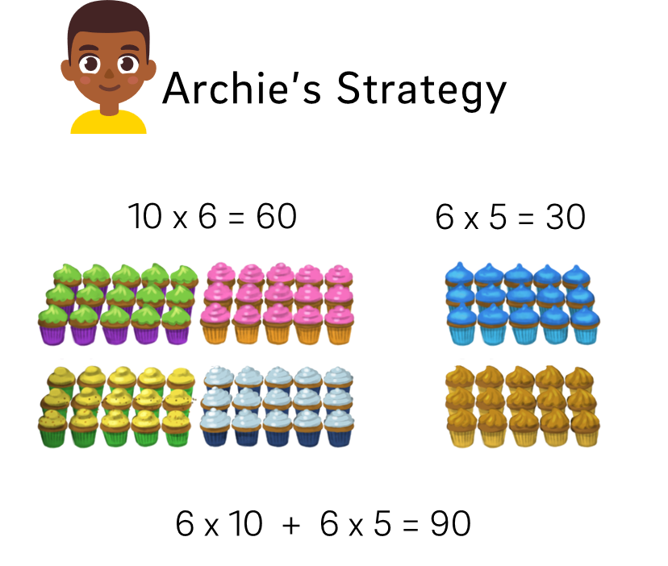
Four strategies

Slide 9
Task 2 • How many bread rolls?

Slide 11
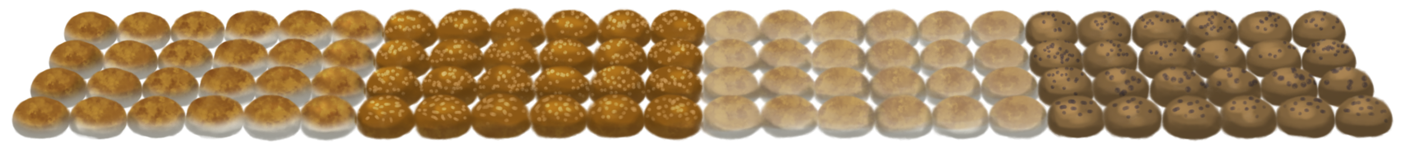

Slide 12
Task 3 • How can I work it out?

Slide 13
Number string 1
2 x 6
5 x 6
7 x 6
10 x 6
17 x 6
27 x 6
6 x 52

Slide 14
Number string 2
9 x 10
9 x 9
9 x 11
9 x 3
9 x 13
9 x 15
23 x 9

Slide 15





We know how to multiply by 2, 3, 5 and 10
How could I work out
7 x 6?
How could I work out
7 x 9?
How could I work out
8 x 7?
How could I work out
6 x 12?
How could I work out
15 x 3?

Slide 16
Task 4 • Packing rolls

Slide 18
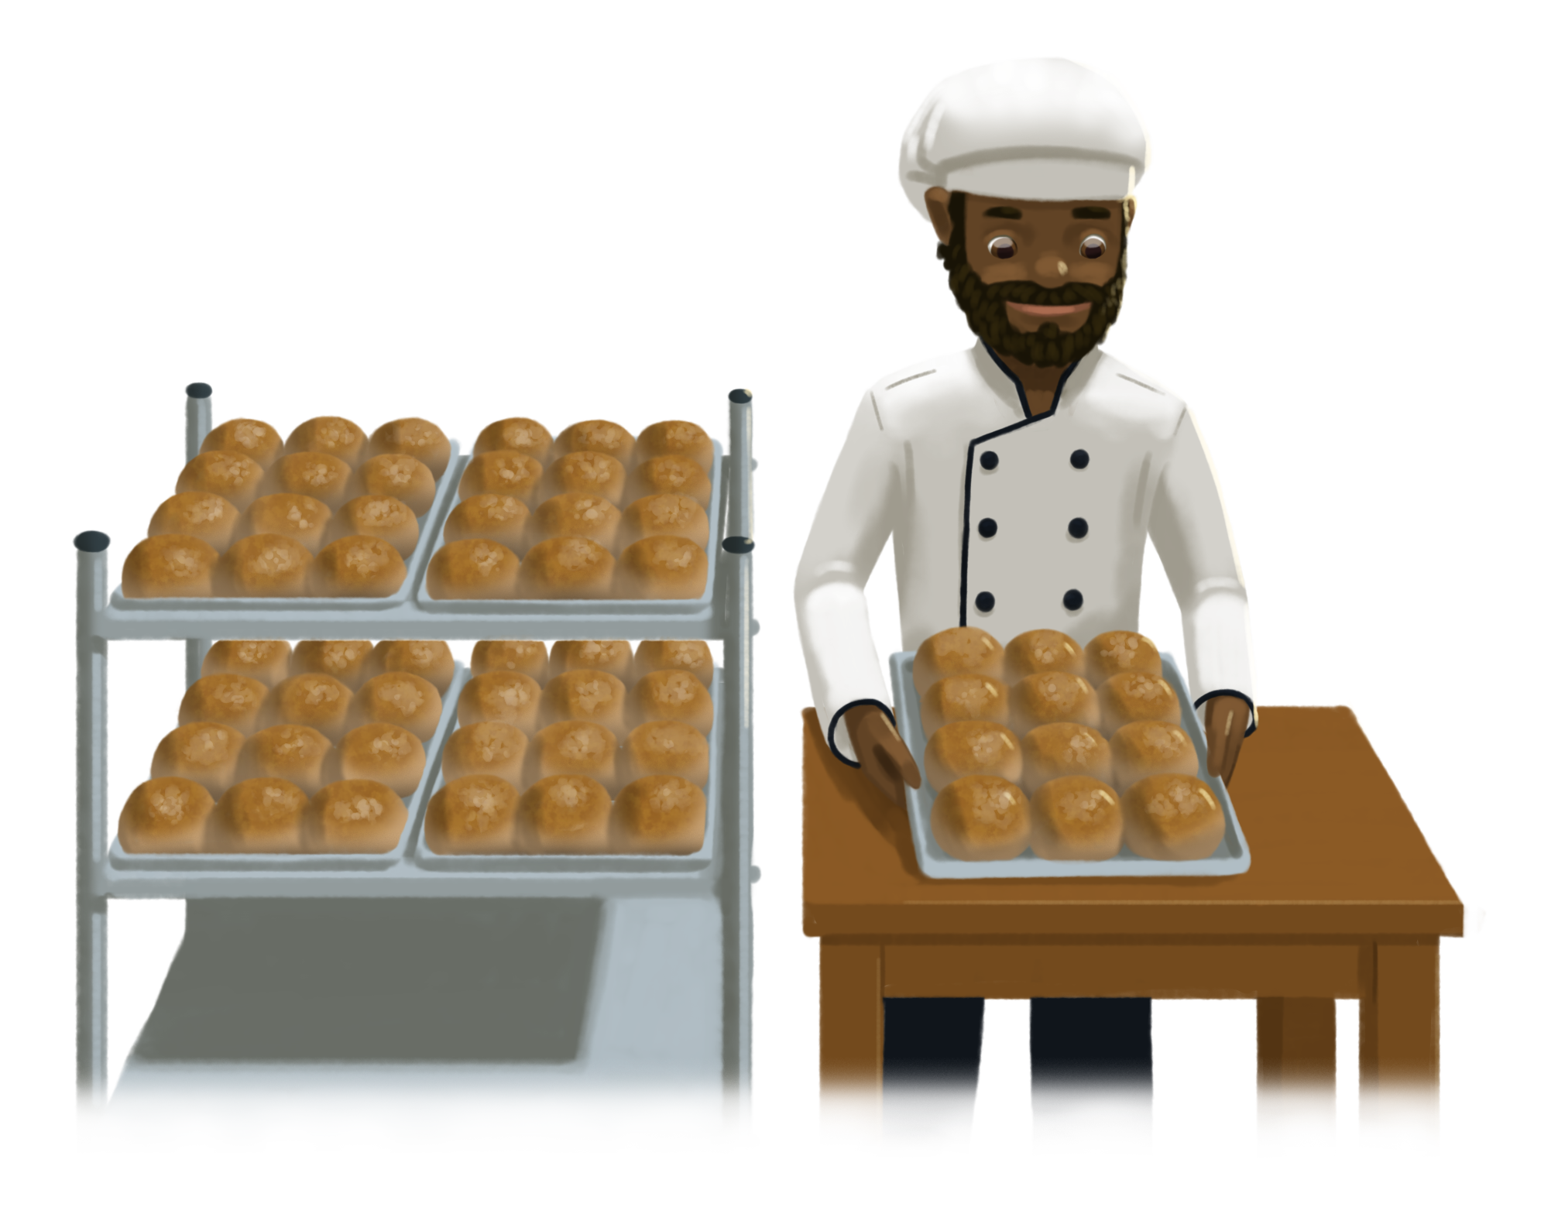

Slide 19
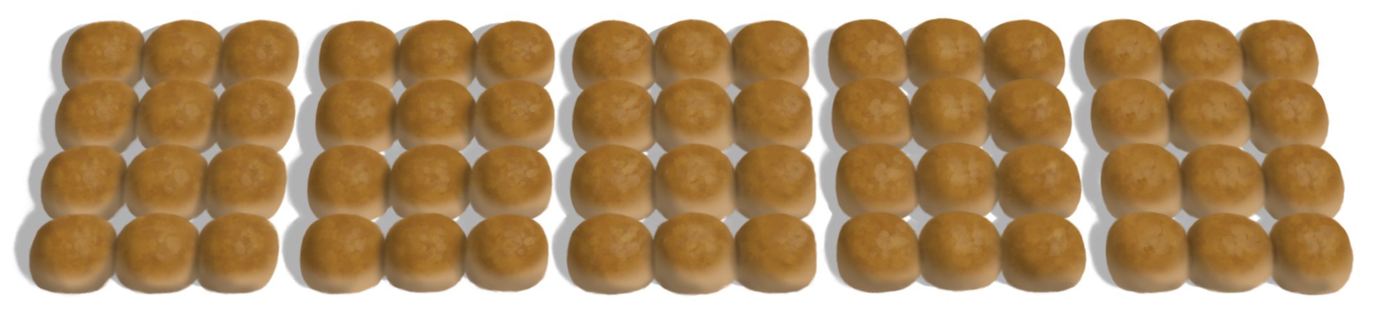

Slide 20
5 x 12
12 is here.
5 trays of 12 bread rolls
But where is the 10 in these equations?
5 trays with 2 groups of 6
5 x 2 x 6
But where is the 12 in these equations?
5 x 2 x 6
5 trays of 2 bags with 6 in a box
10 is here.
10 x 6
10 bags of 6 bread rolls

Slide 21
5 trays of 12 bread rolls
5 x 12
5 trays with 2 groups of 6
5 x (2 x 6)
Here is the 12
Here is the 10
(5 x 2) x 6
5 trays of 2 bags with 6 in a box
10 x 6
10 bags of 6 bread rolls

Slide 22
Task 5 • Packing cakes

Slide 24


Slide 25
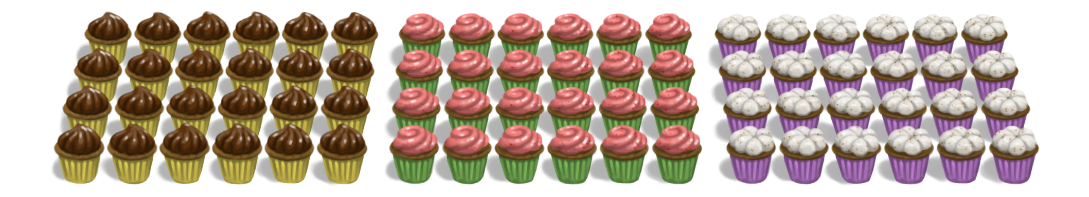

Slide 26
3 x 24
24 is here.
3 trays of 24 cupcakes
But where is the 12 in these equations?
3 trays with 4 groups of 6
3 x 4 x 6
But where is the 24 in these equations?
3 x 4 x 6
3 trays of 4 boxes with 6 in a box
12 is here.
12 x 6
12 boxes of 6 cakes

Slide 27
3 trays of 24 cupcakes
3 x 24
3 trays with 4 groups of 6
3 x (4 x 6)
Here is the 24
Here is the 12
(3 x 4) x 6
3 trays of 4 boxes with 6 in a box
12 x 6
12 boxes of 6 cakes

Slide 28
Task 6 • Transforming arrays

Slide 29
Number string 1
2 x 6
5 x 6
7 x 6
10 x 6
17 x 6
27 x 6
6 x 52

Slide 30
Number string 2
9 x 10
9 x 9
9 x 11
9 x 3
9 x 13
9 x 15
23 x 9

Slide 31
5 trays of 12 bread rolls
5 x 12
5 trays with 2 groups of 6
5 x (2 x 6)
Here is the 12
Here is the 10
(5 x 2) x 6
5 trays of 2 bags with 6 in a box
10 x 6
10 bags of 6 bread rolls

Slide 32
3 trays of 24 cupcakes
3 x 24
3 trays with 4 groups of 6
3 x (4 x 6)
Here is the 24
Here is the 12
(3 x 4) x 6
3 trays of 4 boxes with 6 in a box
12 x 6
12 boxes of 6 cakes

Slide 33
Task 7 • Card sort

Slide 35
We can partition numbers in multiplication
Isabella’s Strategy
Archie’s Strategy
2 x 5 = 10
10 x 6 = 60
6 x 5 = 30
1 x 5 = 5
6 groups of 10 + 6 groups of 5 = 90
6 x 10 + 6 x 5 = 90

Slide 36
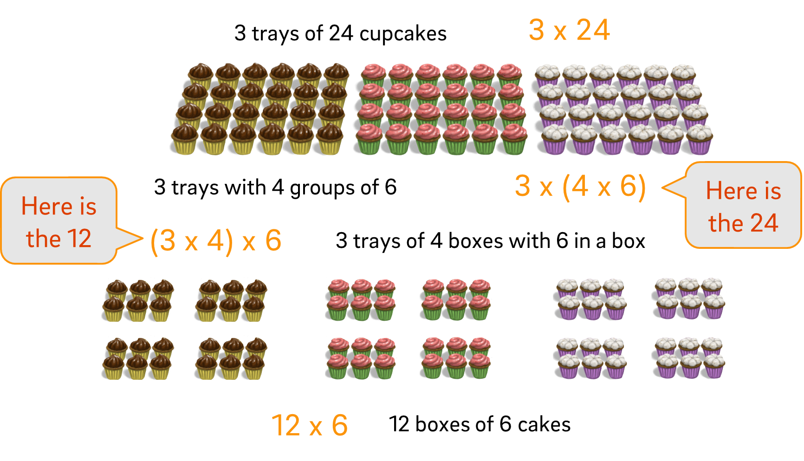
It doesn’t matter how we group numbers in multiplication

Slide 37
7 x 8
7 x 8 = 7 x (2 x 2 x 2)
Double 7, double again and double again
7 x 8 = 7 x (5 + 3)
7 x 8 = (5 + 2) x 8
5
3
8
5
40
7
35
21
x2
x2
x2
2
16
7
14
28
56
35 + 21 = 56
40 + 16 = 56

Slide 38
Create your own card sort
Start by selecting a multiplication problem.
Think of at least three different ways that the multiplication problem can be solved.
Represent the different solution methods as an array and as an equation.
Create a card for each array and for each equation.

