Slide 1
What makes us happy?
(Y10)

Slide 2
Mathematical modelling

Slide 3
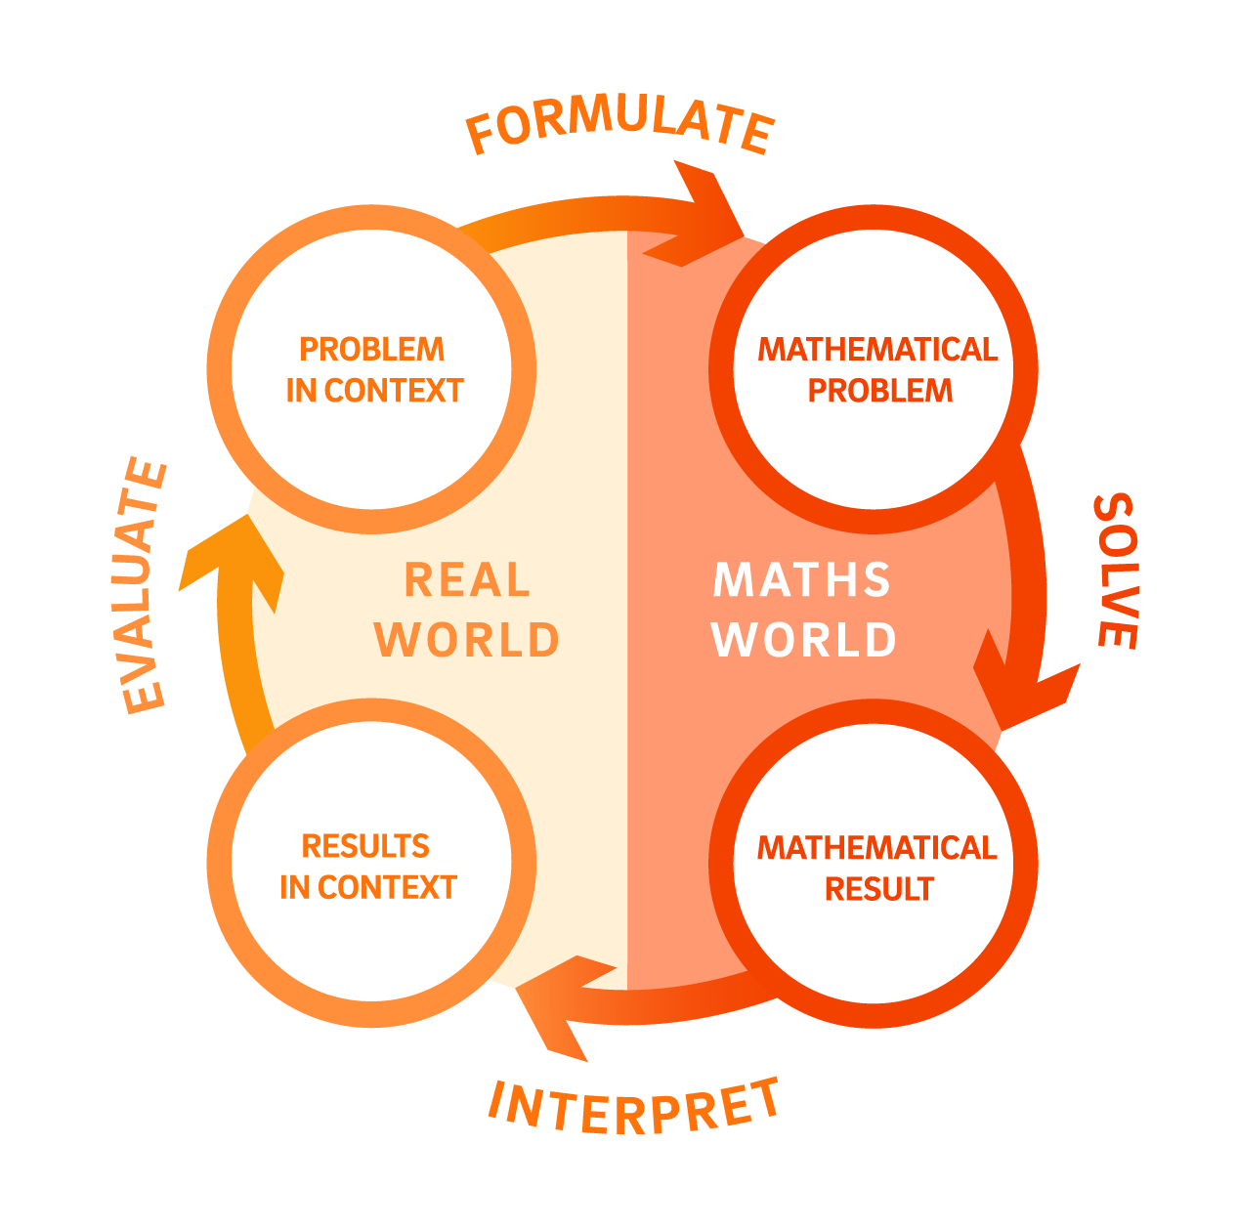

Slide 4
Lesson 1 • Measuring happiness

Slide 6
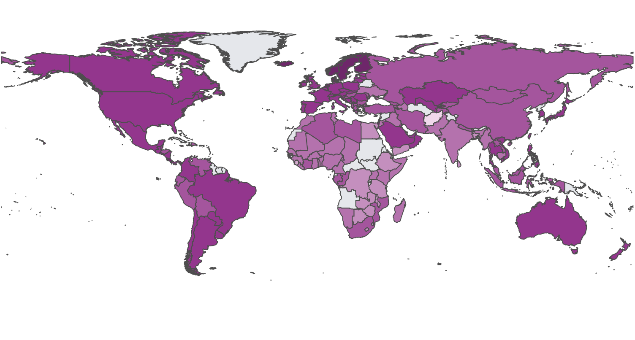
World Happiness Report
Source: The World Happiness Report

Slide 7
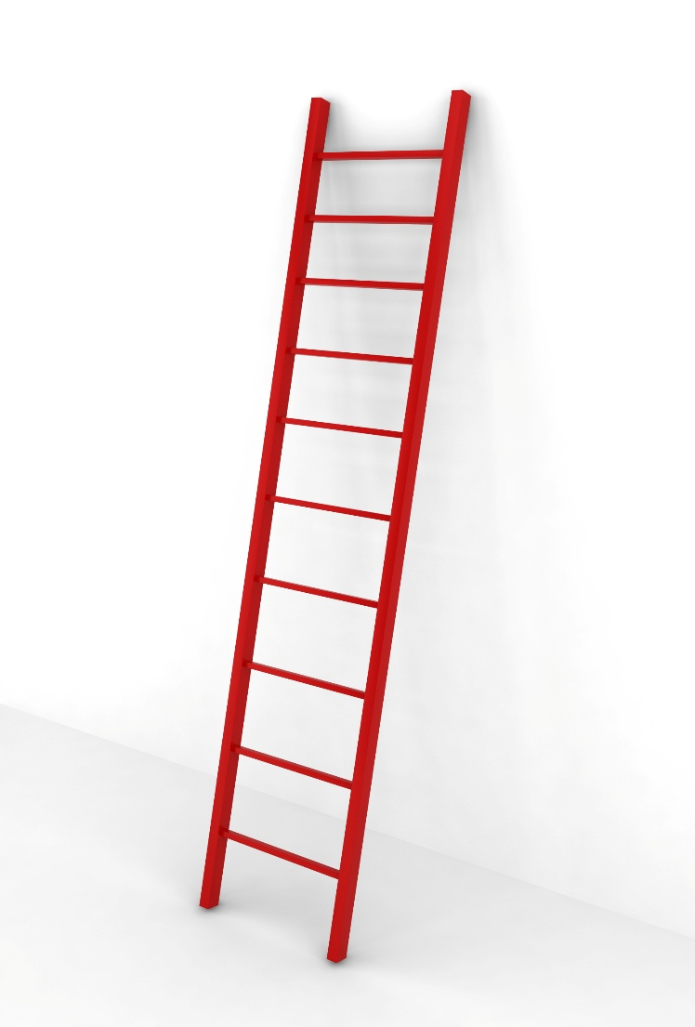
The Cantril Ladder
“Please imagine a ladder, with steps numbered from 0 at the bottom to 10 at the top. The top of the ladder represents the best possible life for you, and the bottom of the ladder represents the worst possible life for you.
On which step of the ladder would you say you personally feel you stand at this time?”

Slide 8
Lesson 2 • Does wealth make us happy?

Slide 10
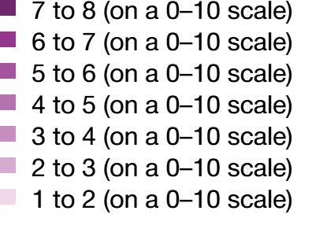
World Happiness Report
Source: The World Happiness Report

Slide 11
Describing correlation
Direction | Positive or negative
Strength | Weak, moderate, or strong
Linearity | Linear or non-linear

Slide 12
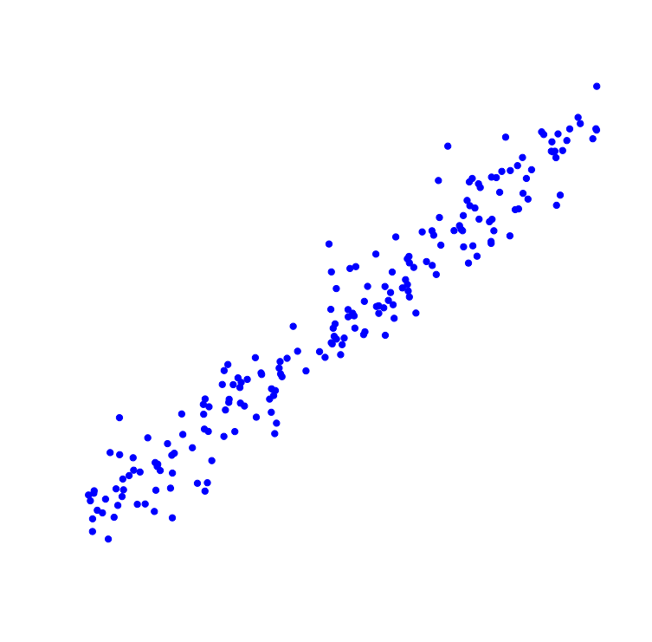
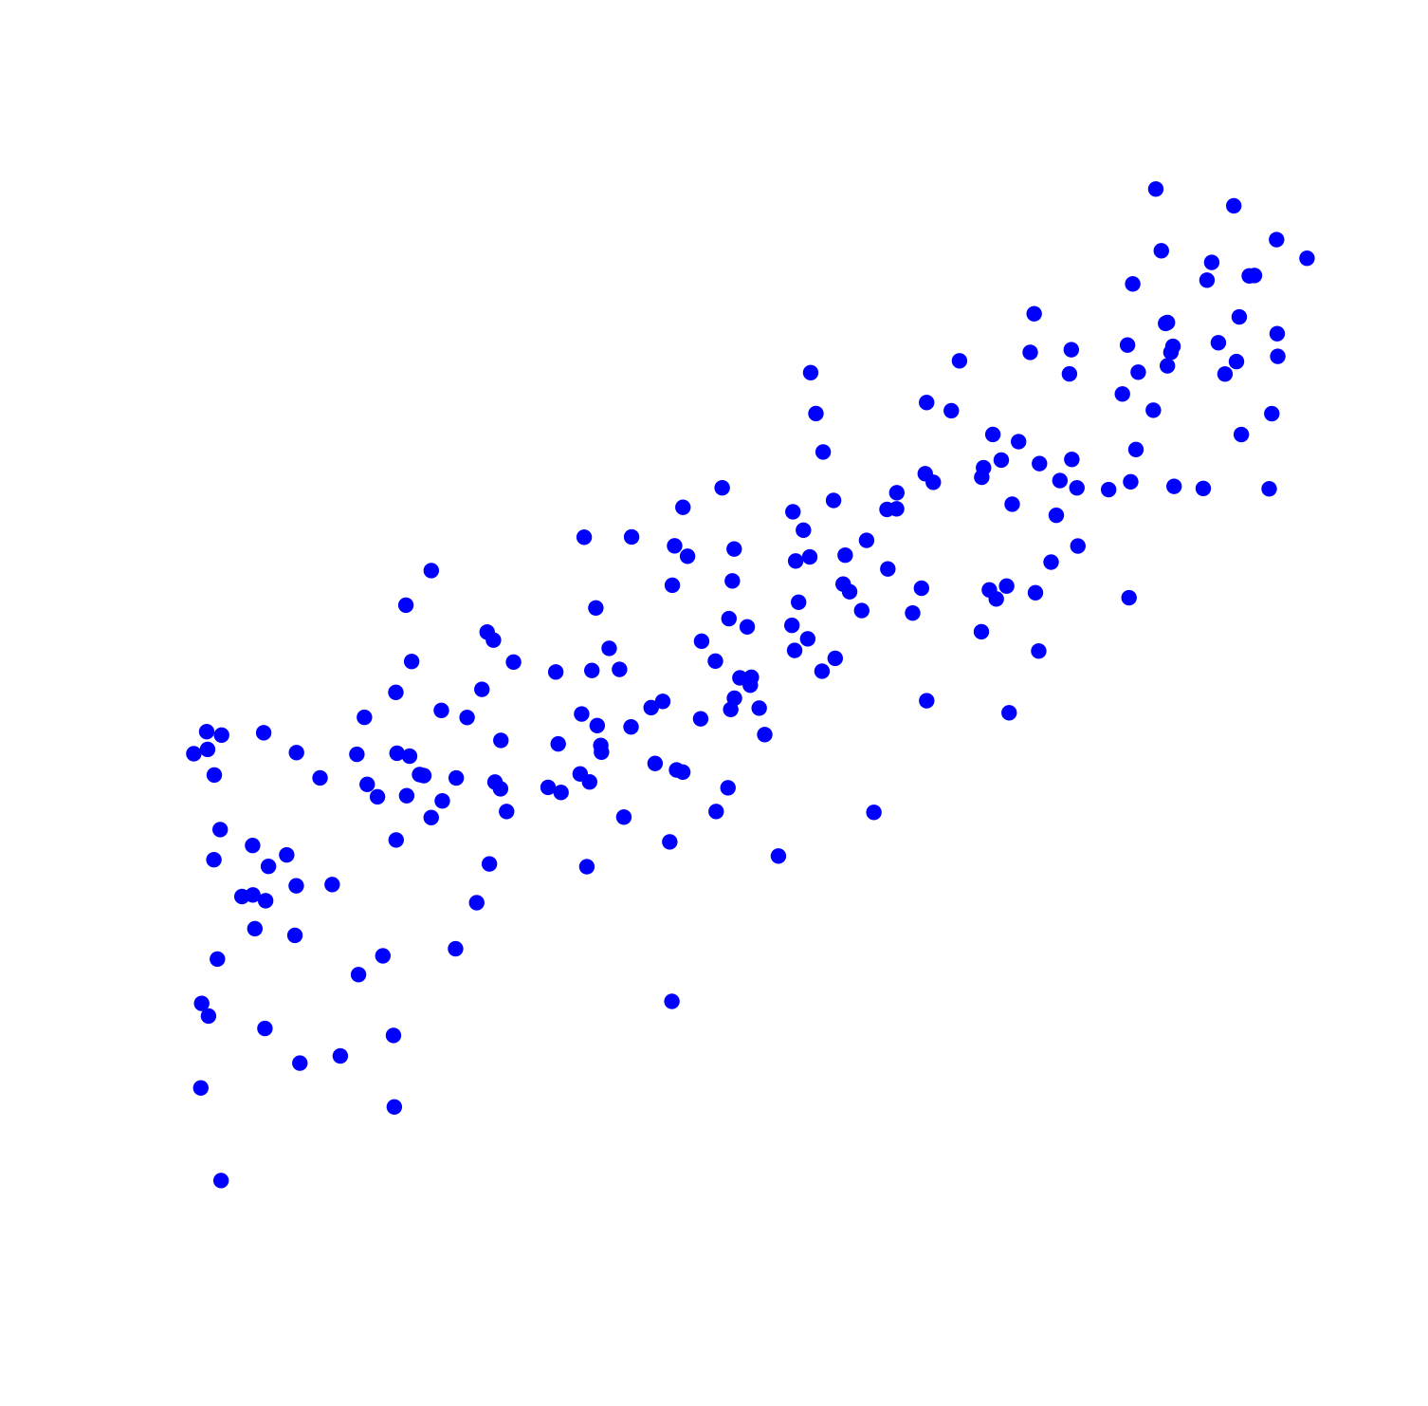
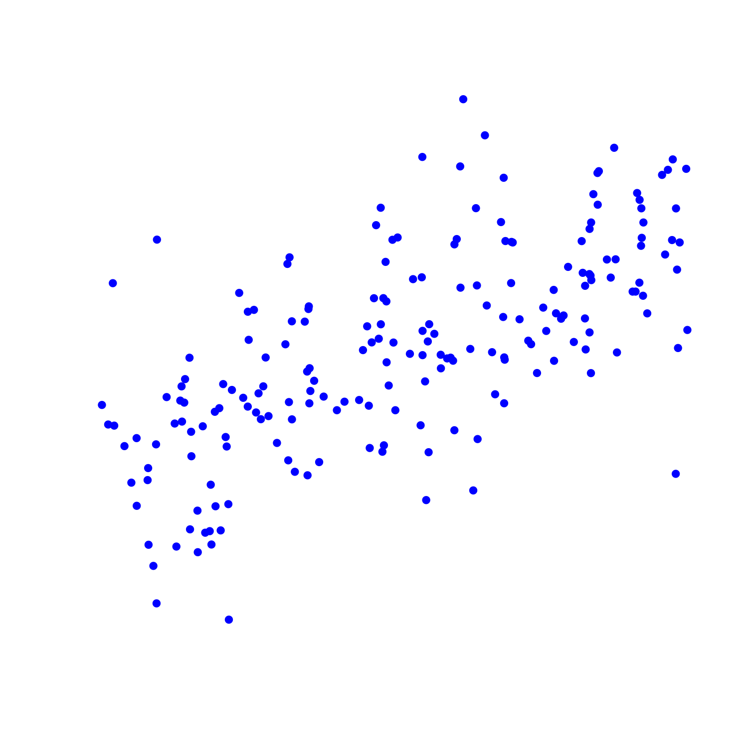
Describing correlation: positive (linear)
Strong
Moderate
Weak

Slide 13
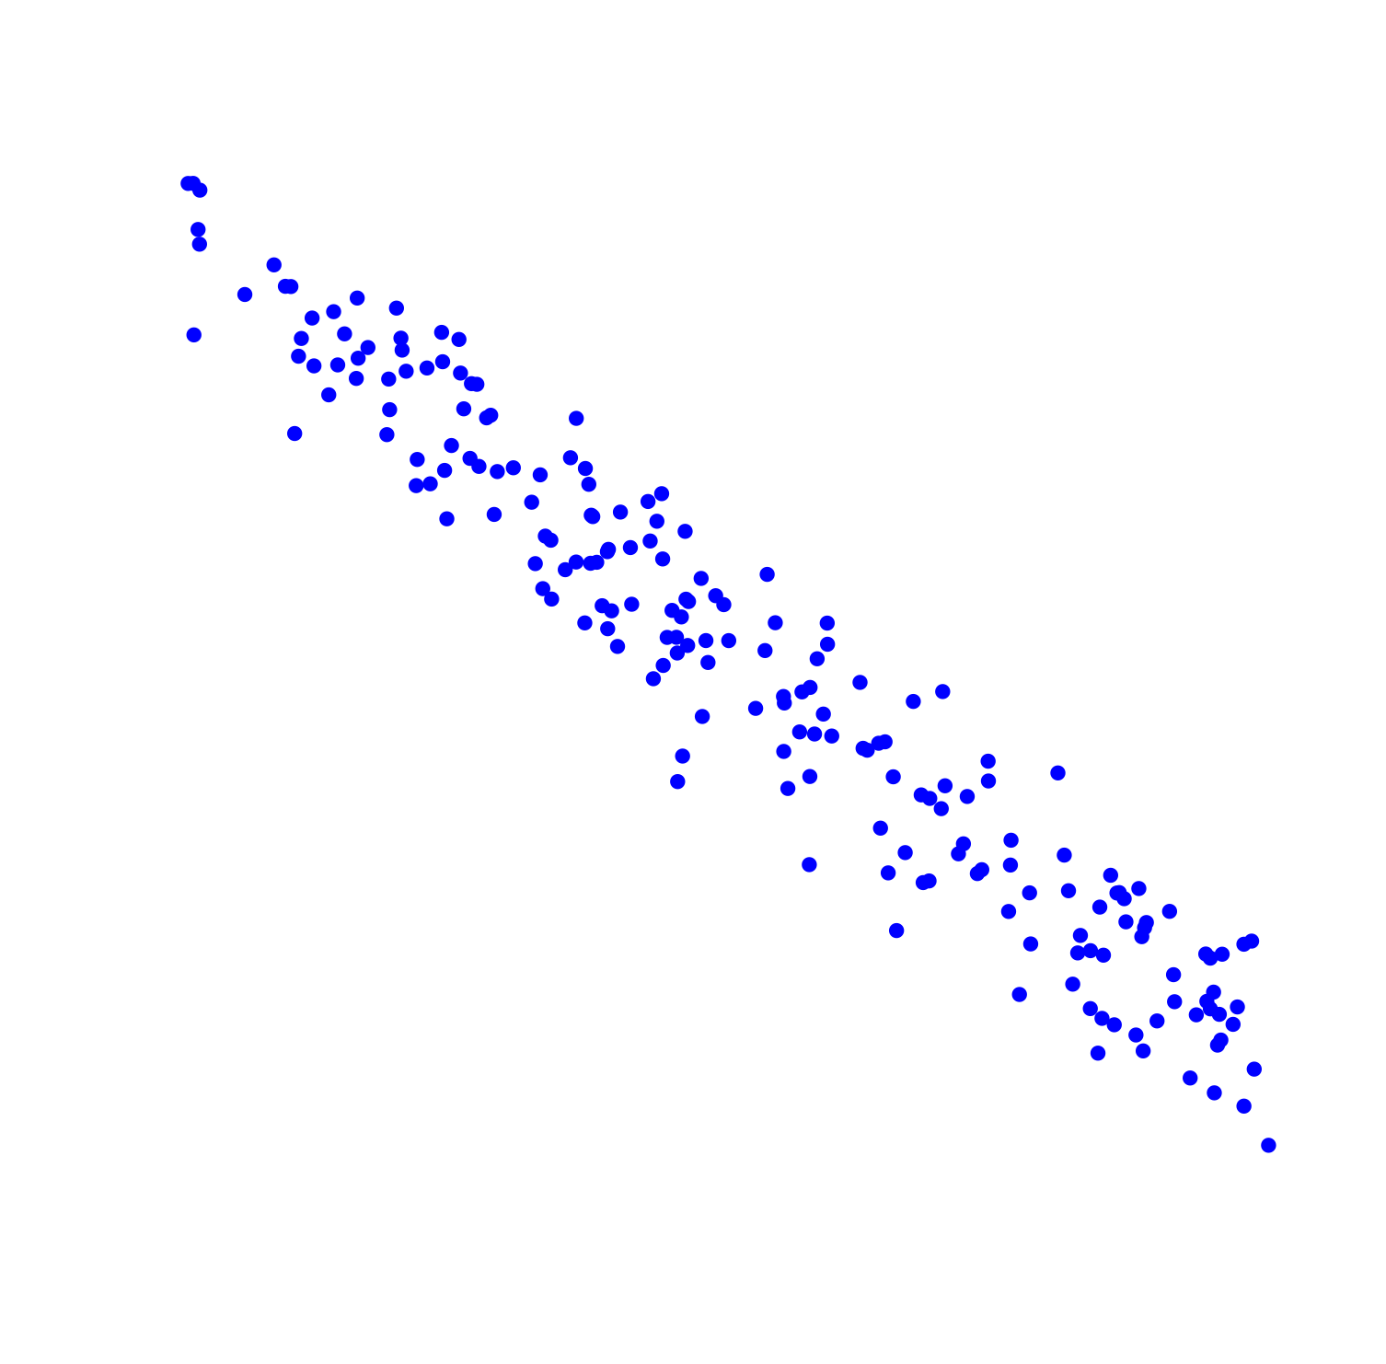
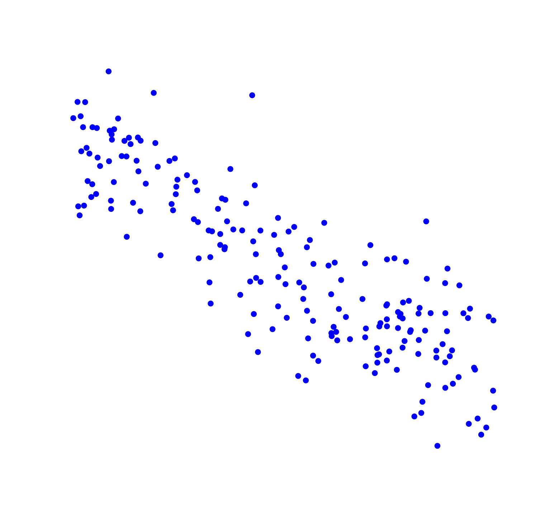
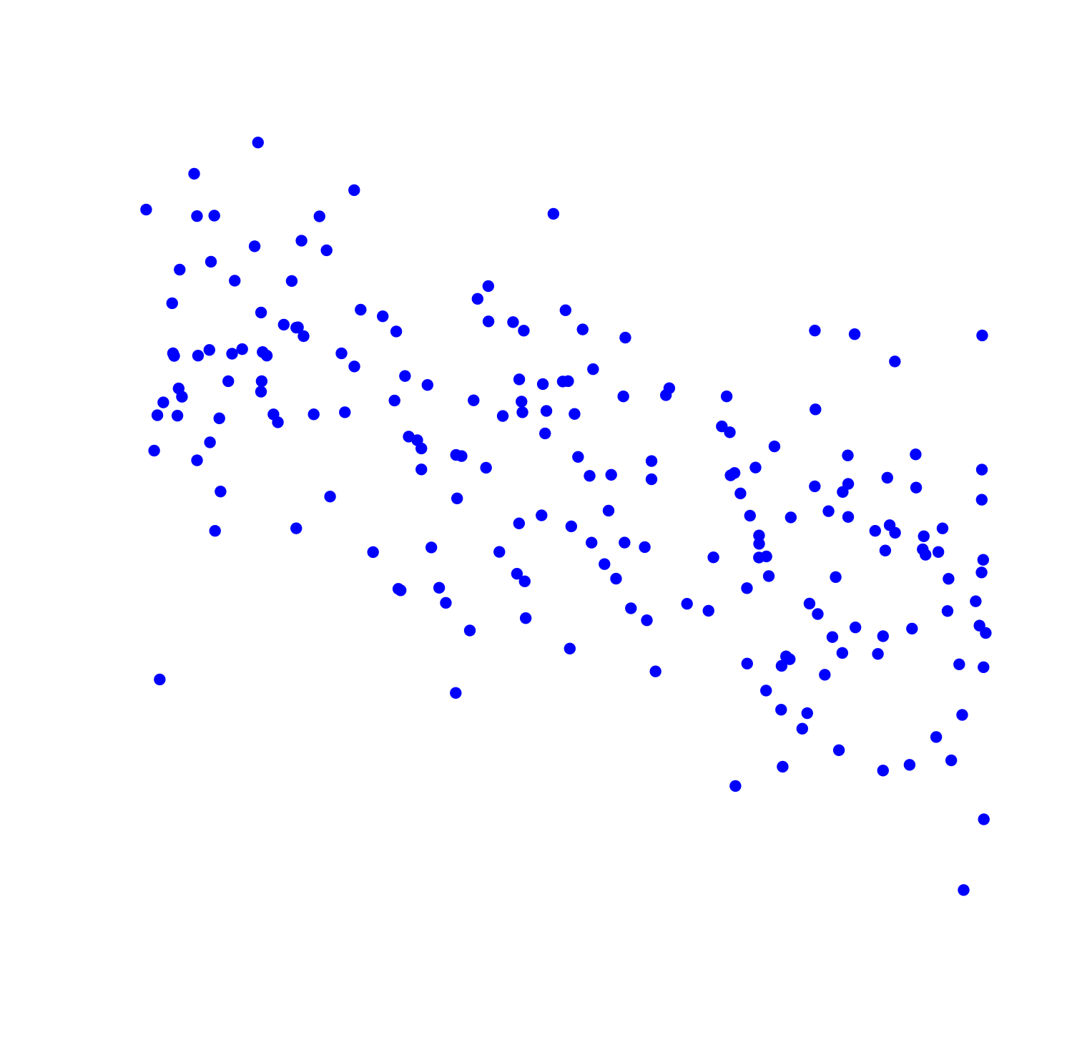
Describing correlation: negative (linear)
Strong
Moderate
Weak

Slide 14
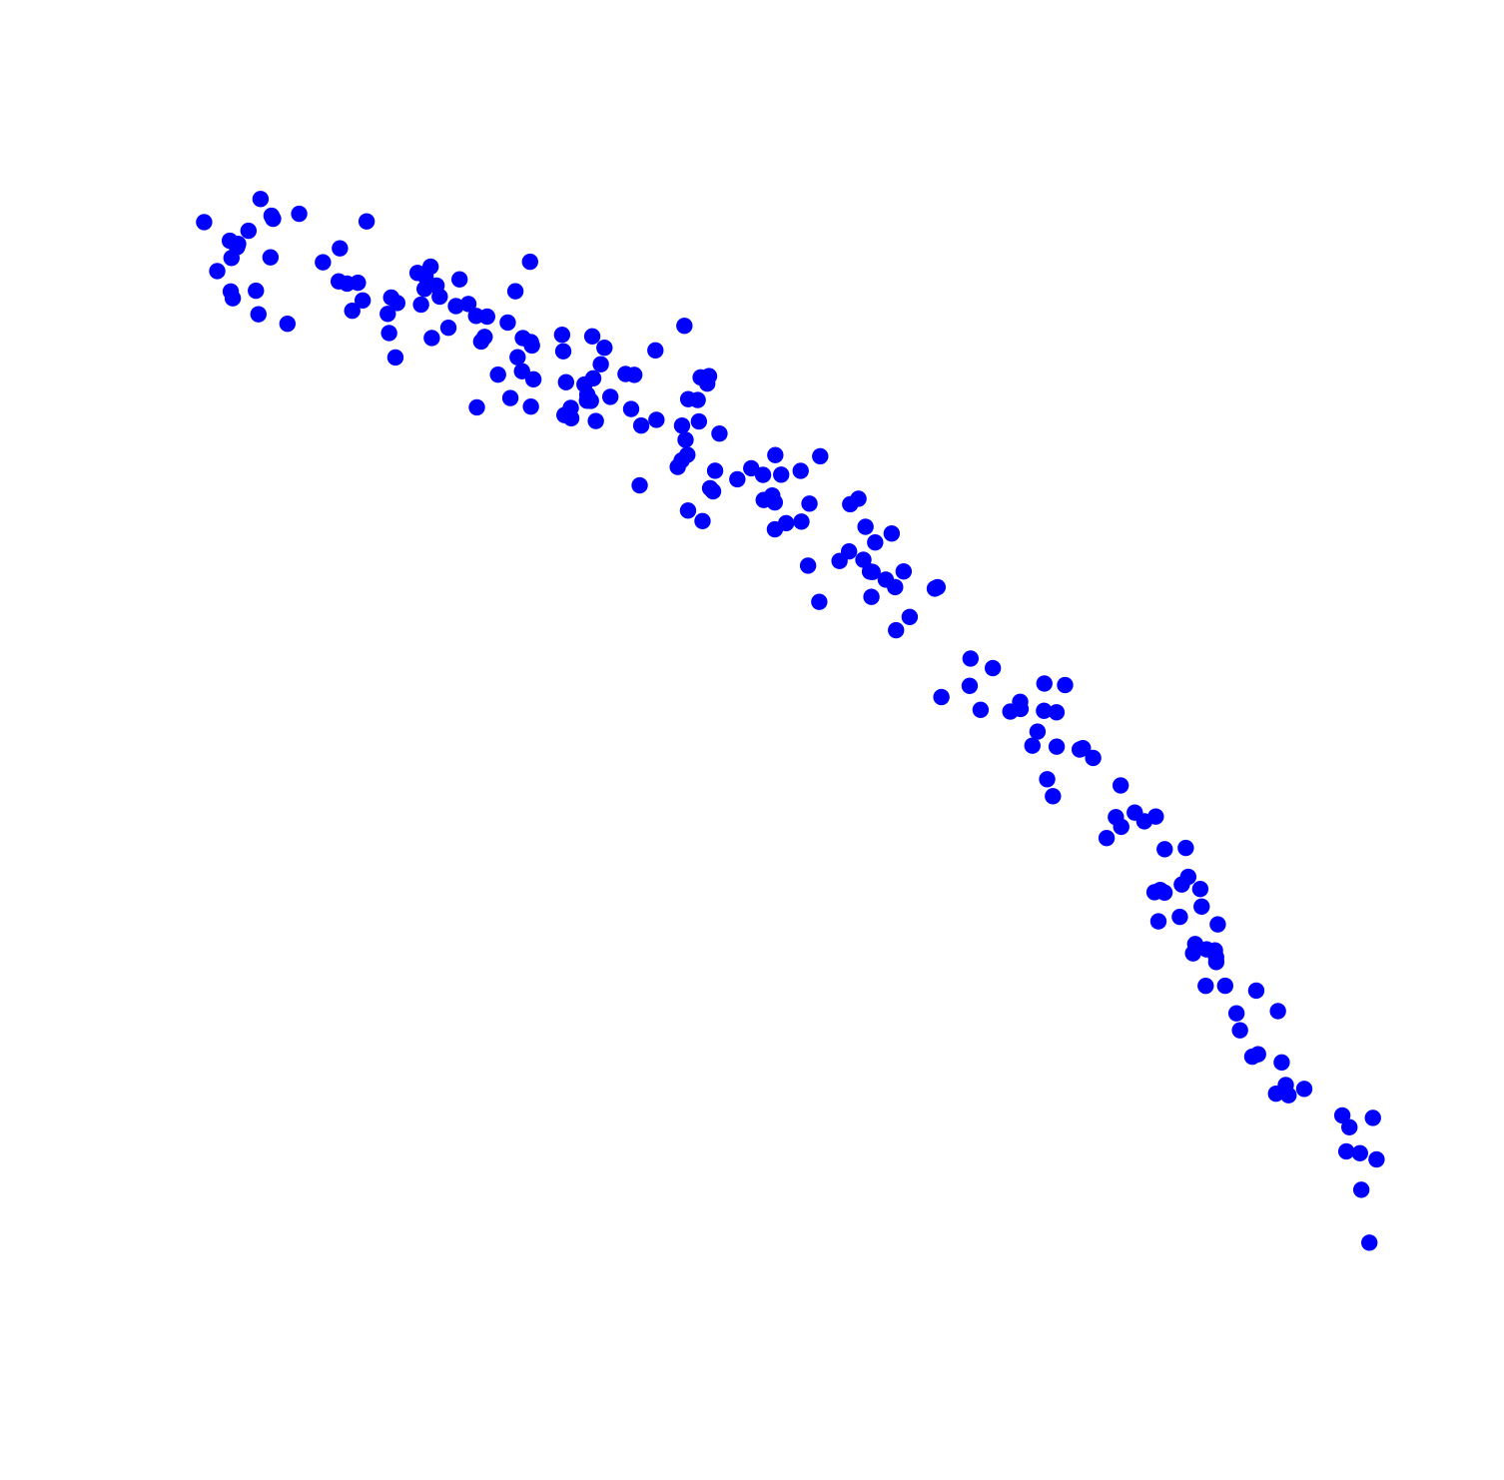
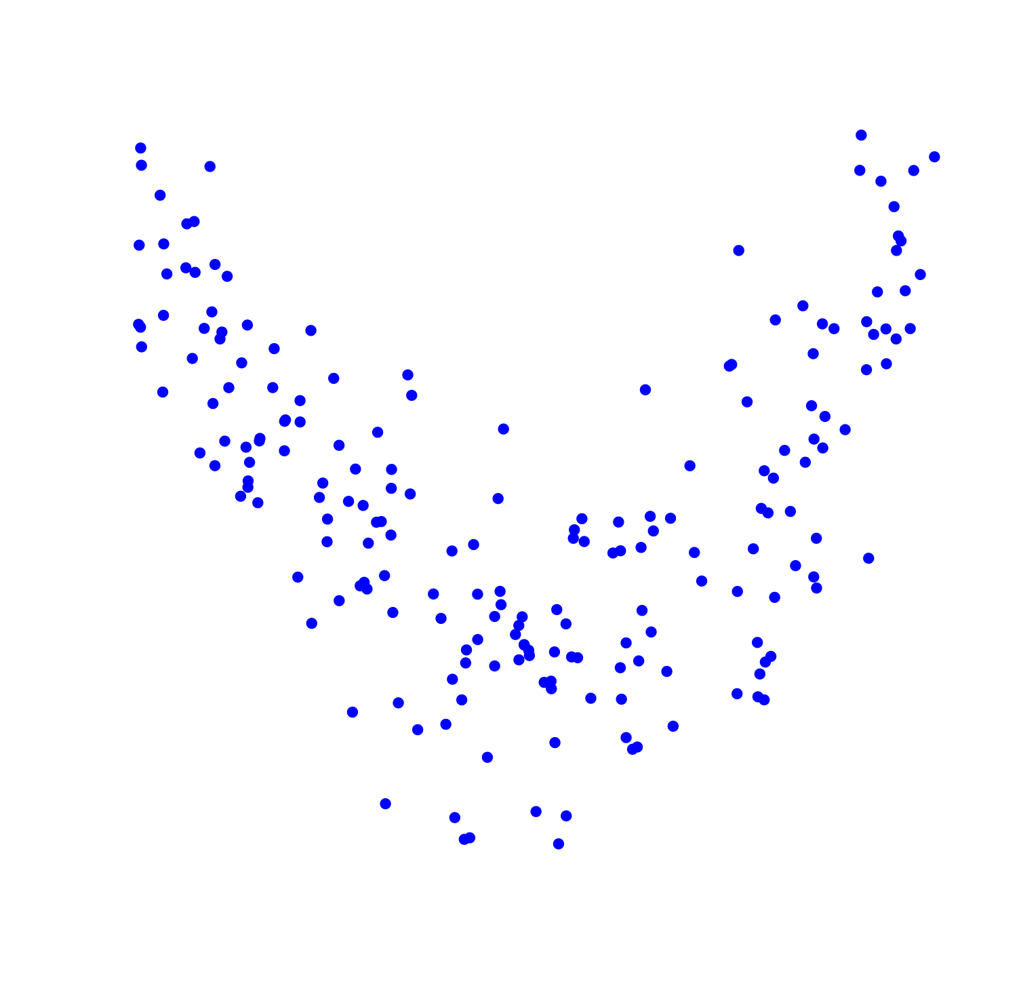
Describing correlation: non-linear

Slide 15
Lesson 3 • A closer look at wealth

Slide 17
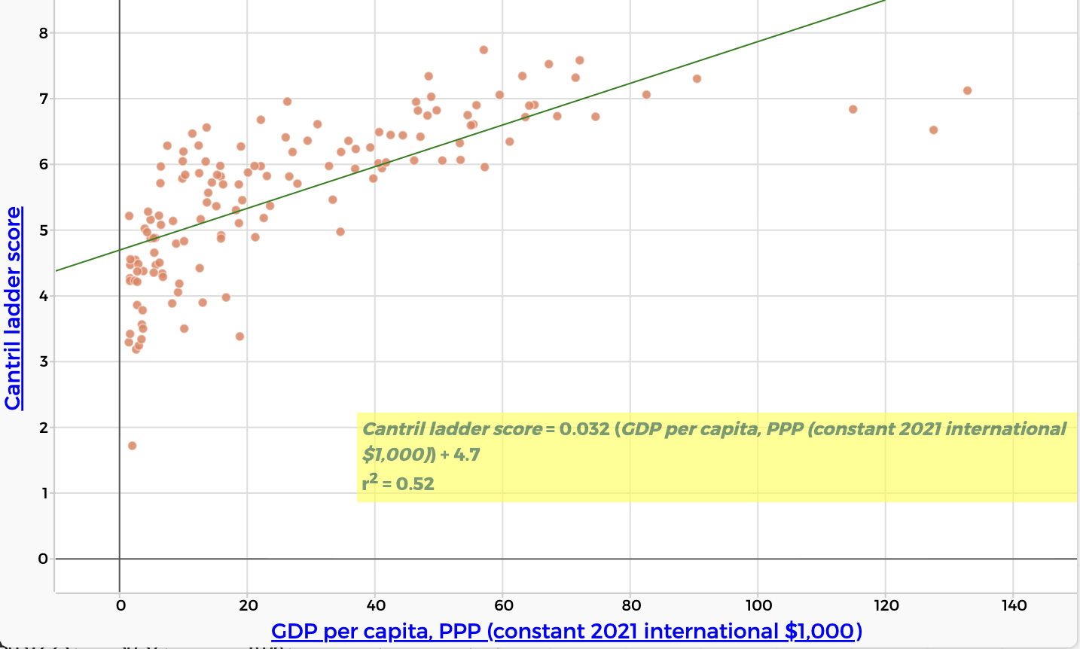
GDP per capita (PPP) and Cantril Ladder score
Data from: The World Happiness Report

Slide 18
Lesson 5 • What else makes us happy?

Slide 20
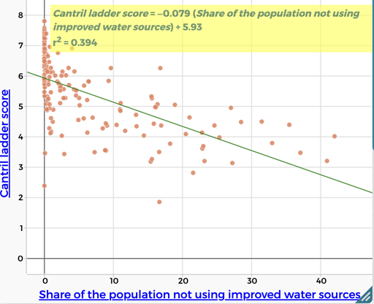
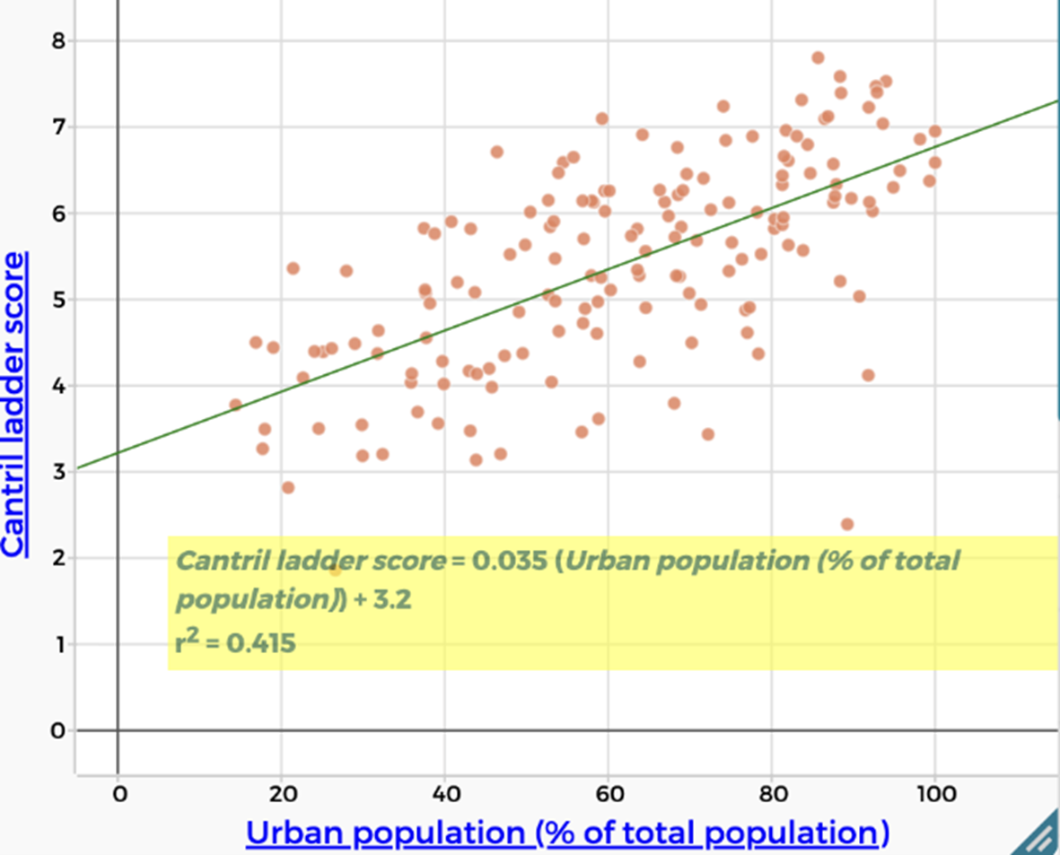
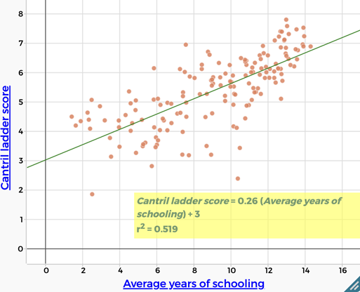
Comparing r² values
r² = 0.394
r² = 0.415
r² = 0.519

Slide 21
Interpreting r²
r² = 0.02
r² = 0.16
r² = 0.52
r² = 0.72
r² = 0.79
r² = 0.97

Slide 22
Measuring other factors
Health - life expectancy
Education - years spent in formal schooling
Water - percentage of population without access to an ‘improved’ water source
Hunger - percentage of population undernourished
Urbanisation - percentage living in urban areas

Slide 23
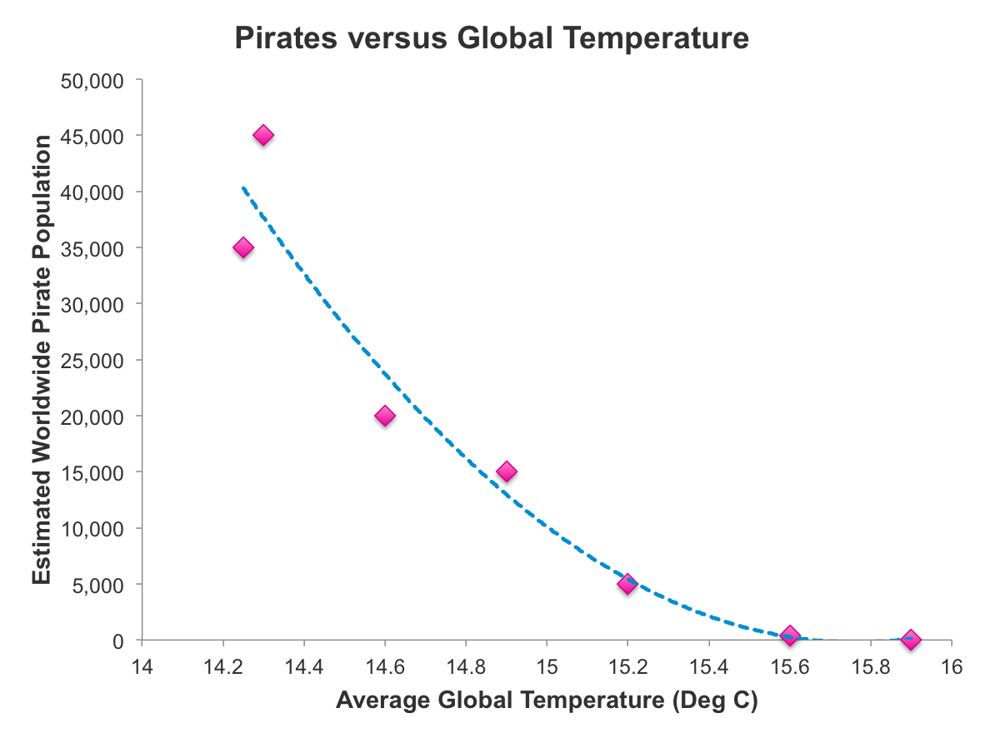
Correlation or causation
Are increasing global temperatures causing a decrease in the worldwide pirate population?

