Slide 1
What’s in a number?
(Y2)

Slide 2
Task 1 • How will you sort it?

Slide 3
Numbers to sort
24 | 34 | 27
40 | 47 | 207
140 | 2 | 142
7 | 70 | 374
72 | 37 | 42
How could you sort these numbers?

Slide 4
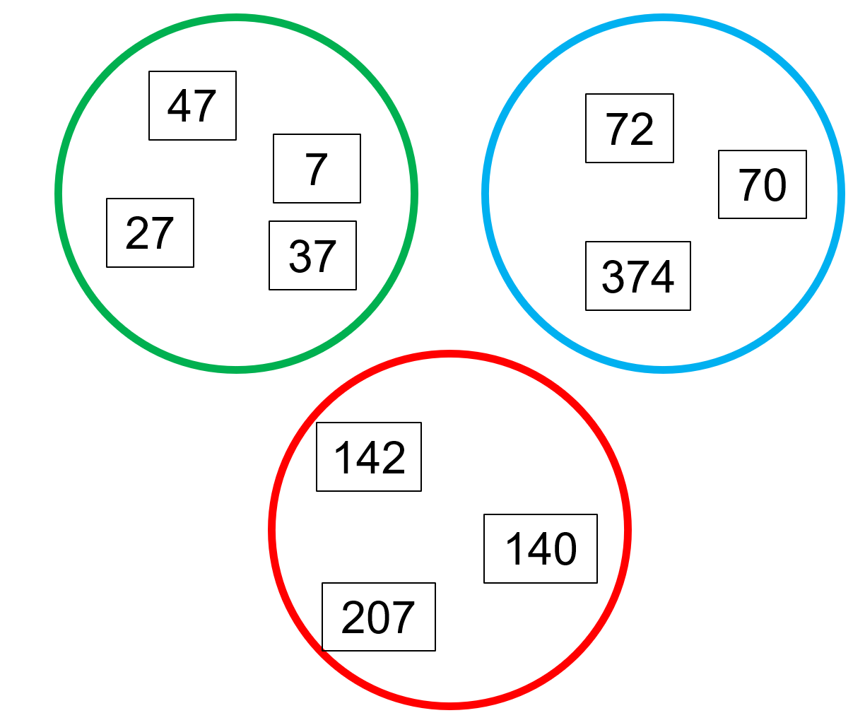
How did we sort these numbers?
Why don’t these numbers fit in a group?
How could we make a group using some of them?
70
7
3 digits
2
24
42
40
34

Slide 5
Task 2 • Number sort

Slide 6
Place value
12
21

Slide 7
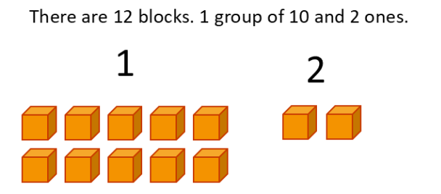
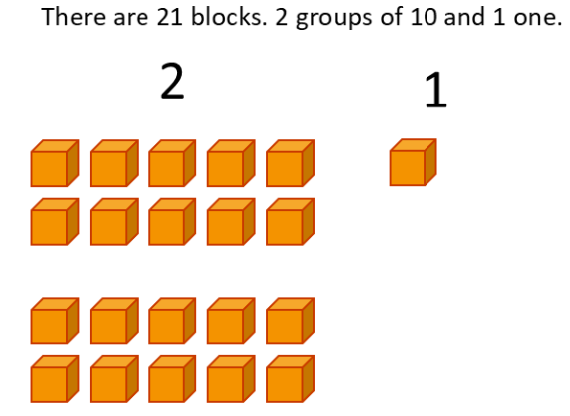
Place value
12
21

Slide 8
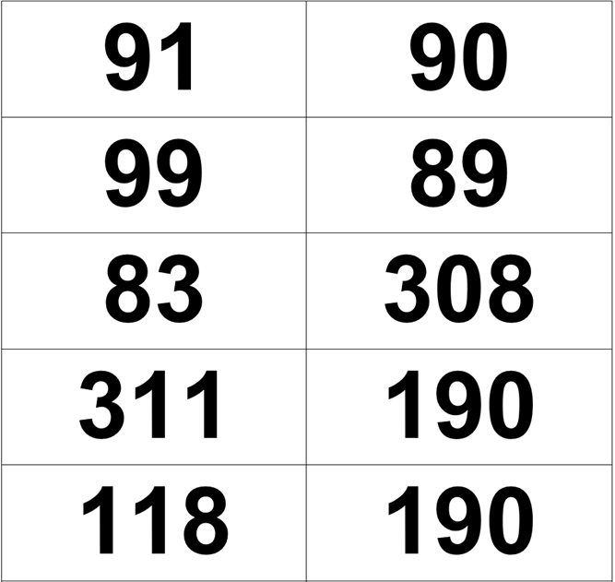
Numbers to sort
I wonder how you could sort these numbers.
What labels would each group have?

Slide 9
Task 3 • Similarities and differences

Slide 10
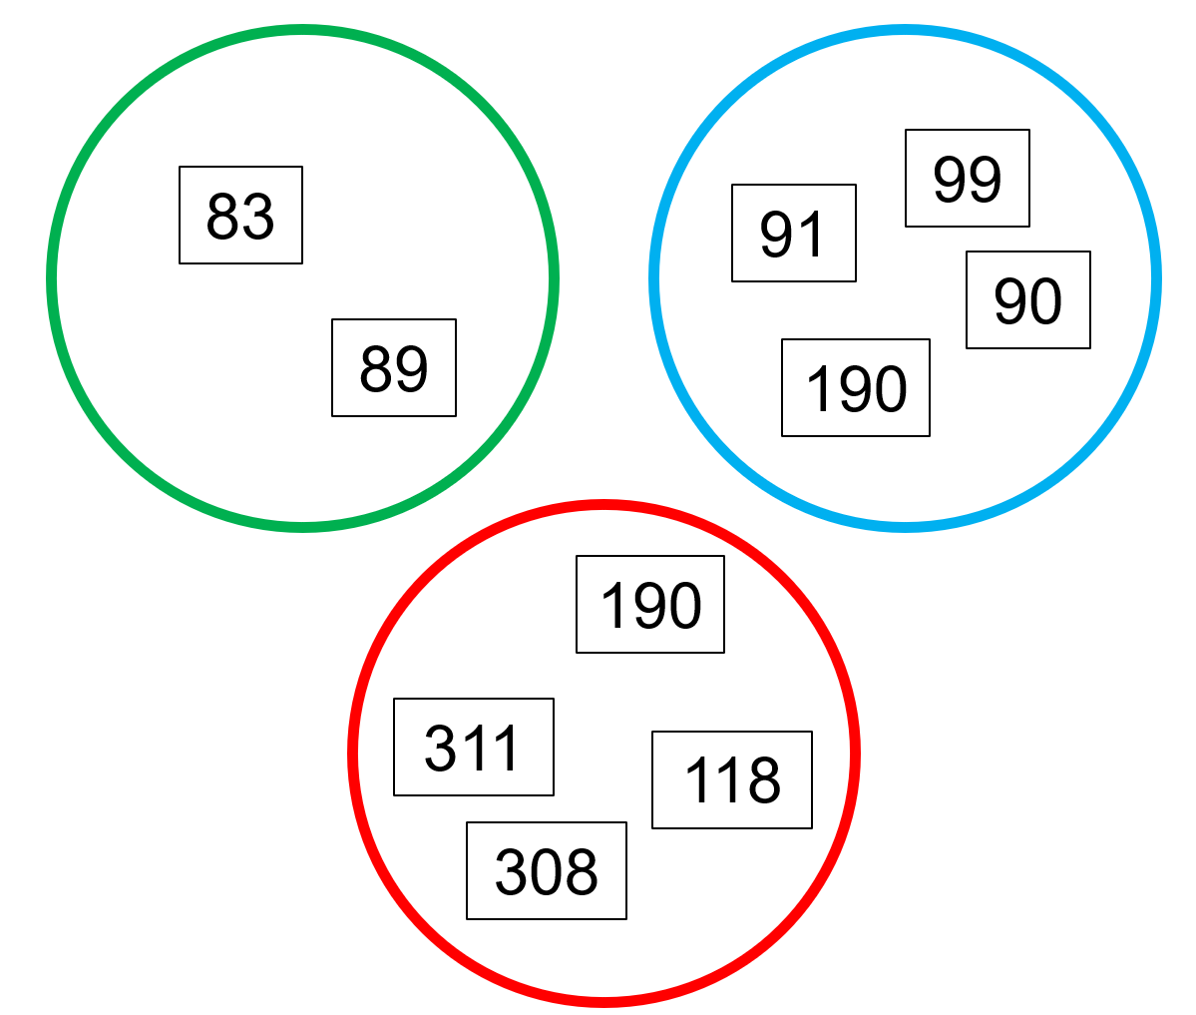
How are these numbers sorted?
8 tens (80)
9 tens (90)
Do you notice any number that fits in more than one circle?
More than 10 tens (100)

Slide 11
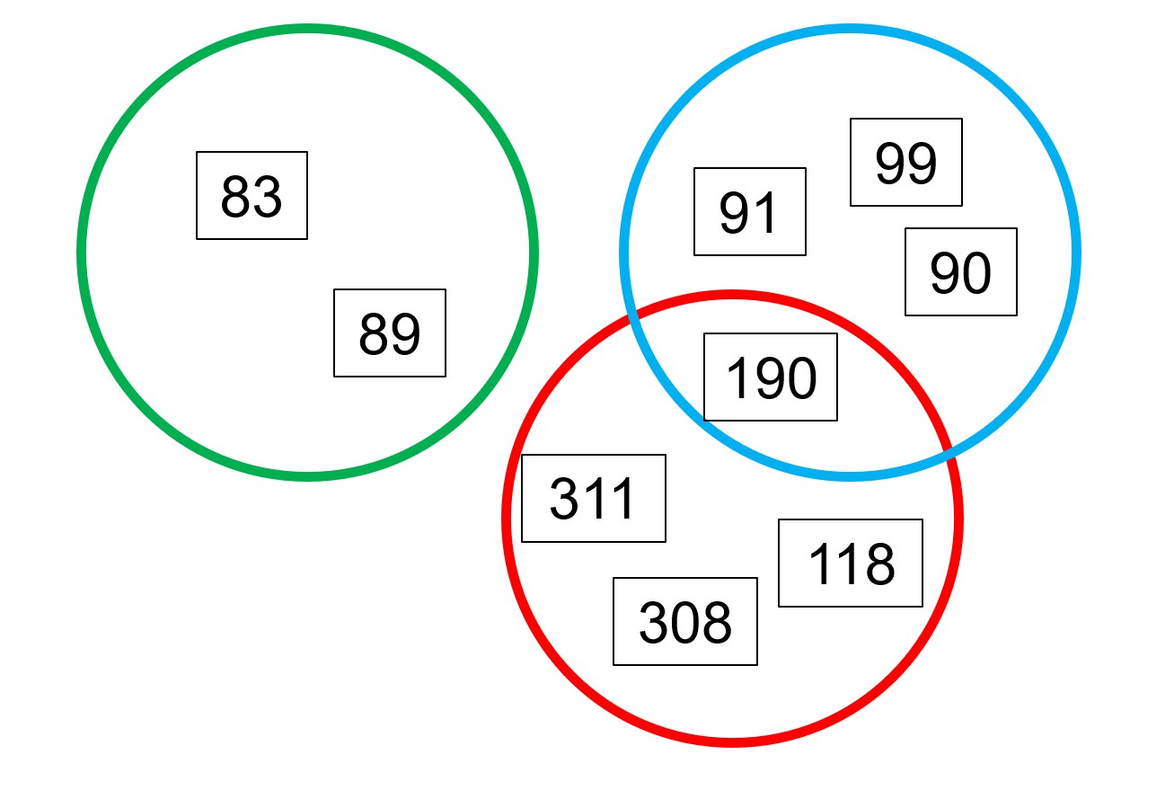
Why does the number fit in both circles?
8 tens (80)
9 tens (90)
More than 10 tens (100)
9 tens (90)
More than 10 tens (100)

Slide 12
Build Task • Place value sort

Slide 13
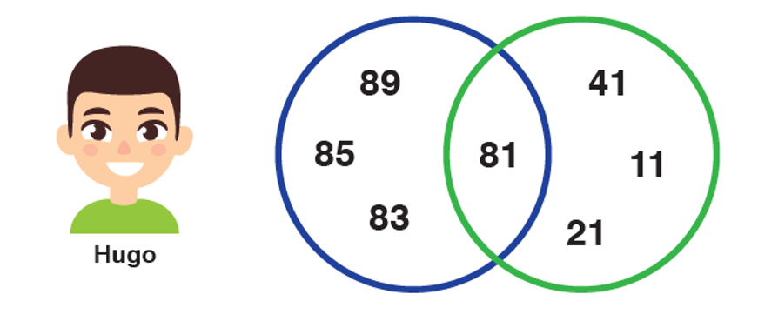
What’s the connection?
8 tens
1 one

Slide 14
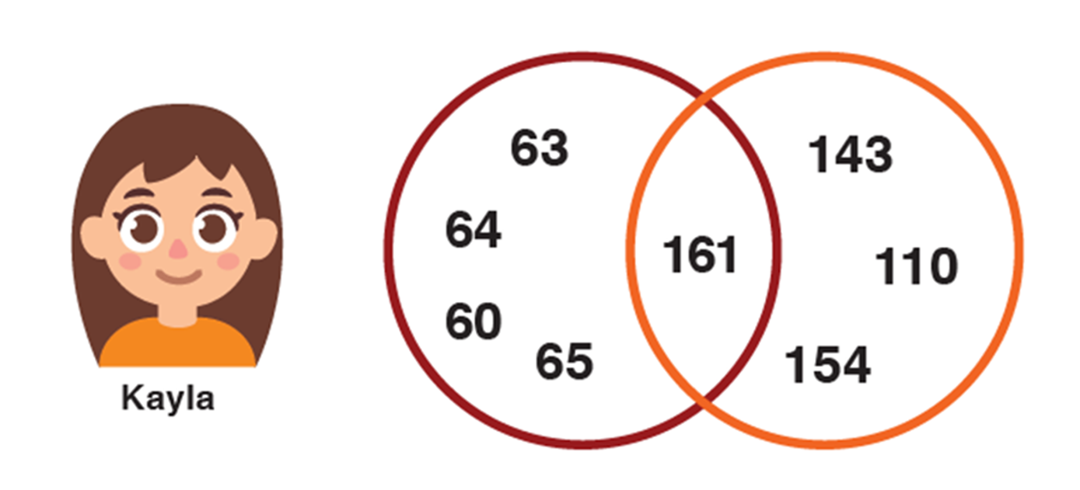
What’s the connection?
6 tens
1 hundred

Slide 15
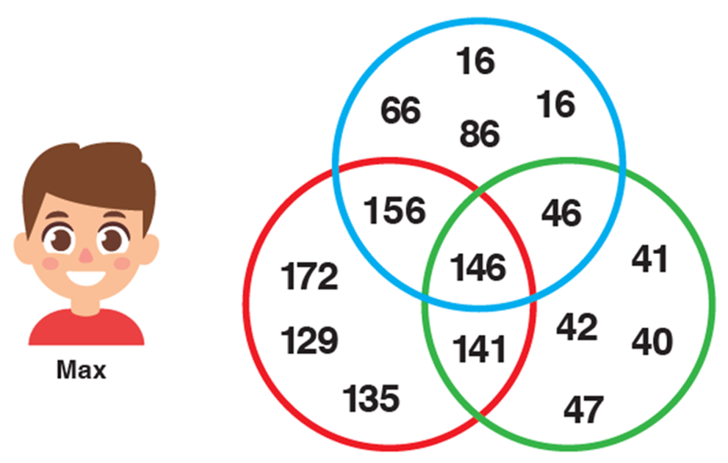
What’s the connection?

Slide 16

Red circle sort
156
172
146
129
141
135
more than 1 hundred or more than 10 tens

Slide 17
Green circle sort
46
41
146
42
141
40
4 tens
47

Slide 18
Blue circle sort
6 ones
16
66
16
86
156
46
146

Slide 19
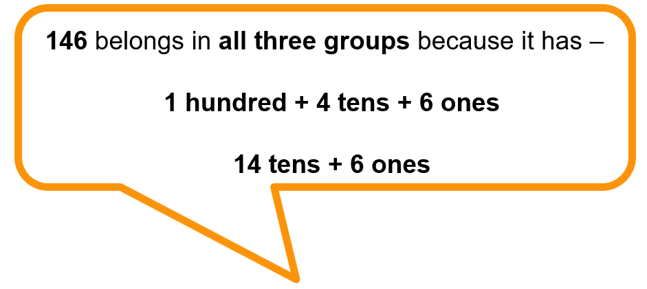

What’s the connection?
6 ones
4 tens
more than 1 hundred or more than 10 tens

Slide 20
Build Task • Place value sort game

Slide 21
Place value sort cards
180 | 81 | 30 | 180 | 81 | 30
87 | 118 | 132 | 87 | 118 | 132
82 | 40 | 80 | 82 | 40 | 80
100 | 188 | 20 | 100 | 188 | 20

Slide 22

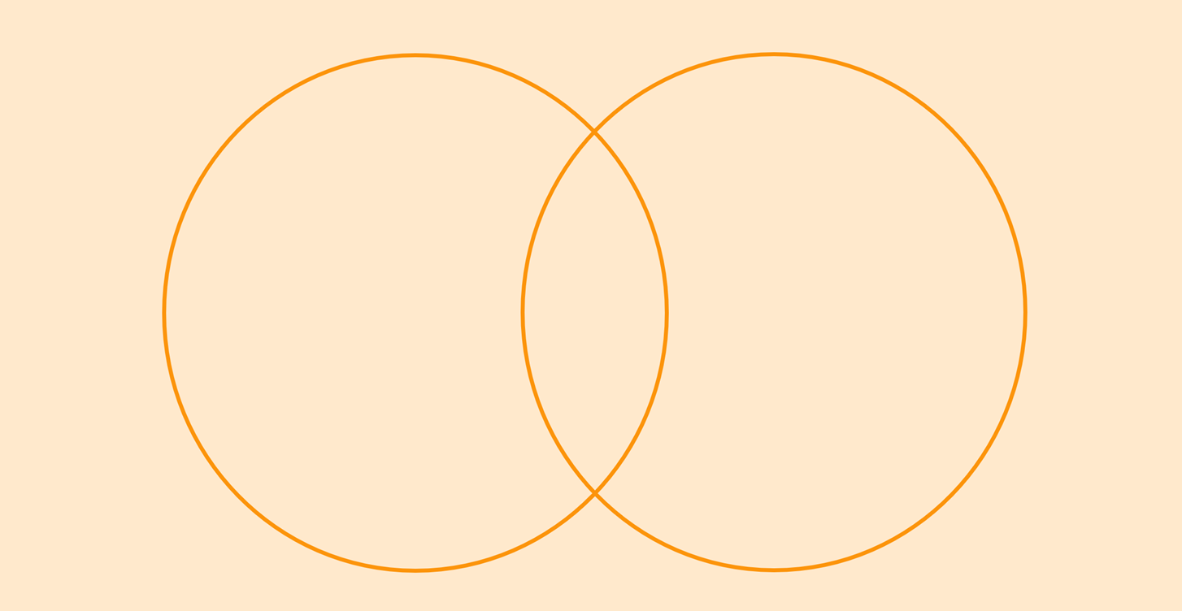
Place value sort Game Board

Slide 23
Place value sort game
How to Play:
Shuffle the Place Value Sort cards and place them face down in a pile next to the game board.
One player draws a card from the pile and places it in the overlapping section of the Venn diagram.
Each player thinks of a place value rule for the number in the overlap, to label each of the Venn diagram circles.
Players take turns drawing a card and placing it on the game board.
The game ends when all cards have been placed.
Players shuffle the cards and repeat for a different number card.

Slide 24
Task 5 • Place value understanding

Slide 25
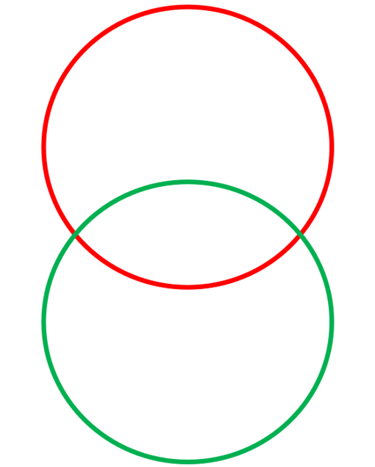
What numbers belong in the circles?
25

Slide 26
What numbers belong in the circles?
275

Slide 27
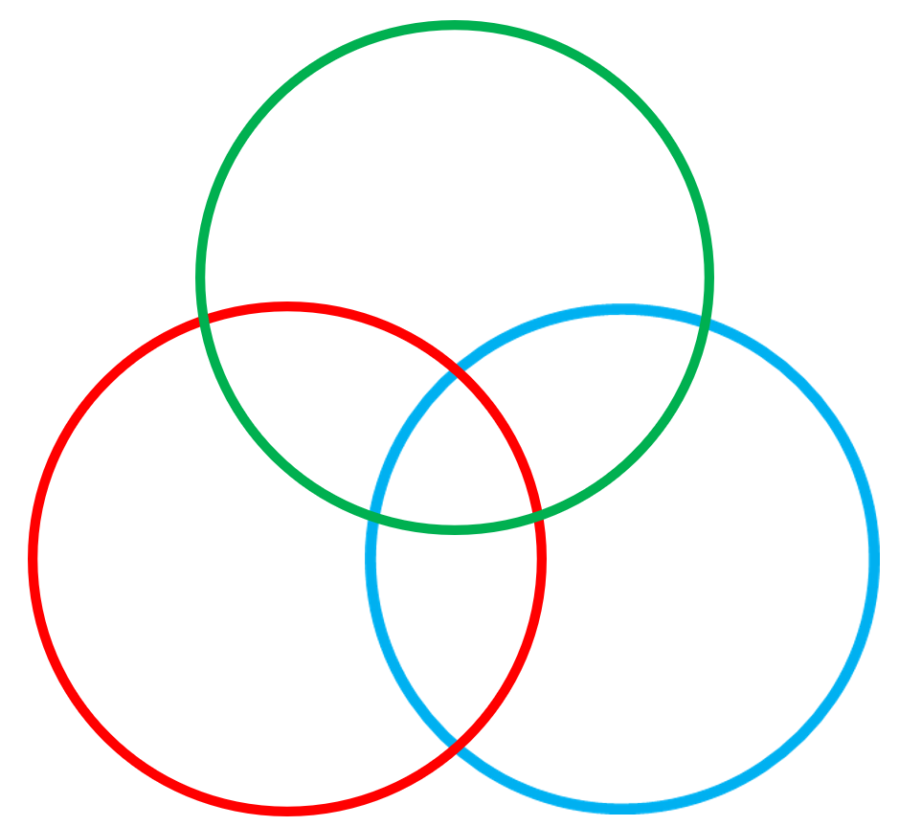
What numbers belong in the circles?
36

Slide 28
What numbers belong in the circles?
236

