Slide 1
Algebra: Pens and patterns
(Y6)

Slide 2
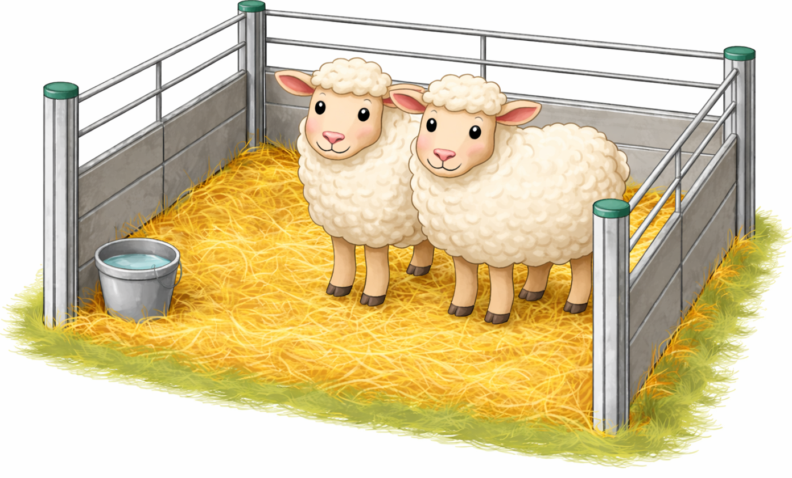
Task 1 • Sheep pens

Slide 3
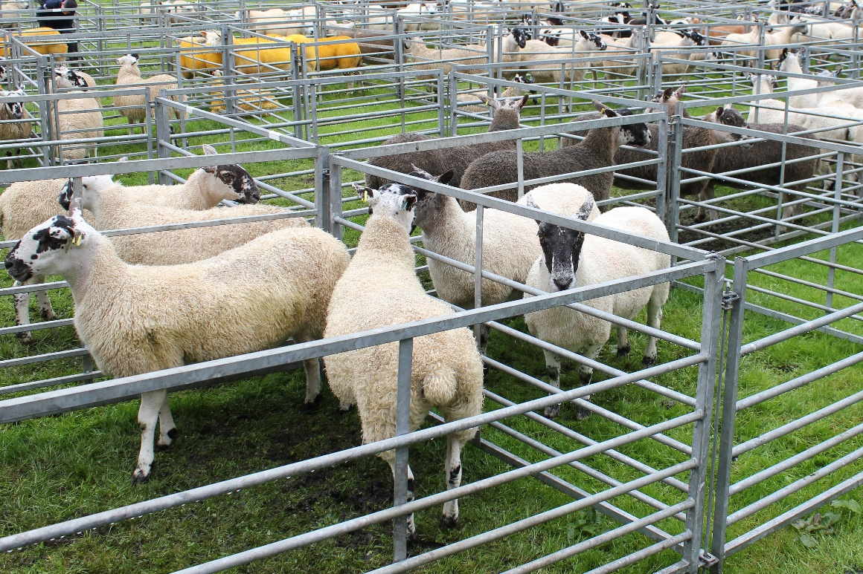
Agricultural show – sheep pens
An agricultural show needs to build pens that contain sheep.
Each pen is made from fence panels.
How many pens might be required?
How many panels might be needed to build these pens?
What else might we need to consider?
iStock/Scott O'Neill

Slide 4
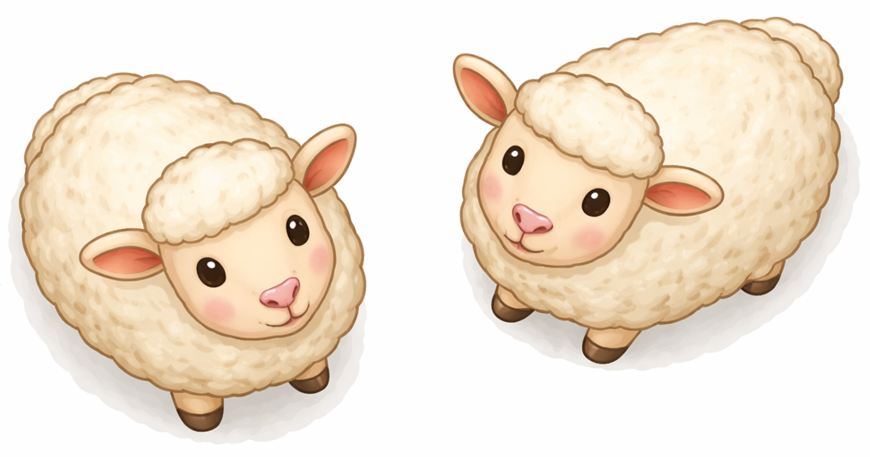
Representing pens in two dimensions
A pen can be represented as a square where the sides of the square represent the fence panels.

Slide 5
Row of connected square pens
A row of connected pens will be built.
How many panels are required to build different numbers of connected pens?

Slide 6


Connected pens – building from separate squares
How many panels are required to build different numbers of connected pens?
Number of pens | 1 | 2 | 3 | 4 | 5 | 10 | 25 | 1000
Number of panels | 4 | 7
10
13
16
$$+3$$
$$+3$$
$$+3$$
$$+3$$
Step-by-step rule
Start with four panels and add three each time another pen is added.

Slide 7
Finding relational rules
Is there a quicker way to find the number of panels rather than adding three each time?
The number of panels can be found by __________________________________________
This works because _________________________________________________________

Slide 8
Connected pens – finding a relational rule
How many closed square pens were used? How many panels were needed for this?
How many U-shaped open pens were used? How many panels were needed for this?
Relational rule: Subtract one from the total number of pens, then multiply by three, then add four

Slide 9
Finding a different relational rule
Start with open three-sided pens
Combine these together
Add one final panel to close the last pen
Relational rule: Multiply the number of pens by three and then add one

Slide 10
Summary – Sheep pens
What did we learn today?
A growing pattern can be expressed with step-by-step or relational (direct) rules.
Step-by-step rules move from one number in a pattern to the next.
Relational rules allow any number in the pattern to be found directly by knowing where you are in the pattern.

Slide 11
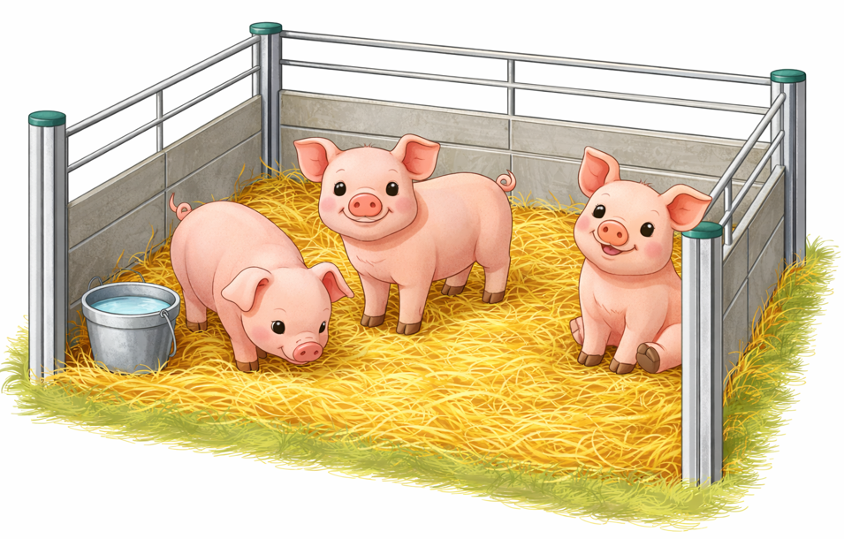
Task 2 • Pig pens

Slide 12
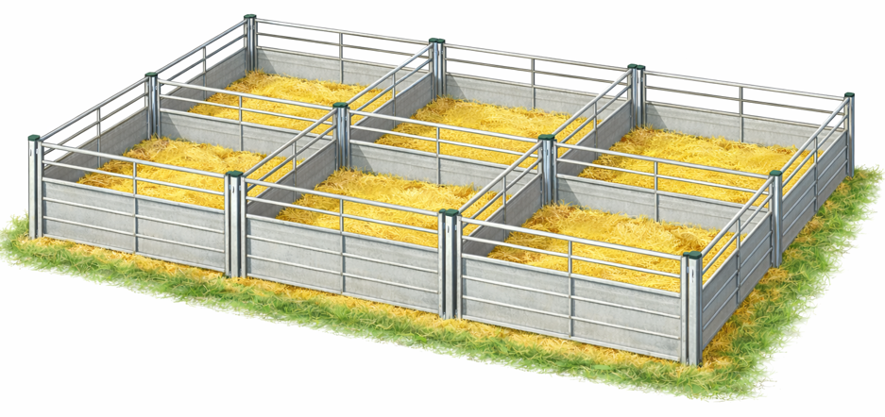
Two rows of square pens

Slide 13
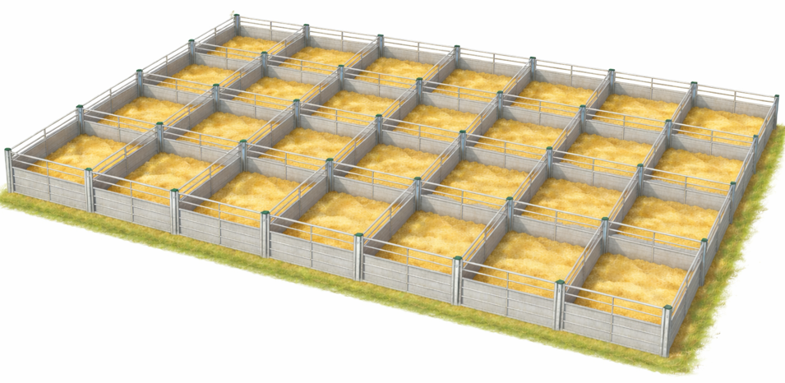
Any number of rows and columns
More rows can be added. The size can be described by the number of rows and columns.
columns
Hint 1
How can we find the number of pens from the number of rows and columns?
rows
Hint 2
How could you use L-shapes of two panels to construct the pens?
How many panels are needed for pens arranged in any number of rows and columns?

Slide 14
Counting the panels
Number of pens = number of rows $×$ number of columns
Counting the panels
Step 1: Multiply the number of rows
by the number of columns
Each pen starts with two panels joined as an L-shape
Step 2: Multiply by 2
Step 3: Add the number of rows
Step 4: Add the number of columns
then add one panel for each row
then add one panel for each column

Slide 15
Rule for any size array
Counting the panels
Step 1: Multiply the number of rows by the number of columns
Step 2: Multiply by 2
Step 3: Add the number of rows
Step 4: Add the number of columns
Relational rule
Number of panels = number of rows $×$ number of columns $×2$ $+$ number of rows $+$ number of columns

Slide 16
Design challenge: 24 pens
What possible arrangements exist for 24 square pens arranged in a rectangle? How many panels does each arrangement use?
What is the minimum number of panels required for 24 pens in a rectangle?
If 24 square pens can be arranged in any form (not necessarily a rectangle), what arrangement uses the fewest panels?
Number of panels = number of rows $×$ number of columns $×2$ $+$ number of rows $+$ number of columns

Slide 17
Summary – Task 2
What did we learn today?
Growing patterns can be expressed with step-by-step, relational rules and algorithms.
Rules can involve more than one input (e.g. number of rows and number of columns).

Slide 18
Task 3 • Show design

Slide 19
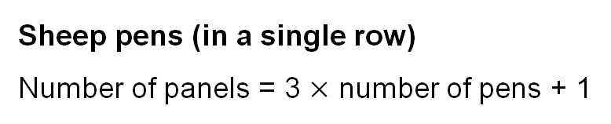
Design the show
The show will have a total of 400 animals.
This can be any combination of sheep or pigs but there must be at least 80 of each.
There are two sheep in each pen and three pigs in each pen.
Sheep pens cost $10 for each panel used. Sheep pens must be a single row of connected squares.
Pig pens cost $20 for each panel used. Pig pens are squares but can be arranged in any form.
Sheep pens (in a single row)
Number of panels = 3 $×$ number of pens + 1
Pig pens (if arranged in a rectangle)
Number of panels = number of rows $×$ number of columns $×$ 2$+$ number of rows $+$ number of columns
Your task is to create a design that gives the cheapest total price.

