Slide 1
Multiplication: reSolve Market
(Y3)

Slide 2
Task 1 • Finding multiplication

Slide 3
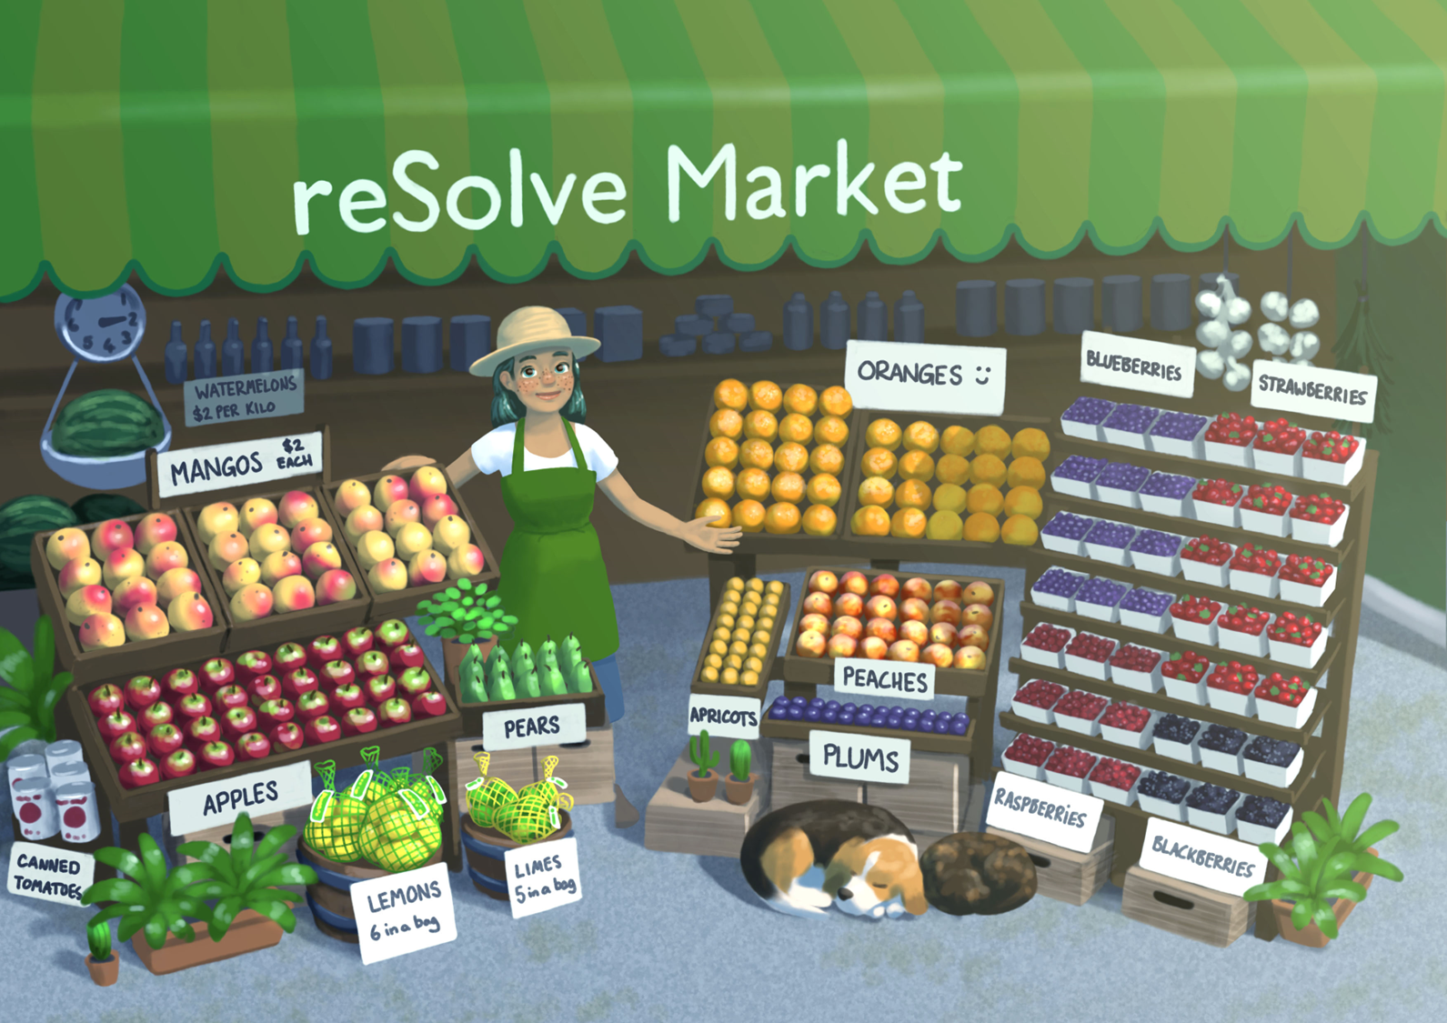

Slide 4
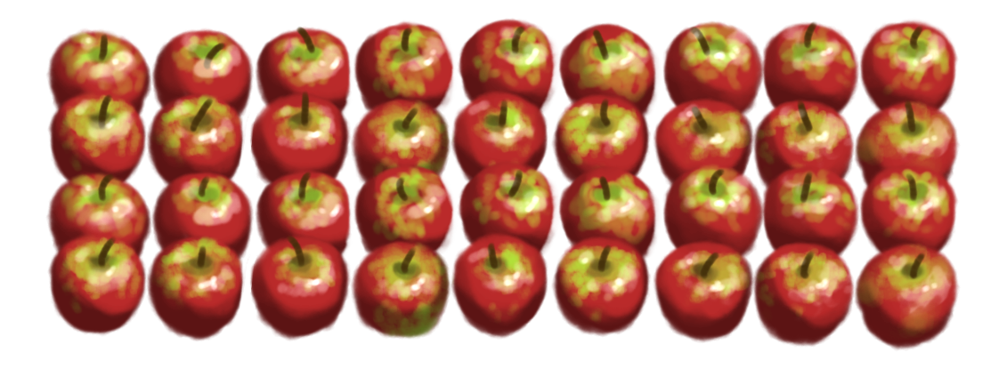
How many and how much
how many
how much
the whole
4 x 9 = 36
how many
rows
how much in each row

Slide 5
Task 2 • Mangoes and apples

Slide 7
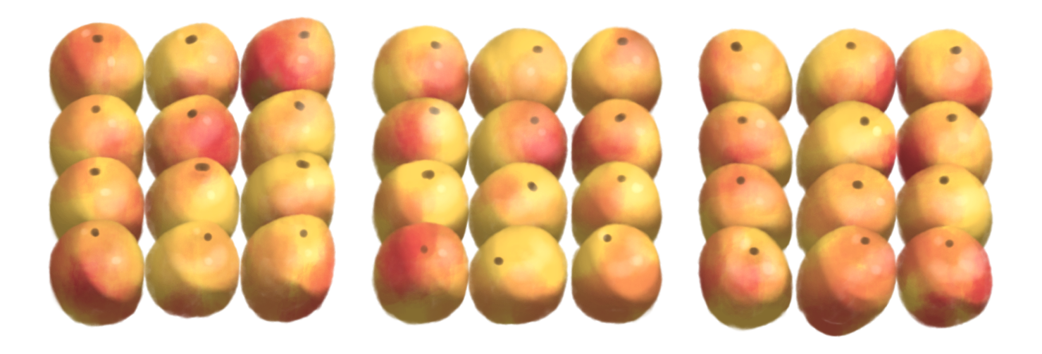
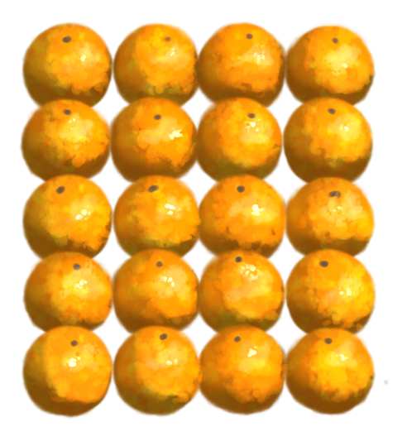
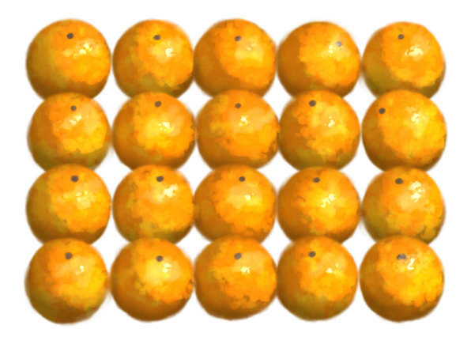
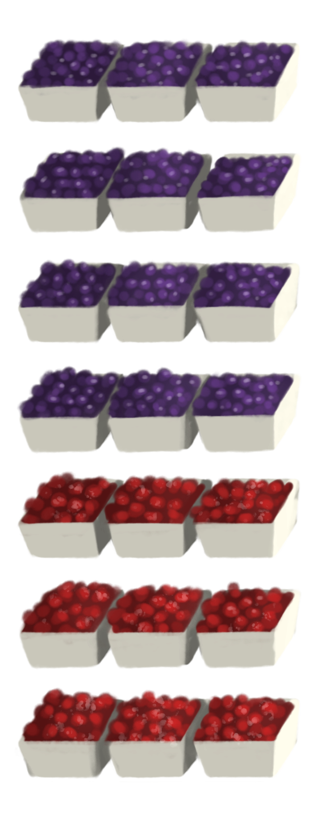
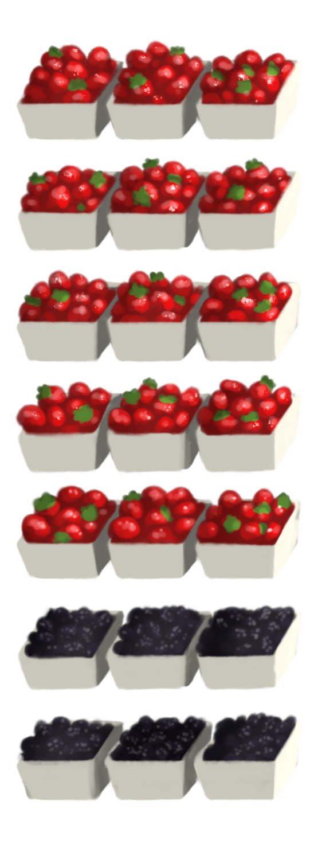
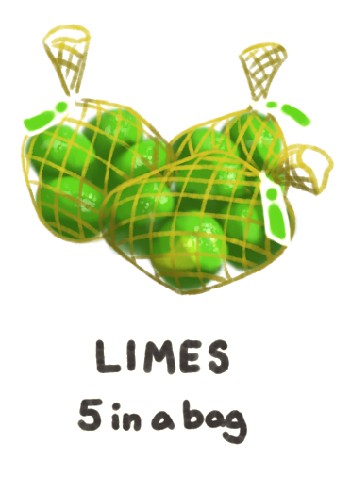
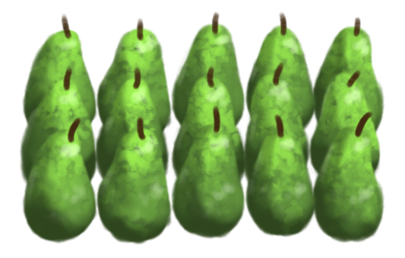

Slide 8
Mangoes and apples

Slide 9
Limes and pears

Slide 10
Oranges

Slide 11
Berries

Slide 12
Task 3 • Making arrays

Slide 14
Making arrays
One person is Student 1, and the other person is Student 2.
Student 1 selects a number card. You both collect that number of counters.
Work on your own to arrange all your counters into an array. Don’t look at your partner’s array – not yet!
On your student sheet, draw a picture of your array and the multiplication fact that matches your array.
Now it is time to look at your partner’s array! Compare your arrays and the fact that you recorded. Are they the same or different? Talk about the similarities and differences that you notice.
Student 2 selects a card, and you repeat the activity.

Slide 15
Task 4 • Hidden fruit

Slide 17
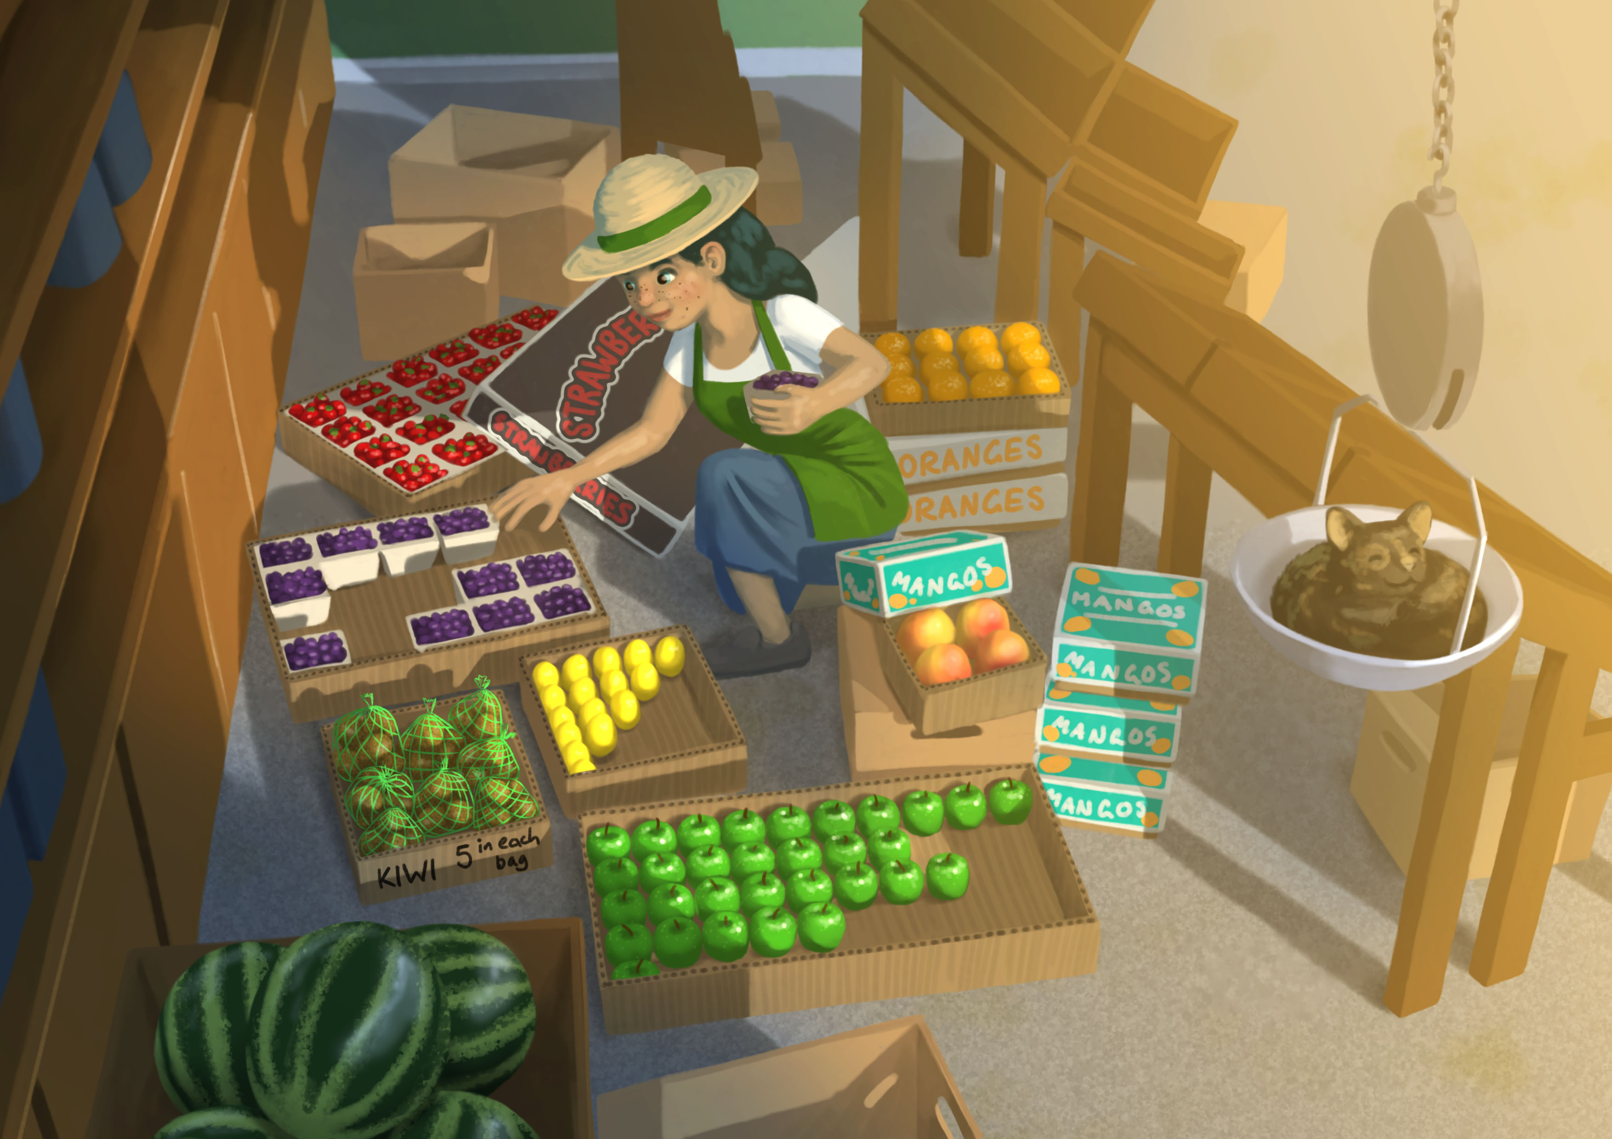

Slide 18

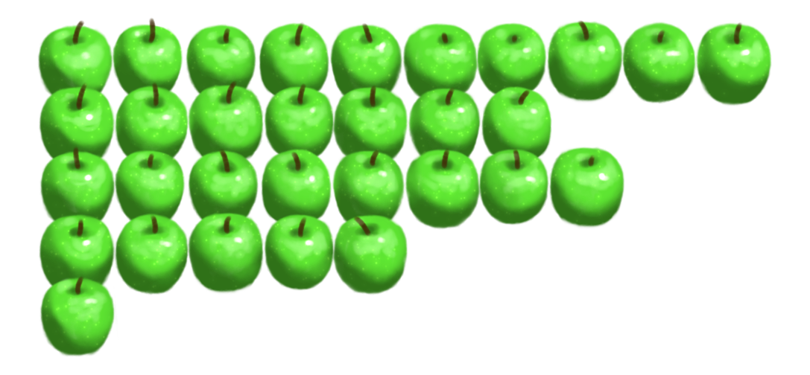
Tommy’s strategy
I did a lot of counting!

Slide 19

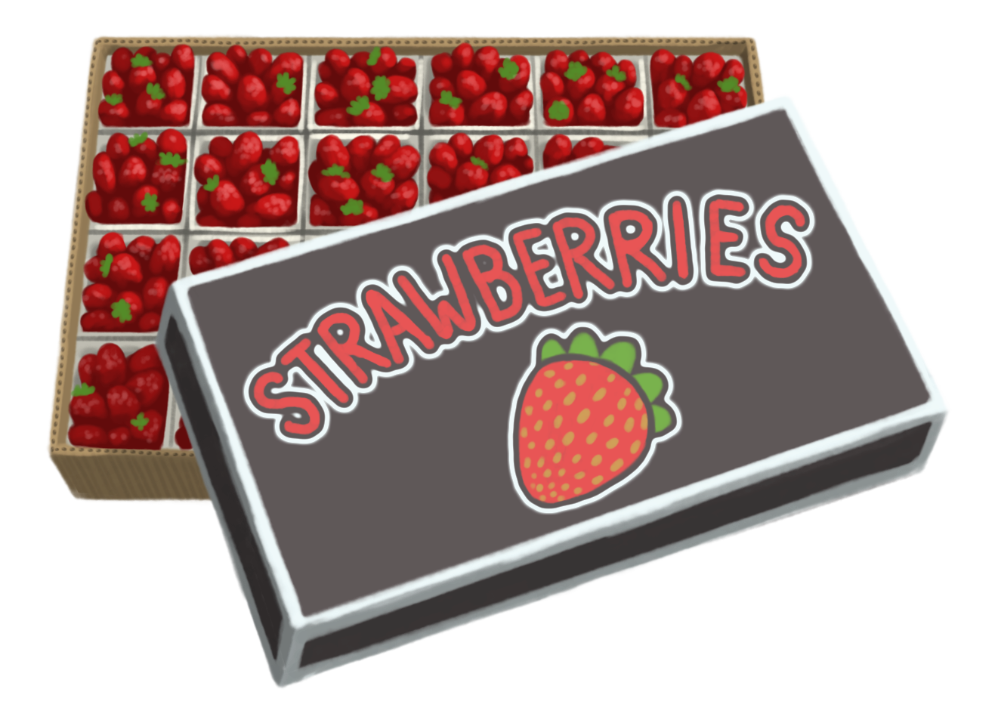
Isla’s strategy
4 x 6 = 24
6 in each row
4 rows

Slide 20

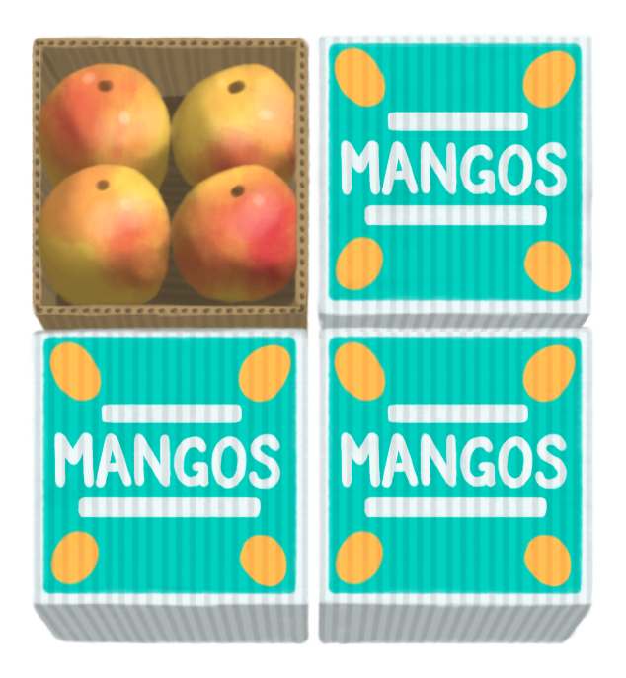
Anya’s strategy
I can skip count by 2s.
2
4
10
12
6
8
14
16

Slide 21
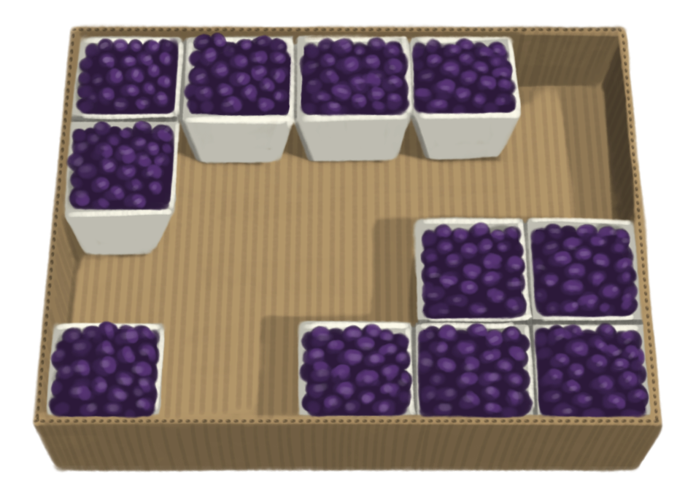
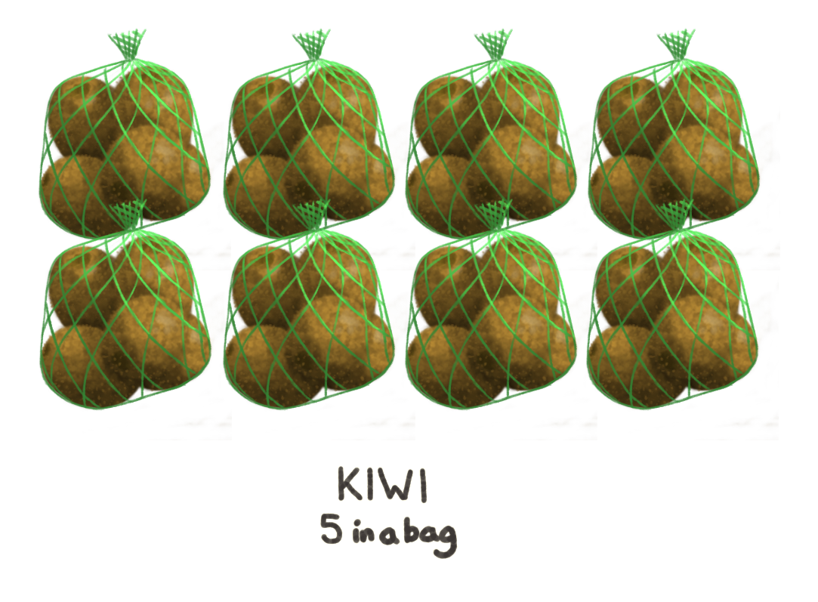
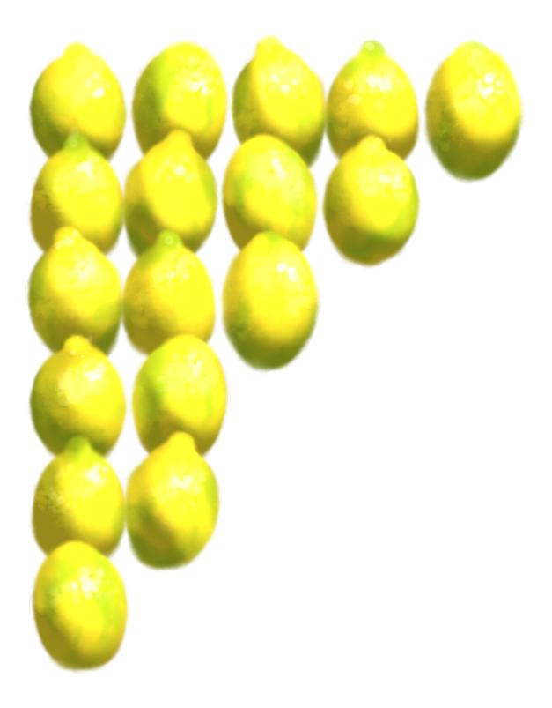
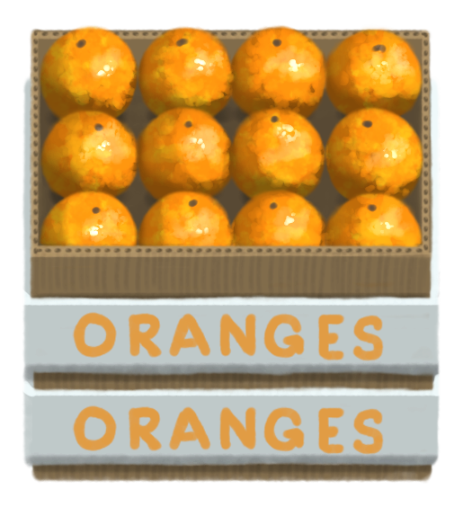
How many?

Slide 22
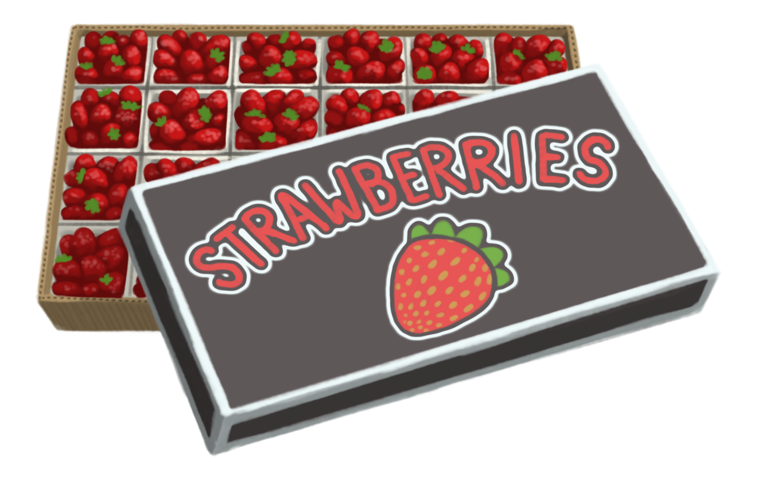
How many and how much
how many x how much = the whole
6 in each row
4 rows
4 x 6 = 24

Slide 23
Task 5 • Rolling arrays

Slide 25
Rolling arrays
A game is played in pairs
Each player rolls one die. The player with the highest number is Player 1 and the other person is Player 2.
Player 1 selects a coloured pencil and has their turn first. They roll both dice and select one number to represent how many rows and the other number to represent how much in each row. They draw this as an array on the gameboard and record as a multiplication fact in the middle of the array.
Player 2 uses the other coloured pencil and takes their turn.
The game is over when a player cannot fit the array that they have rolled onto the gameboard. The winner is the player who drew the last complete array.

Slide 26
Task 6 • Lemon arrays

Slide 28
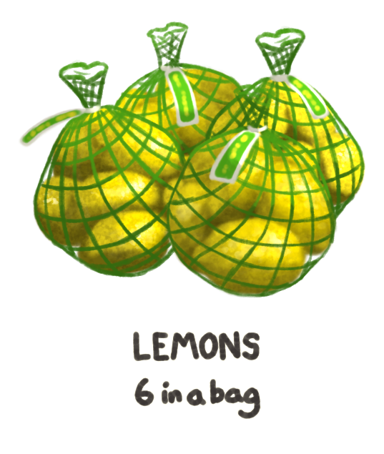
Lemon arrays

Slide 29
Lemon arrays
how many
how much
the whole
4 rows of 6 = 24
4 x 6 = 24
how many
how much
the whole
3 rows of 8 = 24
3 x 8 = 24

Slide 30
Fact families
4 x 6 = 24
6 x 4 = 24
24 ÷ 6 = 4
24 ÷ 4 = 6

Slide 31
Fact families
8 x 3 = 24
3 x 8 = 24
24 ÷ 8 = 3
24 ÷ 3 = 8

Slide 32
Limes and kiwifruit

Slide 33
Task 7 • Making fact families

Slide 34
Making fact families
One person is Student 1, and the other person is Student 2.
Student 1 selects a number card. You both collect that number of counters.
Work on your own to arrange all your counters into an array. Don’t look at your partner’s array – not yet!
On your student sheet, draw a picture of your array and the fact family for the array that you created.
Now it is time to look at your partner’s array! Compare your arrays and the family of facts that you record. Are they the same or different? Talk about the similarities and differences that you notice.
Student 2 selects a card, and you repeat the activity.

Slide 35
Task 8 • Finding fact families

